Slide 1


^{Office of American Citizens}
^{Services and Crisis Management}
U.S. Department of State
Bureau of Consular Affairs  US Department of State

Slide 2



American Citizens Abroad
Americans made over 65 million trips in 2012
6.8 million Americans reside overseas
Over 200,000 students study abroad
65,000 overseas births to U.S. parents

Slide 3
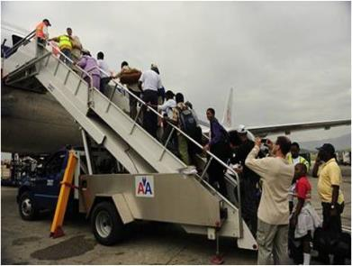

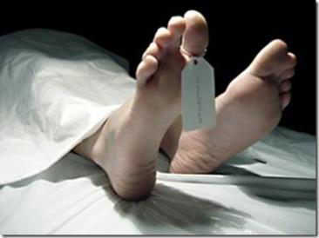
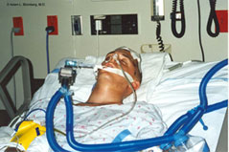
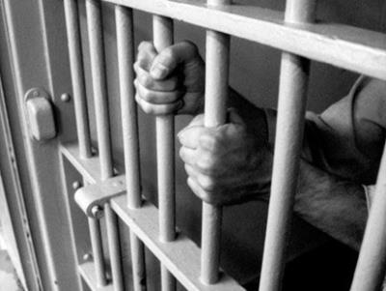
Emergency Services

Slide 4
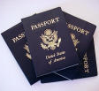
Assistance for Citizens Abroad
Issuance of Emergency Passports
Welfare/whereabouts
Arrests
Medical Emergencies
Crisis Response
Deaths

Slide 5

Welfare/Whereabouts Requests
Over 24,000 requests per year
Contact hospitals, hotels, jails, morgues, local authorities, etc.
Privacy Act Limitations
Cannot compel response or return to the United States
Phone home!!

Slide 6
Medical Emergencies
Help identify medical resources
Make a consular visit
Provide basic translation
Help identify financial resources
Notify friends/family
Help coordinate medical evacuations

Slide 7

Arrests
U.S. citizens subject to host country laws
Consular notification and access
Monitor case: communicate with family and the U.S. Department of State

Slide 8
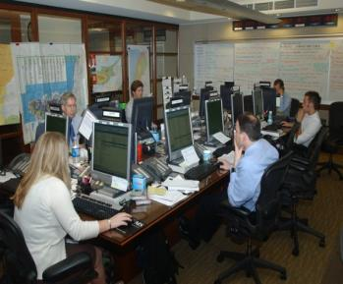
Crisis Response
Call center – 20,000 calls on 7/7/05
Immediate needs
Departure/assisted evacuation

Slide 9

International Child Abduction
Provide information on Hague Convention
Jurisdictional Treaty
Advocate not for parents, but for Hague Convention
Monitor Court Case
Welfare visits on children

Slide 10
Additional Assistance
Deaths & estates
Crime/terrorism victims’ assistance
Kidnappings
Financial assistance/repatriations

Slide 11
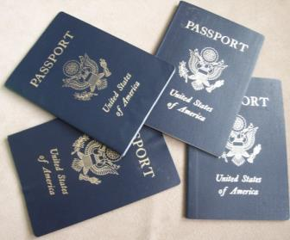

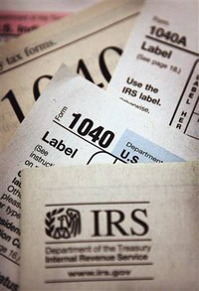



Routine Services

Slide 12

Routine Services
Smart Traveler Enrollment Program
In case of emergency, Embassy can contact
traveler and offer assistance
Receive information from the nearest Embassy
All information is kept private
Free service

Slide 13

Consular Information Program
“Know Before You Go”
The Consular Information Program aims to help U.S. citizens living and traveling abroad make informed decisions and plans.

Slide 14

Consular Information Program
No Double Standard Policy
-- Specific, credible, non-counterable threat
-- Collaboration with Regional Security Officers

Slide 15
Consular Information Program
Emergency Messages
Security Messages
Travel Alerts
Travel Warnings
Country Specific Information
Fact Sheets (e.g. avian influenza)
Media and Social Media

Slide 16
Thank you!
Bureau of Consular Affairs  US Department of State

