Slide 1

U.S. Citizenship and Civic Integration
Alanna Ow, Chief of Staff, Office of International Affairs, Department of Homeland Security

Slide 2


Immigration and Integration
The United States is committed to promoting citizenship and its importance to society, raising awareness of citizenship rights and responsibilities, and fostering civic integration
Integration of immigrants is a multi-faceted, multi-sector responsibility and is viewed as a whole of society initiative.
Naturalization is an important milestone in the civic integration, as new citizens are required to cultivate skills that foster integration and build a foundation to participate in American democracy and our civic institutions.
Citizenship is critical to civic integration, since naturalization offers immigrants the same rights as native-born Americans and fosters a sense of belonging and inclusion that builds a sense of shared ownership in society.

Slide 3
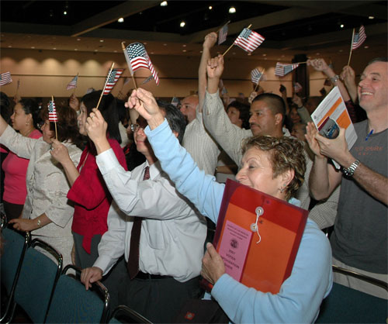
Integration and Naturalization
In 2012, the eligible immigrant population in the U.S. was approximately 8.8M individuals.
On average, over 650K permanent residents become citizens each year.
The decision to become an American ultimately rests with the individual, as impacted by factors unique to each person.
The U.S. Federal Government, through the U.S. Citizenship and Immigration Services provides public information and educational resources to assist immigrants in making an informed decision for their individual situation.

Slide 4

Citizenship and Immigration Services - Initiatives
Free citizenship educational materials online and in print in various languages
Capacity building for immigrant-serving organizations
Citizenship and Integration Grant Program to expand capacity for high quality citizenship preparation services in local communities. Since 2009, $33M in grants have been awarded and more than 66K permanent residents have received citizenship preparation services as a result.
Training to prepare adult educators that teach civics and citizenship to immigrants and public education and awareness initiatives.
Letters of Agreement with cities of Chicago and Los Angeles to promote citizenship and civic integration.

Slide 5

Citizenship and Immigration Services - Initiatives
Outreach and other public materials in English, Spanish, Chinese, Vietnamese.
Outstanding American by Choice Recognition to highlight and celebrate the contributions of naturalized citizens.
Naturalization ceremonies that appropriately commemorate the special and significant nature for candidates taking the Oath of Allegiance to the United States.
These initiatives benefit not only immigrants themselves, but all of U.S. society as we work to build a stronger civic identity and encourage civic participation through activities that reflect the significance of vested citizenship.

Slide 6


