Slide 1

Office of American Citizens Services and Crisis Management, U.S. Department of State

Slide 2

American Citizens Abroad
Americans make over 60 million trips abroad every year
4.5 million Americans reside overseas
Over 200,000 students
study abroad

Slide 3

Assistance for Citizens Abroad
Issuance of Emergency Passports
Welfare/whereabouts
Arrests
Medical Emergencies
Crisis response

Slide 4

Welfare/whereabouts requests
Over 200,000 requests per year
Contact hospitals, hotels, jails, local authorities, etc.
Privacy Act limitations
Can not compel response or return to the U.S.
Phone home!!

Slide 5

Medical Emergencies
Help identify medical resources
Make a consular visit
Provide basic translation
Help identify financial resources
Notify friends/family
Help coordinate medical evacuations

Slide 6

Arrests
U.S. citizens subject to host country laws
Consular notification and access
Monitor case; communicate with family & the U.S. Department of State

Slide 7

Crisis Response
Call center – 20,000 calls on 7/7/05
Immediate needs
Departure/assisted
evacuation

Slide 8
Additional Assistance
Deaths & estates
Crime/terrorism victims’ assistance
Kidnappings
Financial assistance, repatriations

Slide 9

Consular Information Program
“Know Before You Go”
The Consular Information Program aims to help Americans living and traveling abroad make informed decisions and plans.

Slide 10

Consular Information Program
No Double Standard Policy
  Specific, credible, non-counterable threat
  Collaboration with Regional Security Officers

Slide 11
Consular Information Program
Warden Messages
Travel Alerts
Travel Warnings
Country Specific Information (CSI)
Fact Sheets (e.g. avian influenza)
Media

Slide 12
Consular Information Program
Information from variety of sources
  Embassies, consulates
  Intelligence community
  Media
  Foreign governments
  Others

Slide 13
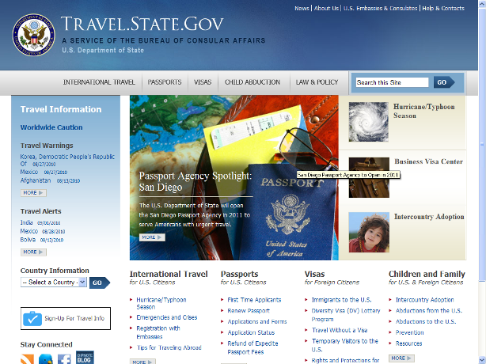
www.travel.state.gov

