Slide 1


United Nations Office on Drugs and Crime
Promoting Cooperation between Mexico and Central America to Prevent and Combat Migrant Smuggling

Slide 2


United Nations Office on Drugs and Crime
What is Migrant Smuggling?
“Facilitating the illegal entry of a person into a State party other than this person’s country of origin or residence with the aim of obtaining, directly or indirectly, financial gain or another material benefit.”

Slide 3
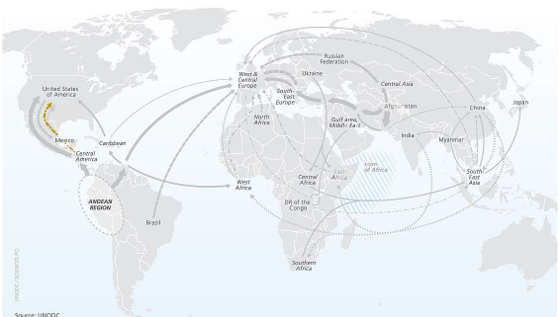
United Nations Office on Drugs and Crime
UNODC – Migrant Smuggling
The right to safe migration
Protocol Against the Smuggling of Migrants by Land, Sea, and Air:
TO PROTECT the rights of migrants victims of migrant smuggling;
TO PREVENT and combat the crime;
TO PROMOTE international cooperation between States parties with the aim of achieving the above-mentioned objectives.

Slide 4

United Nations Office on Drugs and Crime
More than 70 million persons are forced to migrate due to conflict, political unrest, violence and natural disasters, among other causes.
Of these persons, an estimated 50 million irregular migrants use the services of migrant smugglers during some stages of their journey.
Migrants victims of migrant smuggling often face situations that place their lives at risk; furthermore, they are victims of exploitation and abuse; and others are subject to physical and psychological violence, abduction and extortion.
The migrants that are unable to pay high fees to travel along safe routes are forced to make long journeys involving high risk for their lives.
Two primary routes: 1) from the East/North/West of Africa to Europe; and 2) from South America to the United States.
Migrant smuggling to cross the southern border of the United States generates close to USD$6.6 billion for criminals each year.

Slide 5
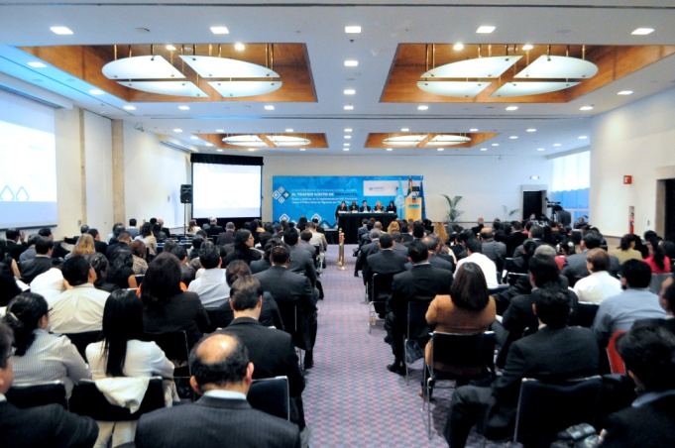
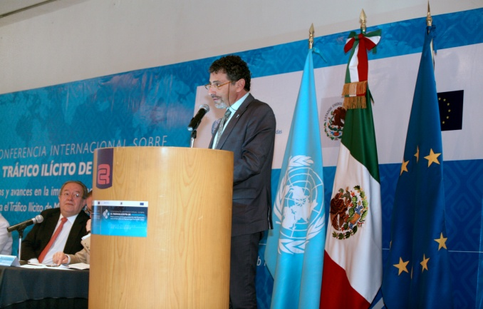

M
UNODC – Migrant Smuggling
United Nations Office on Drugs and Crime
Preparatory actions implemented in 2011 and 2012:
1. A research study on the status of legislation on migrant smuggling (UNODC, 2011);
2. Three workshops to assess the real capacities of Mexico and Central America to investigate migrant smuggling (October 2011, La Antigua, Guatemala; January 2012, Tuxtla Gutiérrez, Chiapas; February 2012, San José, Costa Rica); and
3. “International Conference on Migrant Smuggling: Challenges and Advances in Implementing the Protocol Against the Smuggling of Migrants by Land, Sea and Air” (April 2012, Mexico City).

Slide 6
Four key challenges:
Lack of special legislation typifying migrant smuggling
Different perspectives among autonomous authorities and institutions in regard to promoting and ensuring respect for human rights
Limited specialized knowledge of law enforcement, immigration, customs and border control authorities to prevent and investigate the crime
Limited information by the media about the existence and scope of the crime

Slide 7

United Nations Office on Drugs and Crime
PROJECT OBJECTIVE
To implement coordinated effective actions to prevent and combat migrant smuggling and to provide relevant authorities with the political and technical elements required for building strong, sustainable and reliable schemes to protect migrants victims of migrant smuggling..

Slide 8
United Nations Office on Drugs and Crime
  Coverage area: Mexico and Central America
  Duration: 3 years
  Donor: European Union
  Counterparts: Secretariat of Foreign Affairs, Central American and Caribbean Board of Attorney General’s Offices
  Synergies: International Organization for Migration, EUROPOL, Frontex
The technical assistance provided by UNODC will mainly consist of facilitating meetings between Mexican and Central American officials to promote training and international cooperation, within the framework of shared responsibility in regard to the security of migration movements through Central America and Mexico.

Slide 9
United Nations Office on Drugs and Crime
EXPECTED RESULTS
To promote the establishment of comprehensive regulatory frameworks to prevent and combat migrant smuggling and protect the rights of migrants victims of migrant smuggling.
2. To help formulate and adopt inter-institutional guidelines at a national level among government authorities and autonomous human rights organizations in order to address the crime of migrant smuggling in a comprehensive manner and identify victims of migrant smuggling.
3. To train law enforcement, immigration, customs and border control officers to combat migrant smuggling in an effective manner.
4. To develop a communication strategy on migrant smuggling, to be disseminated through the media.

Slide 10
Relevant Actions
United Nations Office on Drugs and Crime
Meetings between authorities and autonomous human rights organizations
An assessment of the training units of target institutions
Regional training master plan
Certifying facilitators from Mexico and Central America to lead national training sessions based on UNODC specialized manuals (training of trainers)
Capacity-building sessions at a national level to investigate the crime
Bilateral workshops in selected border cities to promote international cooperation
A communication strategy and awareness-raising materials with specific information about migrant smuggling and the rights of migrants victims of migrant smuggling, to be disseminated through the media
An information workshop for the media
Regional meetings to exchange best practices

Slide 11
Challenges and Opportunities
United Nations Office on Drugs and Crime
Linking national networks against migrant smuggling and trafficking of countries of origin, transit and destination.
UNODC
-An inter-regional cooperation strategy with Central America and the Caribbean;
-Supporting Member States in implementing their strategic policies against migrant smuggling and trafficking.

Slide 12
Global Scope
United Nations Office on Drugs and Crime
To link activities of this Project with other regional UNODC initiatives
AIRCOP
Strategic airports in the Americas
Container Control Programme
The new phenomenon of smuggling of migrants in containers
Public Prosecutor Network (REFCO)
To help dismantle criminal networks and prosecute key criminal organizations

Slide 13
United Nations Office on Drugs and Crime for Central America and the Caribbean in Panama – UNODC ROPAN
Amado Philip de Andrés
Regional Representative
Regional Unit against Migrant Smuggling and Trafficking
Felipe De La Torre, Regional Advisor
Mariana Alegret, International Cooperation Officer
Victor Aguirre, Technical Cooperation Assistant
Nayely Sánchez, Technical and Logistics Assistant
Shellah Franceschi, Project Assistant

