Slide 1





CONSULAR PROTECTION
FOR
MIGRANT WORKERS
WORKSHOP
Panama City, Panama
25 - 26 April, 2018

Slide 2
What is the Regional Conference on Migration?
The RCM is a regional consultation process on migration, non-binding, to address migration in the region in a practical and comprehensive manner, from a technical-political level.
Created in 1996, as a product of the Tuxtla Summit.
Integrated by 11 countries: all the countries of North America, Central America and the Dominican Republic.

Slide 3
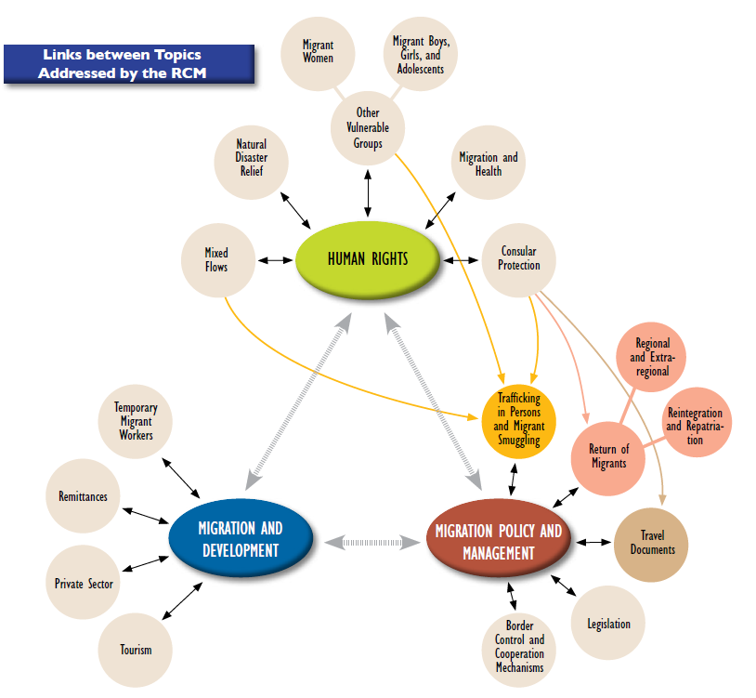
RCM WORKING AREAS

Slide 4
RCM Liaison Officers Networks
Network for Consular Protection
Network for the Protection of Migrant Boys, Girls and Adolescents
Network to combat trafficking and smuggling

Slide 5
Network for Consular Protection
June 2017:
9. To suggest the RCGM the approval of the following activities in the framework of the RCM:
  a) With regard to the Workshop on the consular protection of migrant workers, reaffirm the interest of countries to carry it out with the support of ILO and IOM, which will circulate a concept note through the Technical Secretariat to confirm the needs of the countries in this topic and possible contributions to co-finance the face-to-face workshop. Take note of the offer by the ILO and IOM to develop an online training module on this subject.

Slide 6
Network for Consular Protection
November 2017:
8. To receive the concept note presented by IOM jointly with the International Labour Organization (ILO) to carry out a Workshop on Consular Protection of Migrant Workers. Member Countries will submit their inputs to the TS before the end of 2017.
In this regard, the Liaison Officers Network for Consular Protection recommends to the RCGM the approval of the Workshop, which will be organized by IOM and ILO, and will be co-financed by the United States. It is suggested to hold this workshop during the first semester of 2018, in Panama in a date to be confirmed.

Slide 7
Vice-ministerial Decision
Declaration XXII RCM (November 2017):
15. To approve the implementation of the following activities in 2018:
e) Workshop on consular protection for migrant workers, with support from ILO and IOM, to be held in the first quarter of 2018 in Panama at dates to be determined.

Slide 8
CRMST@iom.int http://portal.crmsv.org http://portal.rcmvs.org

