Slide 1
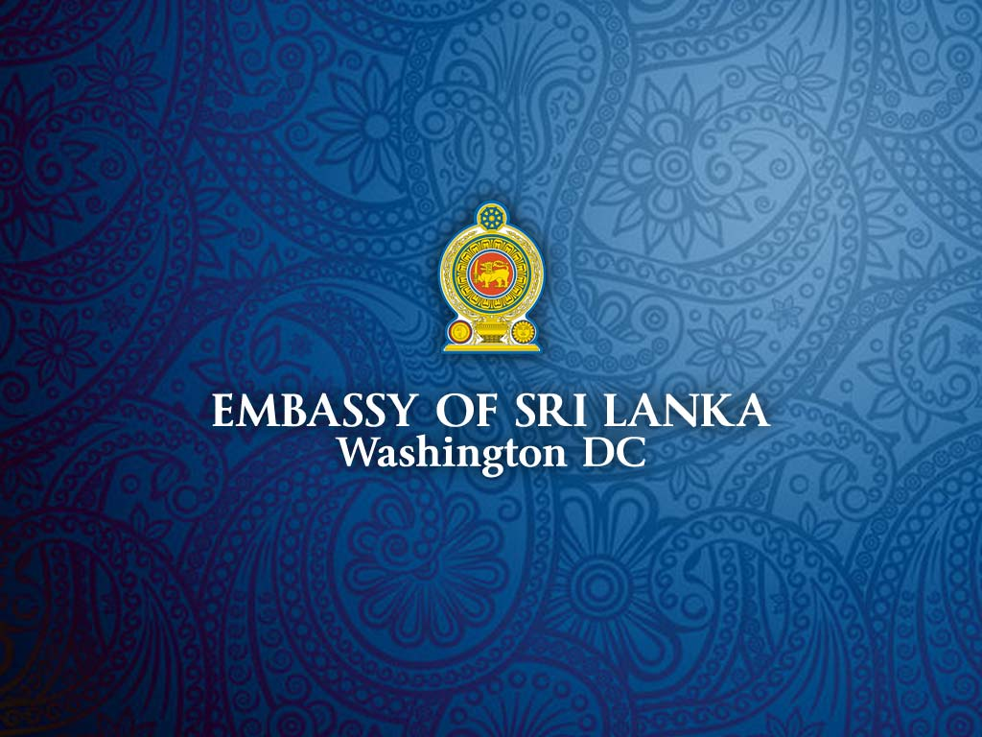

Slide 2

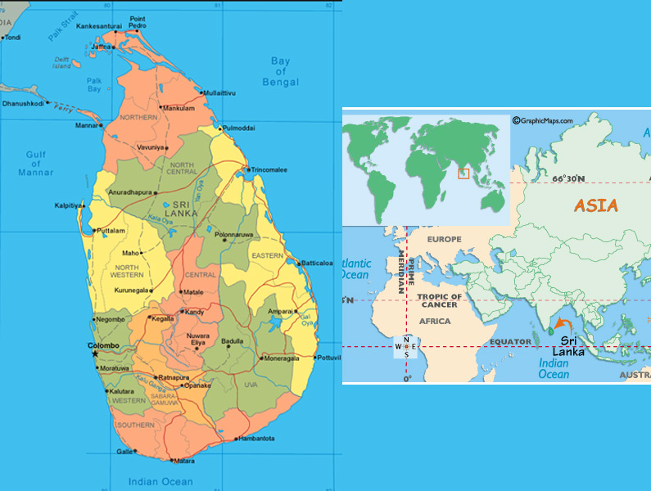

Slide 3


the Democratic Socialist Republic of
Sri Lanka
Sri Lanka is an island of no great size, yet it has an extraordinary number of facets. As Sir Arthur C Clarke remarked: “The Island of Sri Lanka is a small universe; it contains as many variations of culture, scenery, and climate as some countries a dozen times its size . . . I find it hard to believe that there is any country which scores so highly in all departments – which has so many advantages and so few disadvantages.” Lovely beaches, beautiful landscapes, impressive ruins, a vibrant culture and charming people.

Slide 4
SRI LANKA: AT A GLANCE
Geography
  North Latitude 6º-10º
  East longitude 80º-82º
  Maximum Length 432Km
  Maximum Breadth 224Km
  Land Area
  65,525 Sq.Km
  62,336 Sq.Km (excluding Inland Waters)
  Highest Waterfall – Bambarakanda 241 meters
  Highest Peak Pidurutalagala 2524 meters
  Longest River Mahaweli 335 Km

Slide 5
Population
19.043 million
  Male - 9.707 million
  Female - 9.336 million
  Density - 304 sq/km
  Growth Rate - 1.4
  Provincial Population
  (1981 Census)
    Western - 3.920 million
    Central - 2.009 million
    Southern - 1.883 million
    North Western - 1.704 million
    Sabaragamuwa - 1.482 million
    Northern - 1.109 million
    Eastern - 0.975 million
    Uwa - 0.914 millionNorth
    Centra - 0.849 million

Slide 6
Ethnicity [%]
  Religion [%]

Slide 7
TODAY’S SRI LANKA
Development’s from 2010 to 2012
Sri Lanka successfully concluded a Humanitarian Operation against terrorism in May 2009. Today, Sri Lanka is aggressively promoting ethnic reconciliation, redevelopment of conflict-affected areas and expanding trade and foreign investments for the restoration of normalcy throughout the country.

Slide 8
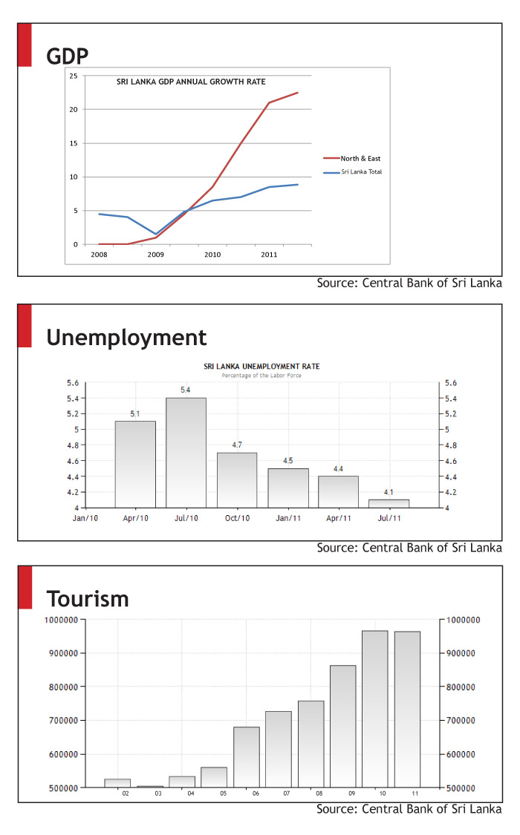
PROGRESS IN
REDEVELOPMENT

Slide 9
MISSIONS ABROAD
Sri Lanka has 59 overseas missions to take care of the
interest of the Sri Lankan nationals.
The major concentrations are as follows
^{ASIA}
Bangladesh –
Dhaka (High Commission)
People's Republic of China –
Beijing (Embassy),
Shanghai (Consulate)
India –
New Delhi (High Commission),
Chennai (Consulate),
Mumbai (Consulate)
Indonesia –
Jakarta (Embassy)
Japan –
Tokyo (Embassy)
Republic of Korea –
Seoul (Embassy)
Malaysia –
Kuala Lumpur (High Commission)
Maldives –
Malé (High Commission)
Myanmar –
Yangon (Embassy)
Nepal –
Kathmandu (Embassy)
Pakistan –
Islamabad (High Commission),
Karachi (Consulate)
Philippines –
Manila (Embassy)
Singapore –
Singapore (High Commission)
Thailand –
Bangkok (Embassy)
Vietnam –
Hanoi (Embassy)

Slide 10
MISSIONS ABROAD
^{MIDDLE EASTERN COUNTRIES}
Iran –
Tehran (Embassy)
Israel –
Tel Aviv (Embassy)
Jordan –
Amman (Embassy)
Kuwait –
Kuwait City (Embassy)
Lebanon –
Beirut (Embassy)
Oman –
Muscat (Embassy)
Palestine –
Ramallah (Rep. Office)
Qatar –
Doha (Embassy)
Saudi Arabia –
Riyadh (Embassy),
Jeddah (Consulate)
Turkey –
Ankara (Embassy)
United Arab Emirates –
Abu Dhabi (Embassy),
Dubai (Consulate)

Slide 11
MISSIONS ABROAD
^{NORTH & CENTRAL AMERICA}
Brazil
Brasilia (Embassy)
Canada
Ottawa (High Commission)
Toronto (Consulate-General)
Cuba
Havana (Embassy)
Mexico
Hony Consulate
United States
Washington DC (Embassy)
Los Angeles (Consulate)
New York (Permanent Mission
to the UN)

Slide 12
MISSIONS ABROAD
^{Europe}
Austria
Vienna (Embassy)
Belgium
Brussels (Embassy)
France
Paris (Embassy)
Germany
Berlin (Embassy)
Frankfurt (Consulate)
Italy
Rome (Embassy)
Netherlands
The Hague (Embassy)
Norway
Oslo (Embassy)
Poland
Warsaw (Embassy)
Russia
Moscow (Embassy)
Sweden
Stockholm (Embassy)
United Kingdom
London (High Commission)

Slide 13
MISSIONS ABROAD
^{AFRICA}
^{MULTILATERAL ORGANIZATIONS}
Geneva
(Permanent Mission to the United Nations and other international organizations)
New York
(Permanent Mission to the United Nations)
Vienna
(Permanent Mission to the United Nations and other international organizations)
Egypt
Cairo (Embassy)
Kenya
Nairobi (High Commission)
South Africa
Pretoria (High Commission)
^{OCEANIA}
Australia
Canberra (High Commission)
Sydney (Consulate)

Slide 14
MISSIONS ABROAD
Recently, Sri Lanka established DPL relations in following
Central American countries.
Islamic Republic of Mauritanal (WA)
Burkina Faso (WA)
Djibouti(EA)
Gabon(CA)
Ivory Coast (WA)
Sierra Leon(WA)
Niger(WA)
Togo (WA)
Malawi(EA)
Chad(CA)
Central African Republic Camaroon (CA) Equatoria Guinea(CA)
Cape Verde (WA)

Slide 15
AMERICA: SRI LANKAN CITIZENS
Sri Lankan Migrant Workers
Permanent Residents
Illegal Migrants
Working migrants are mainly in the Middle East over one million.
Major concentration is from the Permanent Residents (350,000), Students (20,000) & Visiting Sri Lankans

Slide 16
AMERICA: SRI LANKAN CITIZENS
Sri Lanka Embassy in Washington DC Is considered to be the focal point for stranded Sri Lankans in the region.
Assistance we render to;
  Stranded Sri Lankans
  Respective immigration authorities
Main Consular Functions:
  Issues of Travel Documents
  Rene wale of Travel Documents
  Registration of Birth, Registration of Death and Registration of Marriages
  Attestation of Document
  Issues of Visas
  Any other Consuela matters such as helping Sri Lankan, Decease bodies repatriate to Sri Lanka

Slide 17
TRENDS
War and asylum seekers assisted by organized groups with political motives
Employment

Slide 18
CHALLENGES IN FOR PROTECTING
AND ASSISTING ILLEGAL MIGRANTS
Identification of the nationality - usually they are in the detaining centers maintained under the US Coast Guard and Boarder Protection.
Once they are arrested by US Coast Guard and Boarder Protection, the mission is informed of the arrest and assists them in deportation.
Our main challenge is identifying them as a Sri Lankan.
Non-cooperation of the detainee
Difficulty in arranging financial assistance
Refuse to go back

Slide 19
MOST EFFECTIVE WAY TO PROTECT
IRREGULAR MIGRANTS AT TRANSIT
Introduced the Electronic Travel Authority System (ETA)
Control at the point of origin
Introduce biometric systems
To create awareness programs to educate people

Slide 20
CAPACITIES OF MY CONSULATE
TO ASSIST IRREGULAR MIGRANTS
Wide spread network among Mexico Brasilia, LA, NY and Washington DC and the Hony consuls is a strength
We lack financial and legal assistance to coordinate activities between these long distance centers

Slide 21
CONTACTED DIRECTLY
BY THE IMMIGRANTS?
Sri Lanka Embassy in Washington DC is maintaining 24 x7 Public Service Hotline
Email & Fax

