Slide 1

GENERAL DIRECTORATE OF MIGRATION AND IMMIGRATION
Actions to combat migrant smuggling
June 2013

Slide 2
modus operandi
The starting point for migrant smugglers and their victims usually is San Salvador. In many cases, arrested persons and victims come from other departments of the country and use the capital city as their meeting point, or migrant smugglers travel to the place of origin of victims and then transfer them to San Salvador, where they stay one night – at the home of the smugglers or at a hotel or hostel – and then begin the journey toward any of the borders.
Based on the above, it has been observed that migrant smugglers do the following:
    Use international carrier companies (low-fare bus service);
    Use local buses to travel to the border;
    Use taxis and motorbike taxis;
    Deliver victims to other contact persons in Guatemala or Mexico.
According to the information that was obtained, the average charge for each trip is as follows:
    $6,000 – $7,500 (50% usually is paid in advance and the remaining 50% upon arrival in the United States.)

Slide 3
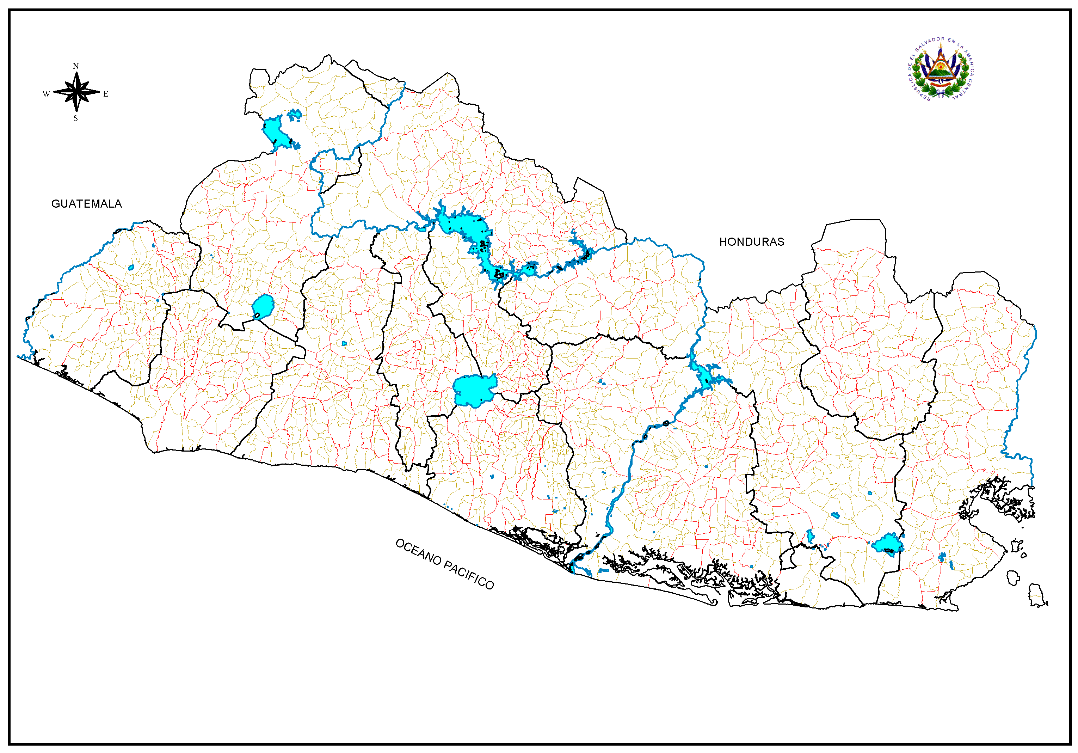
ROUTE FOR SMUGGLING MIGRANTS FROM THE EASTERN REGION
ANGUIATÚ
EL POY
SAN CRISTÓBAL
LAS CHINAMAS
PERQUÍN
Pte. Integración
LA HACHADURA
EL AMATILLO
REFERENCES
Border
Pan-American Highway
Coastal Route

Slide 4
ROUTE FOR SMUGGLING MIGRANTS FROM THE central REGION
ANGUIATÚ
EL POY
SAN CRISTÓBAL
LAS CHINAMAS
PERQUÍN
Pte. Integración
LA HACHADURA
EL AMATILLO
REFERENCES
Border
Pan-American Highway
Coastal Route

Slide 5
ROUTE FOR SMUGGLING MIGRANTS FROM THE western REGION
ANGUIATÚ
EL POY
SAN CRISTÓBAL
LAS CHINAMAS
PERQUÍN
Pte. Integración
LA HACHADURA
EL AMATILLO
REFERENCES
Border
Pan-American Highway
Coastal Route

Slide 6
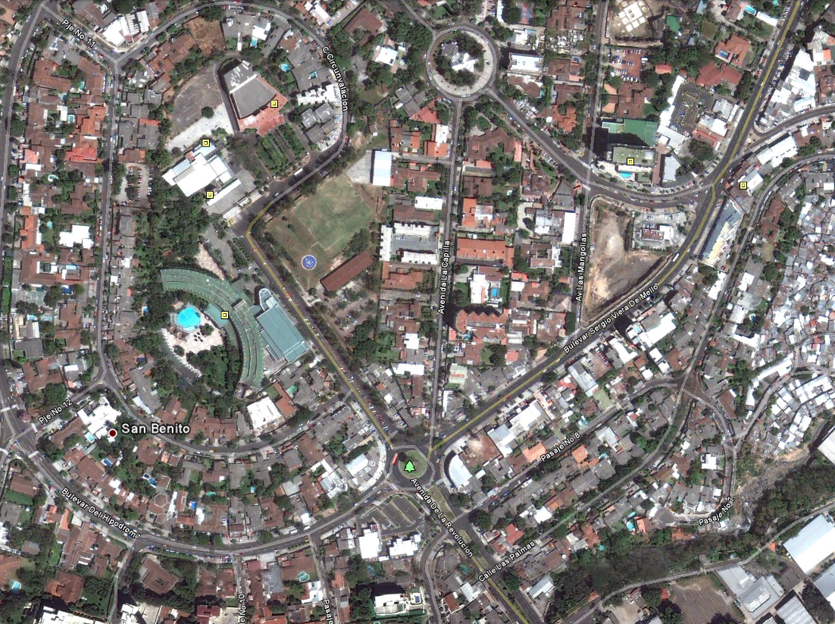
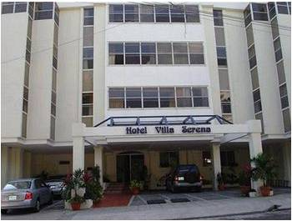




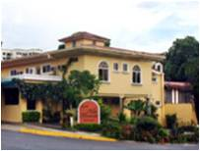
HOTELS USED BY FOREIGN NATIONALS TRAVELLING TO GUATEMALA
N
Teatro Presidente
Hotel
Hotel Sheraton
Pullmantur
Hotel Princess
Redondel Italia
El Sol
Tica Bus
King Quality
Reference
Villa Serena Hotel
Villa Florencia Hotel
Hotel

Slide 7
DETENTION AND ADMINISTRATIVE ACTIONS

Slide 8
REFERRALS THAT led to DETENTION, 2012
CRIME | Las Chinamas Border | San Cristóbal Border | Hachadura Border | El Amatillo Border | El Poy Border | Anguiatú Border | Perquín | AIES | Sucursal | TOTAL
MIGRANT SMUGGLING | 38 | 43 | 72 | 9 | 14 | 3 | 0 | 1 | 1 | 181
USING AND HOLDING FALSE DOCUMENTS | 25 | 34 | 31 | 20 | 3 | 3 | 0 | 4 | 2 | 122
HOMICIDE | 0 | 1 | 3 | 2 | 0 | 1 | 1 | 2 | 6 | 16
FRAUD | 1 | 1 | 1 | 3 | 1 | 2 | 0 | 2 | 0 | 11
EXTORTION | 3 | 2 | 2 | 1 | 0 | 2 | 0 | 0 | 1 | 11
INJURY | 2 | 4 | 0 | 2 | 0 | 0 | 0 | 1 | 0 | 9
ILLEGALLY HOLDING AND USING FIREARMS | 0 | 1 | 2 | 0 | 1 | 0 | 0 | 0 | 4 | 8
SMUGGLING GOODS | 3 | 0 | 2 | 0 | 0 | 0 | 1 | 0 | 0 | 6
ILLEGAL ASSOCIATION | 1 | 1 | 0 | 1 | 1 | 0 | 1 | 0 | 1 | 6
RAPE | 0 | 1 | 2 | 0 | 0 | 1 | 0 | 0 | 0 | 4
REBELLIOUSNESS | 2 | 1 | 0 | 0 | 0 | 0 | 0 | 0 | 1 | 4
ABDUCTION | 1 | 0 | 0 | 0 | 0 | 0 | 0 | 1 | 2 | 4
WRONGFUL APPROPRIATION | 0 | 1 | 2 | 0 | 0 | 0 | 0 | 0 | 0 | 3
OTHER CRIMES | 21 | 10 | 15 | 8 | 9 | 4 | 0 | 6 | 10 | 83
TOTAL | 97 | 100 | 132 | 46 | 29 | 16 | 3 | 17 | 28 | 468

Slide 9
Referrals that led to detention
January 1 – June 12, 2013
CRIME | Las Chinamas Border | San Cristóbal Border | Hachadura Border | El Amatillo Border | El Poy Border | Anguiatú Border | Perquín | AIES | Sucursal | TOTAL
MIGRANT SMUGGLING | 24 | 35 | 30 | 0 | 8 | 2 | 0 | 0 | 1 | 100
USING AND HOLDING FALSE DOCUMENTS | 14 | 8 | 15 | 4 | 1 | 1 | 0 | 8 | 0 | 51
OTHER CRIMES | 8 | 5 | 2 | 2 | 2 | 3 | 0 | 1 | 1 | 24
HOMICIDE | 2 | 1 | 0 | 2 | 1 | 0 | 0 | 0 | 0 | 6
FRAUD | 2 | 0 | 2 | 0 | 1 | 1 | 0 | 0 | 0 | 6
INJURY | 0 | 0 | 1 | 1 | 0 | 1 | 0 | 1 | 0 | 4
ILLEGALLY HOLDING AND USING FIREARMS | 0 | 0 | 0 | 1 | 0 | 0 | 0 | 0 | 0 | 1
EXTORTION | 1 | 0 | 1 | 0 | 0 | 0 | 0 | 0 | 0 | 2
ILLEGAL ASSOCIATION | 0 | 0 | 1 | 2 | 0 | 0 | 0 | 0 | 1 | 4
REBELLIOUSNESS | 0 | 0 | 2 | 0 | 0 | 0 | 0 | 0 | 0 | 2
TOTAL | 51 | 49 | 54 | 12 | 13 | 8 | 0 | 10 | 3 | 200

Slide 10
follow-up on detentions
Migrant Smuggling
      In 2009: (62) persons were detained
      In 2010: (52) persons were detained
      In 2011: (126) persons were detained
      In 2012: (181) persons were detained
      421 Salvadoran nationals were detained.

Slide 11
THANK YOU

