Slide 1
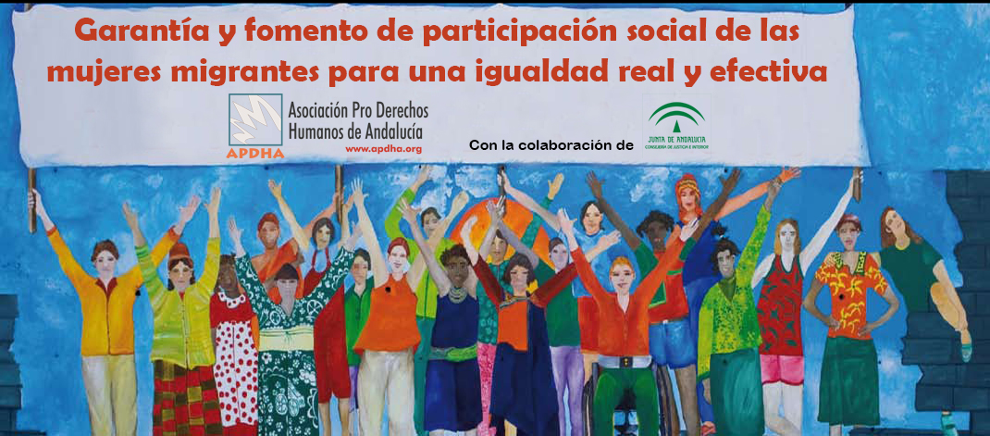




SAVE THE DATE
Women and Labour
Data with a gender approach
I Regional Congress
Women in Migration Contexts
Women and the Global Compact
17-19 December, 2018
San Salvador, El Salvador
Migrant children and adolescents
Working Groups
Panels
Women and the SDGs
Trade Fair
Cultural Activities
Violence against women

