Slide 1

General Directorate of Migration
of the
Dominican Republic

Slide 2
Presented by:
Moisés Vargas
Head of the Department of Deportations and Impediments and the National Office for Refugees

Slide 3
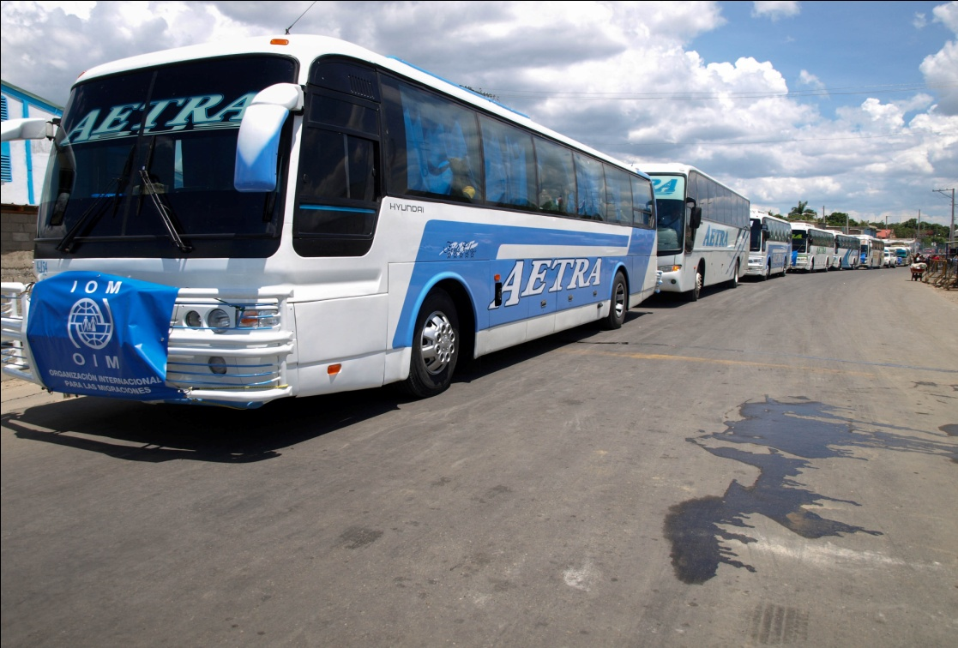


Public Policy on
Migrants in Vulnerable Situations

Slide 4
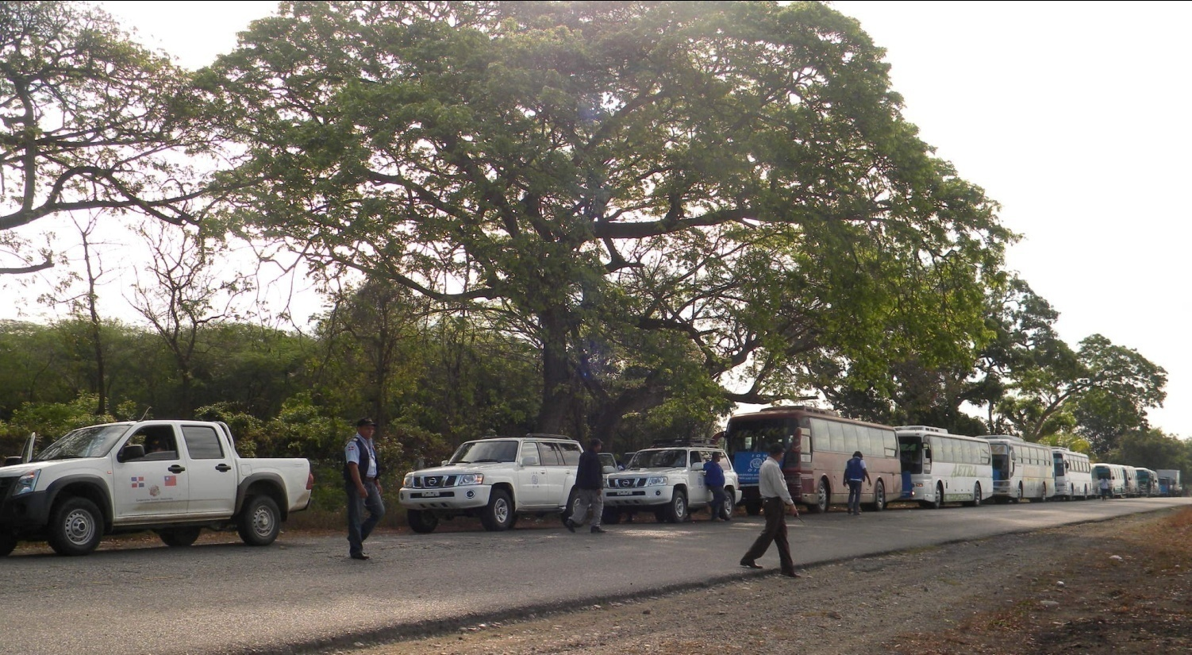
Voluntary Assisted Return Programmes Executed by IOM and DGM

Slide 5

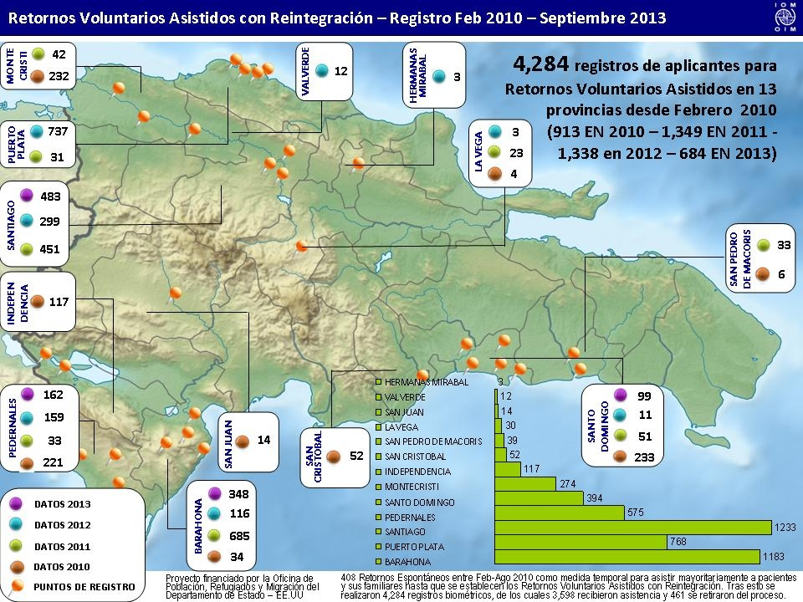
Voluntary Return of Migrants
VOLUNTARY ASSISTED RETURN PROGRAMME FOR MIGRANTS IN VULNERABLE SITUATIONS
EXECUTED BY IOM/DOMINICAN REPUBLIC, IN COORDINATION WITH THE GENERAL DIRECTORATE OF MIGRATION, 2010-2013
Voluntary Assisted Return and Reintegration Records for February 2010 – September 2013

Slide 6
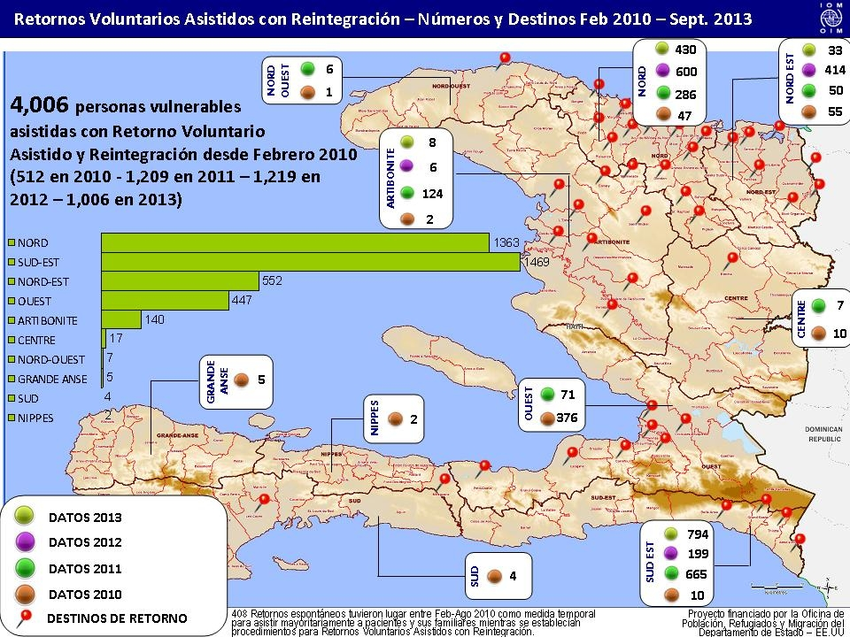
Voluntary Assisted Return and Reintegration in Haiti
Voluntary Assisted Return and Reintegration, Figures and Destinations, February 2010 – September 2013

Slide 7
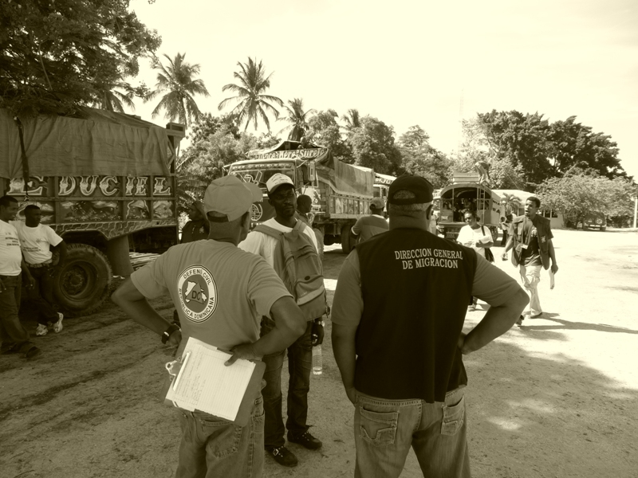
Transfer Process

Slide 8
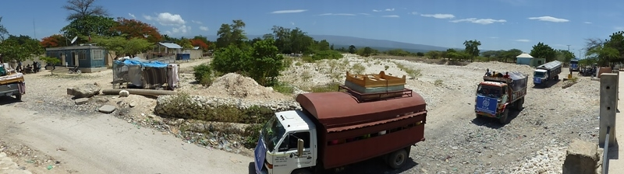
Crossing the
Haiti-Dominican Republic Border

Slide 9
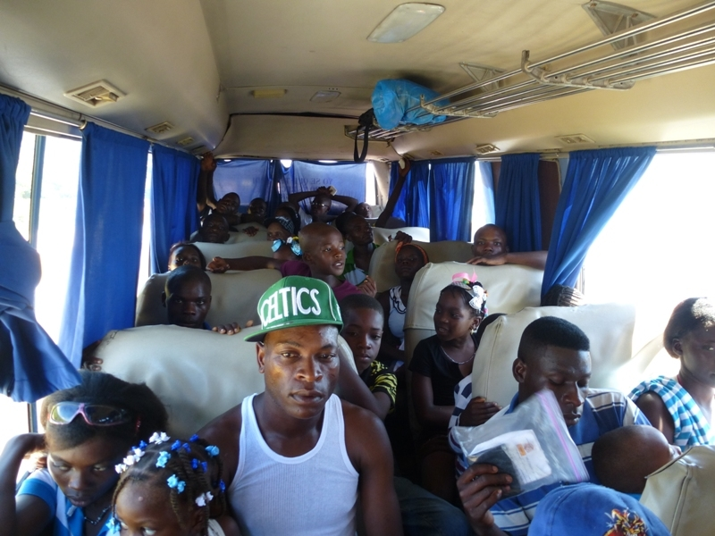

Slide 10
NATIONAL COMMISSION FOR REFUGEES
(CONARE)
CONARE was inactive since 1995. Subsequently, one meeting was held in 2005 granting refugee status, through Resolution No. 01/2005, to five refugee status applicants: 3 Russian nationals, 1 Haitian national and 1 Guatemalan national.
Since 2012, CONARE has been reactivated:
The Technical Sub-committee held 21 meetings from March 20, 2012 to August 29, 2013. Written technical opinions have been issued for 248 refugee status applicants.
CONARE held 4 meetings in 2012-2013 and issued Resolutions 01/12, 03/13, 04/13, 05/13, 06/13 and 07/13 on 248 refugee status applications out of 452 applications recorded until August 2013, with 204 applications pending resolution.

Slide 11
OTHER RESOLUTIONS BY CONARE
Resolution No. 01/13 establishes that the process and procedures for determining refugee status are confidential and that the information should only be available to relevant involved institutions.
Resolution No.02/13 establishes the conditions and requirements for notifying the decisions made by CONARE and filing a petition for review.
Resolutions RR 01/13, 02/13, 03/13, 04/13, 05/13, 06/13, 07/13, 08/13, 09/13 and 10/13. All 10 resolutions are about petitions for review filed by refugee status applicants that have been denied refugee status since they do not meet the requirements established in relevant national and international regulations on this matter.

Slide 12
Deportations by DGM
REPATRIATED DOMINICAN NATIONALS
BY COUNTRY OF REPATRIATION
2012

Slide 13
DEPORTED FOREIGN NATIONALS
BY NATIONALITY
2012

