Slide 1

NATIONAL IMMIGRATION SERVICE
NATIONAL IMMIGRATION SERVICE
Workshop on Unscrupulous Immigration Consultants
Panama
December 15, 2014

Slide 2
NATIONAL IMMIGRATION SERVICE
Unscrupulous Immigration Consultants
Immigrants from different parts of the world arrive in Panama:
Central Americans
South Americans
Asians
Europeans
Africans

Slide 3
NATIONAL IMMIGRATION SERVICE
Unscrupulous Immigration Consultants
IRREGULAR CUBANS: JULY 2009 - JUNE 2014

Slide 4
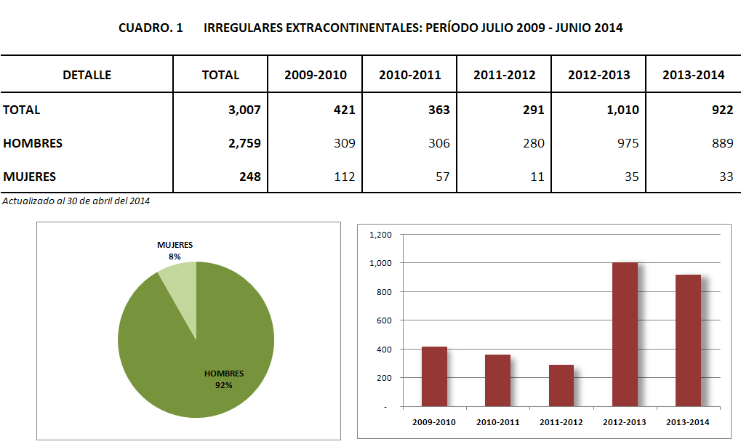
NATIONAL IMMIGRATION SERVICE
Unscrupulous Immigration Consultants

Slide 5
NATIONAL IMMIGRATION SERVICE
Unscrupulous Immigration Consultants

Slide 6
NATIONAL IMMIGRATION SERVICE
Unscrupulous Immigration Consultants
Unscrupulous immigration consultants in Panama:
Three years ago, unscrupulous defrauders located at the former headquarters of the Immigration Service allegedly resolved immigration procedures for foreign nationals and even offered them false permanent residence permits and identity cards without much paperwork.

Slide 7
NATIONAL IMMIGRATION SERVICE
Unscrupulous Immigration Consultants
Unscrupulous immigration consultants in Panama:
To date, unscrupulous persons still exist that offer false naturalization letters and false identity cards to unsuspecting foreign nationals, charging large sums of money.
The passports of foreign nationals that have entered the country in an irregular manner are stamped with false seals.
Foreign nationals pay large amounts of money for promised immigration permits.

Slide 8
NATIONAL IMMIGRATION SERVICE
Unscrupulous Immigration Consultants
Unscrupulous immigration consultants in Panama:
The National Immigration Service urges victims of fraud that have implemented procedures to become Panamanian citizens to report the defrauders to the National Immigration Service (Immigration Unit for Field Actions – UMAC, Spanish acronym).

Slide 9
NATIONAL IMMIGRATION SERVICE
Unscrupulous Immigration Consultants
Unscrupulous immigration consultants in Panama:
Foreign nationals do not report such cases. To date, only a few persons have reported cases to the National Immigration Service in 2014, and for the reported cases the defrauder was identified and referred to the competent authorities.

Slide 10
NATIONAL IMMIGRATION SERVICE
Unscrupulous Immigration Consultants
Unscrupulous immigration consultants in Panama:
In 2013, 22 foreign nationals were arrested in Panama that were wanted by international authorities for offences of fraud, since they offered fraudulent immigration services.

Slide 11
NATIONAL IMMIGRATION SERVICE
Unscrupulous Immigration Consultants
Unscrupulous immigration consultants in Panama:
Immigration procedures should be implemented exclusively at the facilities of the institution, since it is known that criminals continue to deceive foreign nationals with the same modus operandi, and when the foreign nationals initiate the legal procedures they discover that the documents are false and that they have been victims of fraud. Some persons claim to be immigration officers and are defrauding foreign nationals, asking them for money and giving them false documents, and when the foreigners come to the National Immigration Service they are informed that they have been defrauded.

Slide 12
NATIONAL IMMIGRATION SERVICE
Unscrupulous Immigration Consultants
Unscrupulous immigration consultants in Panama:
In addition, unscrupulous lawyers defraud foreign nationals and do not carry out the required immigration procedures.
These lawyers should be sent to the Public Prosecutor’s Office and should be reported to the National Bar Association in order to initiate a disciplinary process before the Fourth Chamber of the Supreme Court of Justice. In Panama, due to the lack of reports disciplinary processes have been initiated for less than 1% of the cases.

Slide 13
NATIONAL IMMIGRATION SERVICE
Unscrupulous Immigration Consultants
1. Unscrupulous immigration consultants exist in Panama:
Unscrupulous immigration consultants do exist in Panama:
Lawyers
Paralegals
Former immigration officers

Slide 14
NATIONAL IMMIGRATION SERVICE
Unscrupulous Immigration Consultants
2. In affirmative cases: What legal or administrative framework has been implemented in the country.
Decree Law 3, February 22, 2008
Act 38, governing administrative procedures
Act 9, governing the legal profession
Criminal Code

Slide 15
NATIONAL IMMIGRATION SERVICE
Unscrupulous Immigration Consultants
3. Upon identifying cases of fraud, what types of approaches exist to investigate these practices and punish them, if appropriate.
A report is filed with the Migration Unit of Field Actions (UMAC), the relevant investigations are carried out and, if sufficient evidence exists of an offence, the case is referred to the Public Prosecutor’s Office.
Offences are penalized as fraud and corruption of civil servants.

Slide 16
NATIONAL IMMIGRATION SERVICE
THANK YOU

