Slide 1



The Health Status of Irregular Migrants in Panama
Dr Javier López
Vice-Minister of Health
in Special Functions
Panama

Slide 2

MIGRATION ROUTES:
The route that is most commonly used by continental and extra-continental irregular migrants is through the Colombian border, since the geography of this country facilitates migration; until recently, it was difficult to detect migrants in that region.
Migrants travel to Panama by land and sea.
PREVIOUS JOURNEY:
Migrants arrive from the African continent in countries such as Brazil (Sao Paulo) and Ecuador (Quito) with regular migration status (visa and passport). From there, they continue their journey with irregular migration status, travelling by land and sea and avoiding immigration controls at the borders of Venezuela, Colombia and Panama.

Slide 3

RECENT MIGRATION FLOWS:
In 2006-2009 irregular migrants from China arrived, the majority of them in transit toward the United States and Canada.
In 2010-2012 the flow of irregular migrants from China stopped and the number of irregular migrants from Bangladesh, Somalia and Ethiopia increased.
Since 2012 irregular migration flows from Africa, Cuba and Haiti have been recorded.

Slide 4
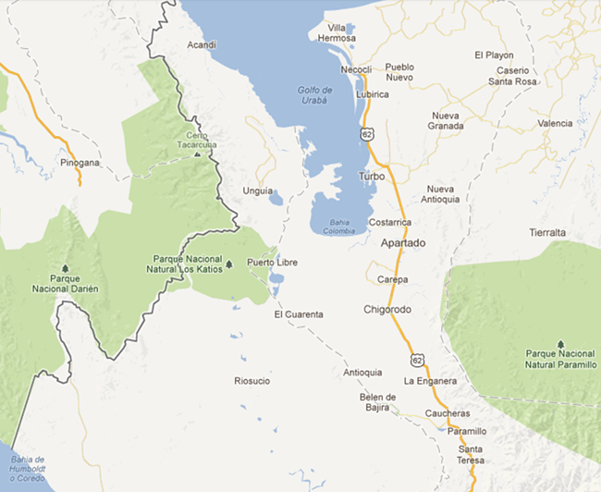
MIGRATION ROUTE
Entry to Panama
Metetí
Sapzurro
Necoclí
Migrants are identified in jungle regions and villages of the Province of Darién
Turbo
Accommodations and exit by sea toward Acandí (Chocó)
PANAMA
COLOMBIA

Slide 5
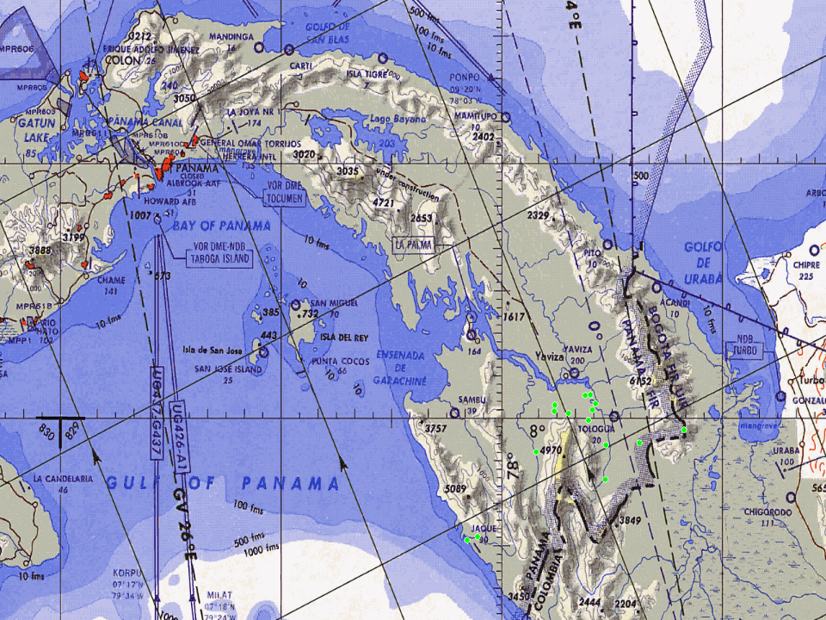
CARTI
ACANDI
TUQUEZA
TURBO
TUPIZA
NAZARETH
UNGUIA
PAYA
PERANCHITO
PUNUSA

Slide 6
RISKS AND HEALTH IMPLICATIONS
Emergence and re-emergence of infectious diseases with a high impact on public health in the country;
Risk of importing diseases from countries of origin;
Social determinants of the situation: overcrowding, malnutrition and negative impacts on health due to the conditions of the journey;
An increase in the demand for clinical and health care.
Notes:
Aparte del los problemas de inseguridad, desempleo, conflictos sociales y discriminación racial, los problemas de salud

Slide 7
Endemic Diseases in Countries of Origin
Hepatitis E (mainly in Nepal and Bangladesh, with up to 60% sero-prevalence);
Hepatitis A, B (Sub-Saharian Africa);
Malaria falciparum;
HIV;
Ebola;
Dengue – serotypes that are not circulating in Panama;
Tuberculosis – multi-drug resistant.

Slide 8
Only in Transit from Ecuador to Panama, Exposed to:
Yellow Fever – Colombia and Brazil;
Zika, Dengue, Chikunguya – Colombia, Venezuela and Brazil;
Haemorrhagic fevers (encephalitis) – Colombia, Venezuela and Brazil;
Malaria falciparum – Colombia.

Slide 9

Humanitarian Aid Provided by the Republic of Panama
Food and shelter;
Essential hygienic services;
Health care;
Vaccination (Yellow Fever, Influenza, MMR-MR);
Internal transfer to the border with Costa Rica.
Notes:
Estos inmigrantes están siendo atendidos por un equipo multidisciplinario, Fuerza de Tarea Conjunta, integrado por Servicio Nacional de Fronteras, Sistema Nacional de Protección Civil, Ministerio de Salud y Ministerio de Relaciones Exteriores. Se han establecido albergues de atención sanitaria y humanitaria (ETAH), donde se les provee atención médica, traslado a centro de segundo y tercer nivel de atención según necesidad, alimentación y otros servicios básicos de salud.

Slide 10
Main Pathologies Identified in Irregular Migrants (INMIR)
More than 5,000 migrants have required health care in
August-September
Minor trauma;
Dermatitis/piodermitis;
Diarrhea/dehydration;
Influenza-like syndrome;
Insect bites.

Slide 11
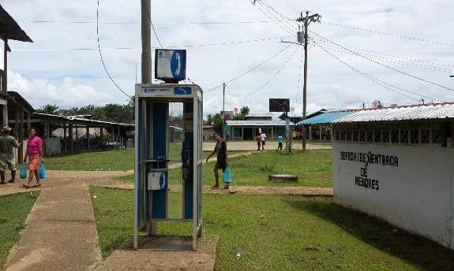
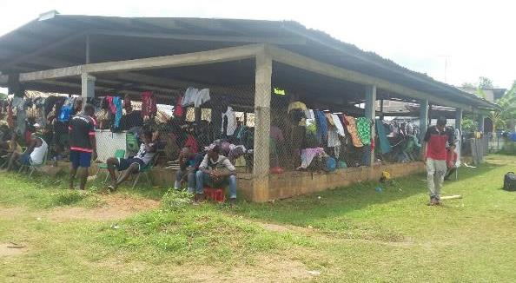
Lajas Blancas Community
⬅
BEFORE
➔
AFTER

Slide 12

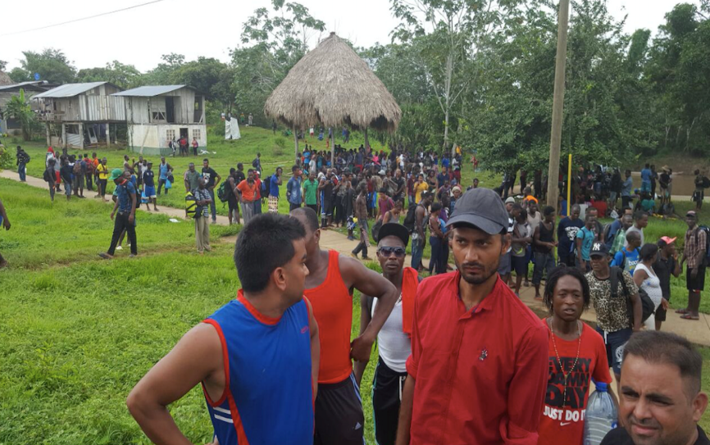
Affected Villages
Nuevo Vigía, Darién

Slide 13

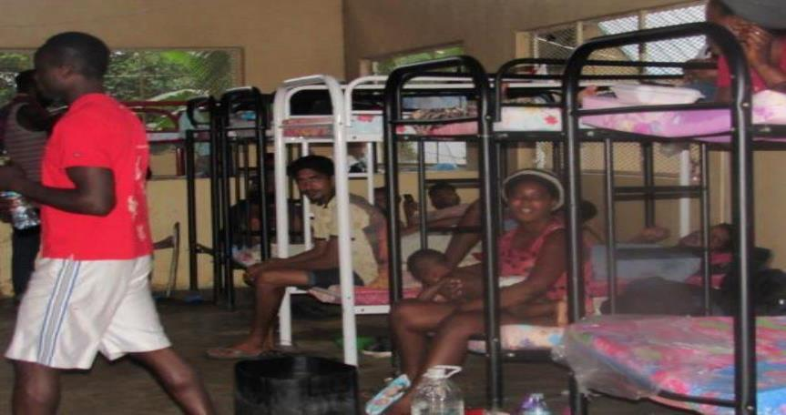
Temporary Humanitarian Assistance Station (ETAH) –
Mas Di in Metetí, Darién

Slide 14

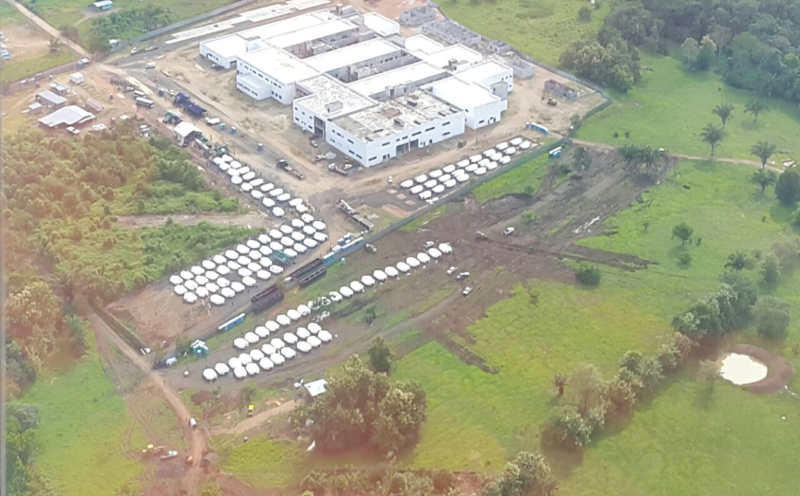
ETAH – Nicanor, Metetí, Darién

Slide 15
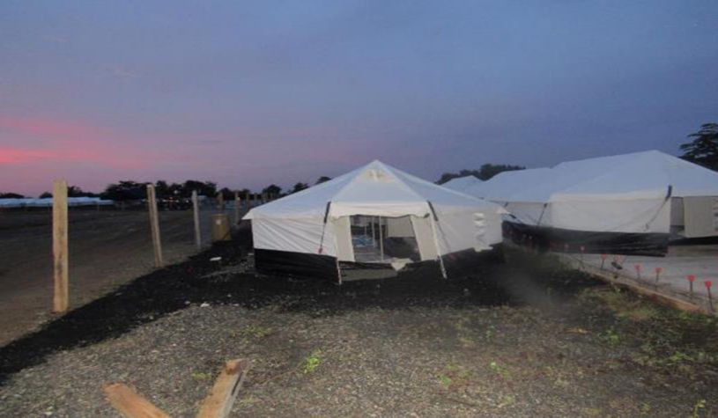
ETAH – Nicanor, Metetí, Darién

Slide 16

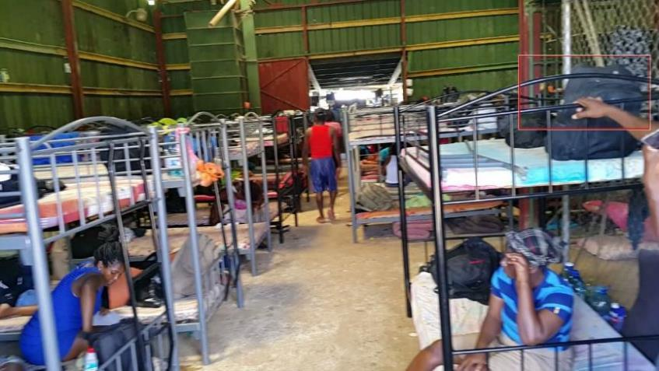
ETAH – Puerto Peñita, Darién

Slide 17
International Response:
WHAT SHOULD BE DONE?
2030 Agenda for Sustainable Development – Goal 10 includes a specific target on facilitating orderly, safe, regular and responsible migration and mobility of people.
New York Declaration for Refugees and Migrants – 71st Session of UNGA. No State can manage this displacement on its own. Greater international cooperation is required – between countries of origin, transit and destination – to help receiving countries and communities.
Health of Migrants (CD55/11) – WHO/PAHO.

Slide 18
CD55/11 – Health of Migrants
A commitment to provide access to high-quality comprehensive health care for migrants in their territories of origin and destination, during transit and upon returning to their country of origin;
The importance of addressing the social determinants of health and eliminating barriers that hinder access to health care, such as cost, language, cultural differences, discrimination and lack of information.

Slide 19

Ministry of Health of Panama

