Slide 1

REGIONAL CONFERENCE ON MIGRATION (RCM)
Liaison Officer Network to
Combat Migrant Smuggling and Trafficking
SEMINAR ON CHALLENGES RELATING TO MIGRATION:
COMBATING MIGRANT SMUGGLING AND TRAFFICKING, MIGRATION SECURITY, AND HUMAN RIGHTS

Slide 2
SEMINAR OBJECTIVES
To differentiate between the concepts of trafficking in persons and migrant smuggling, identifying victims of trafficking.
To discuss existing legislation in the region relating to the crimes of trafficking in persons and migrant smuggling.
To discuss the concept of Human Rights within its entire context and to establish when refugee status should be granted.
To collect and share best practices oriented toward improving relevant legislation in Member States of RCM, including the establishment of minimum legal standards that should be met in managing the above-mentioned crimes.

Slide 3

HUMAN RIGHTS AND MIGRATION
Human Rights
for All

Slide 4

We became aware of the importance of the human rights of nationals and, above all, of migrants.
“…disregard and contempt for human rights have resulted in barbarous acts which have outraged the conscience of mankind, and the advent of a world in which human beings shall enjoy freedom of speech and belief and freedom from fear and want has been proclaimed as the highest aspiration of the common people...” and “All human beings are born free and equal in dignity and rights.”

Slide 5
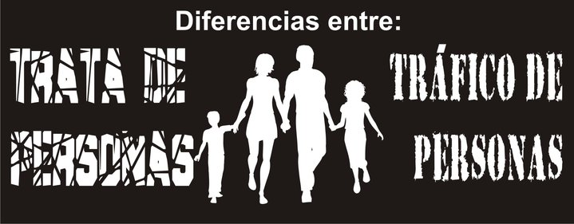
REGIONAL ADVANCES RELATING TO
TRAFFICKING IN PERSONS
Differences between:
TRAFFICKING
IN PERSONS
MIGRANT SMUGGLING

Slide 6

Trafficking in Persons
  National Guidelines
  Regional Guidelines to Combat the Crime of Trafficking in Persons in Central America
  A Regional Strategy for Comprehensive Assistance and Accompaniment of Victims
  An Operative Programme of the Regional Action Framework
  Communication Strategies in five countries
  A Memo of Understanding
  The Establishment of the Regional Coalition Against Trafficking in Persons
TO TRAFFICKING

Slide 7
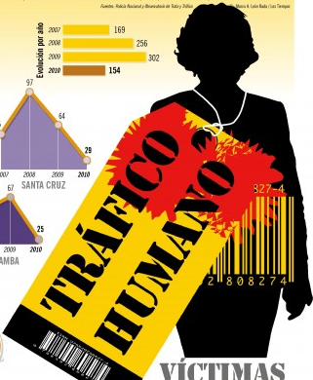
Migrant Smuggling
  The development of the Regional Guidelines for the Preliminary Identification of Profiles and Referral Mechanisms of Migrant Populations in Vulnerable Situations should be highlighted.

Slide 8
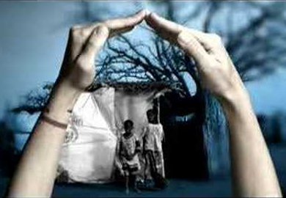
THE LINK BETWEEN ASYLUM AND MIGRATION

Slide 9
When should refugee status be granted to a victim of trafficking?
To prevent refugees, refugee status applicants, returned migrants, stateless persons, and internally displaced persons from becoming victims of trafficking and to address the protection needs of those persons that have already become victims of the crime.
To ensure that the international protection needs of victims of trafficking or persons at risk of becoming victims of trafficking are identified.
To provide assistance to States in order to ensure that victims of trafficking that do not hold any identity documents are able to establish their identity and nationality (to prevent them from becoming stateless persons).

Slide 10

CENTRAL AMERICA:
GEOGRAPHIC AND SOCIAL MAPPING (GSM) PROCESS
“A powerful tool that enables developing a visual instrument (maps) where information spread among key institutional and social actors transforms into knowledge”.

Slide 11
THANK YOU

