Slide 1


Republic of Panama
Ministry of Public Security
National Migration Service
Extracontinental and Cuban Migration Flows through the Republic of Panama
National Migration Service

Slide 2
Background:
Irregular Migrants through Panama
These migrants leave Cuba and travel to countries such as Ecuador, Venezuela and Guyana, and then on to Colombia and then Panama, across the Urabá gulf. From Panama they continue their journey through Central America to Mexico and then on to the United States, their final destination.
Cubans pay up to three million pesos (US$960.00) to travel to Colombia, according to figures provided by Colombian authorities.
National Migration Service

Slide 3
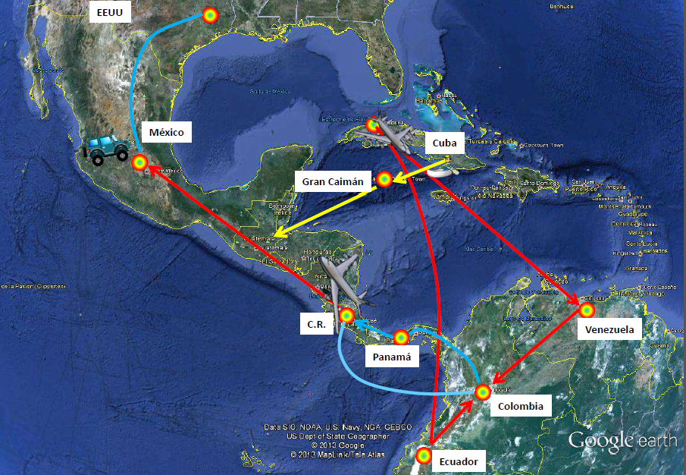
THE ROUTE OF IRREGULAR CUBAN MIGRANTS
National Migration Service

Slide 4
On November 14, 2015 Nicaragua decided to deny transit for humanitarian reasons of Cuban and extracontinental nationals through Nicaraguan territory.
On March 17, 2016 Costa Rica announced that Cuban or extracontinental migrants coming from the Panamanian border would not be admitted into Costa Rica anymore.
On May 9, 2016 Panama closed its borders to irregular migrants, in view of the position of Nicaragua and Costa Rica of no longer allowing these irregular migrants to transit through their territories. These decisions led to an agglomeration of irregular migrants in Panama, thus causing a situation which very nearly turned into a humanitarian crisis.
National Migration Service

Slide 5
IRREGULAR CUBAN MIGRANTS ENTERED THROUGH THE COLOMBIAN BORDER, BY YEAR: 2011-2016
DETAILS
CUBAN NATIONALS
Updated on July 12, 2016
National Migration Service

Slide 6
IRREGULAR CUBAN MIGRANTS, 2016-2016
National Migration Service

Slide 7
Background:
Extracontinental Migration Flows
Migrants travel from Africa and Asia to countries such as Brazil (Sao Paulo) and Ecuador (Quito) with regular migration status (holding a visa and a passport). From then on, their journey becomes irregular. They travel by land and sea, cross the borders of Venezuela and Colombia and enter Panama avoiding immigration checkpoints.
National Migration Service

Slide 8
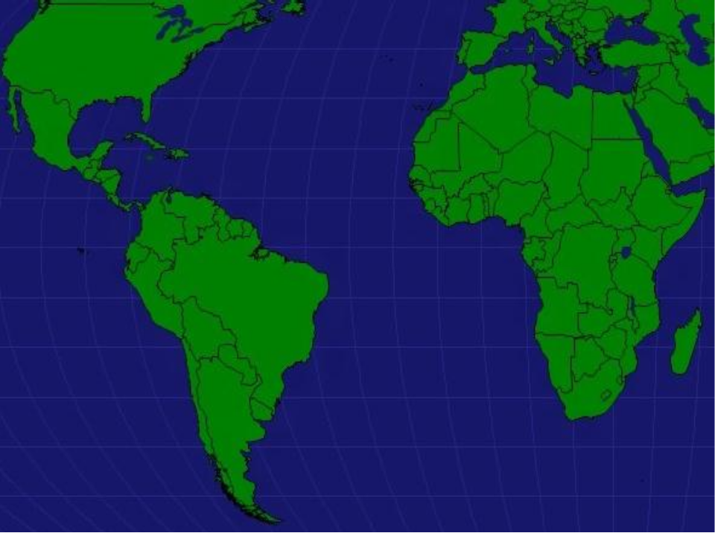















MIGRATION OF AFRICANS AS SOUTH AFRICANS
USA
MEXICO
NIGERIA
GHANA
P
SAO PAULO
SOUTH AFRICA
^{ATLANTIC OCEAN}
CO
ECUADO
R
BRASIL
ERÚ
BOLIVIA
SAO

Slide 9
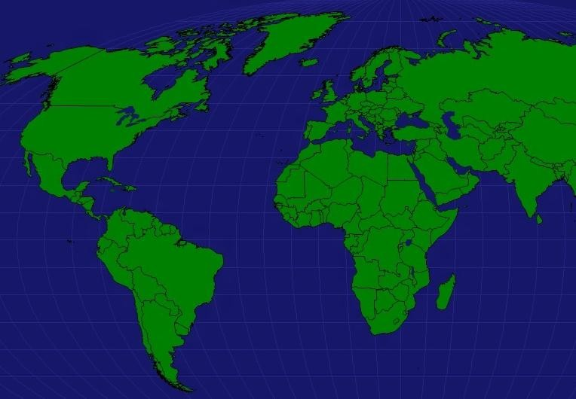



















CANADÁ
EMIRATOS
ARABES ^{N}
^{EEUU} CATAR
^{MÉXICO} GUATEMALA
COSTA RICA
COLOMBIA _{BAN} ECUADOR
PERÚ
BOLIVIA
BY AIR
BY LAND
EPAL
MIGRATION FROM ASIA
MIGRACIÓN
ASIÁTICA
INDIA
COLOMBIA
BANGLADESH
BRASIL

Slide 10
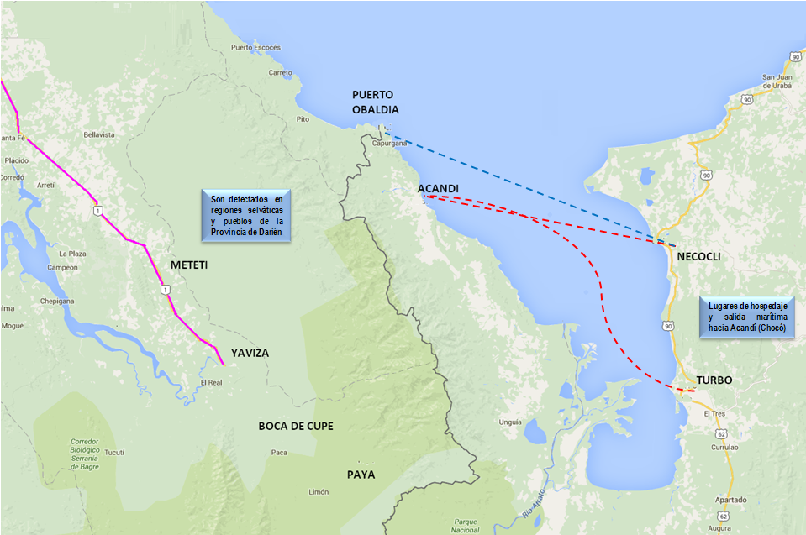


ROUTE OF EXTRACONTINENTAL MIGRANTS
RUTA EXTRACONTINENTALES
TUQUEZA
SAPZURRO
TUPIZA
NAZARETH
PANAMA
COLOMBIA
PUNUZA

Slide 11
EXTRACONTINENTAL MIGRANTS FROM ASIA AND AFRICA THROUGH THE DARIEN REGION: 2009-2016
DETAILS
National Migration Service

Slide 12
National Migration Service

Slide 13
National Migration Service

Slide 14
National Migration Service

Slide 15
Extracontinental Migrants
Linked to
Irregular Groups
National Migration Service

Slide 16

National Migration Service

Slide 17

National Migration Service

Slide 18

THANK YOU
FOR YOUR ATTENTION
National Migration Service

