Slide 1
Migrants and Public Health
Dr Federico Hernandez-Pimentel
Representative of WHO/PAHO in Panama
July 13, 2016

Slide 2
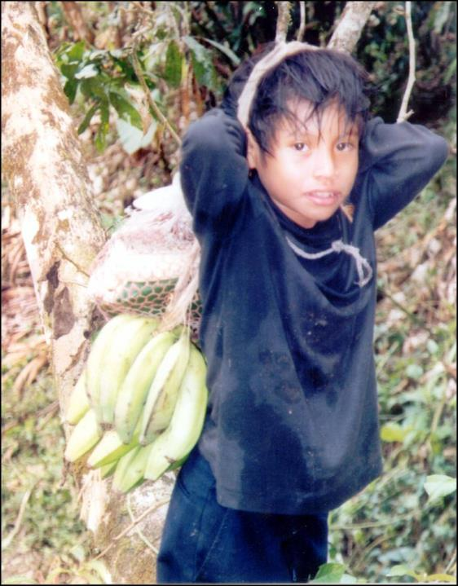
Migration does not always pose health risks, but it is a determining factor in the health-illness process.
Depending on the conditions of migration, health hazards could increase for migrants and communities of transit, destination and return.

Slide 3


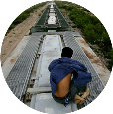
Universal Declaration of Human Rights
Constitution of WHO
0
Humanitarian Aid
Universal Health
Human Security
Origin
Transit
Destina-tion
Return
Notes:
La propuesta de la OPS para abordar las inequidades en salud de la población migrante: conectar la asistencia humanitaria de corto plazo con el acceso universal en salud y la cobertura universal de salud de largo plazo a través de la incorporación del enfoque de la seguridad humana en los planes de salud para fortalecer la resiliencia de los migrantes en situación de vulnerabilidad y de las comunidades de origen, tránsito, destino y retorno.
Constitución de la OMS: …..” El goce del grado máximo de salud que se pueda lograr es uno de los derechos fundamentales de todo ser humano sin distinción de raza, religión, ideología política o condición económica o social.

Slide 4

Areas of Action
Monitoring the health of migrants;
A political and legal framework to promote policymaking;
Strengthening coordination and national regional and international partnerships;
Providing health care and capacity-building to facilitate and promote equitable access to health care for migrants.
Migration should be
orderly, safe and regular.

Slide 5
The EM of PAHO prioritize the health of migrants, humanitarian aid
Action Plan 2015-2019
To increase strategic alliances and cooperation in order to provide prompt and effective health care at an international level.
To establish a regional registry system for foreign medical teams.
To strengthen the capacities of ministries of health to lead and coordinate international humanitarian aid.

Slide 6

Strategy for universal access to health and universal health coverage
Expanding equitable access to comprehensive, quality, people- and community-centred health services.
Strengthening stewardship and governance.
Increasing and improving financing, with equity and efficiency, and advancing toward the elimination of direct payments that constitute a barrier to access at the point of service.
Strengthening multisectoral coordination to address the social determinants of health that ensure the sustainability of universal coverage.

Slide 7
Health Hazards
Ebola virus
Yellow fever
HIV
Diseases preventable through vaccination

Slide 8
Healthy migrants in healthy communities!
Thank you!

