Slide 1

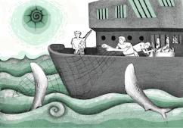
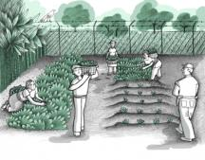
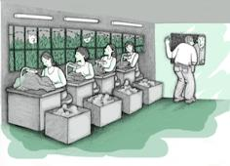


RESEARCH ON TRAFFICKING IN PERSONS FOR THE PURPOSE OF LABOUR EXPLOITATION IN CENTRAL AMERICA
Regional Summary

Slide 2
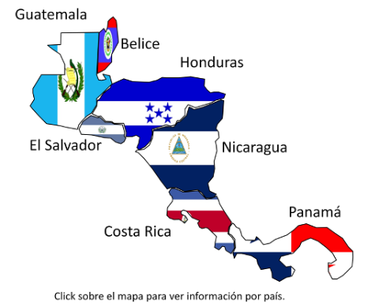
COUNTRIES INCLUDED IN THE RESEARCH
  Guatemala
  El Salvador
  Nicaragua
  Costa Rica
  Honduras (unpublished)
The field work was conducted in 2010-2011.

Slide 3
OBJECTIVES
To identify specific protection and assistance needs of surviving victims of trafficking in persons for the purpose of labour exploitation.
To formulate recommendations for government authorities, NGOs and other stakeholders with the aim of preventing the incidence of this crime.
To develop appropriate strategies for the detection and identification of situations of trafficking for the purpose of labour exploitation and to improve interventions to assist surviving victims.

Slide 4
PRIMARY RESULTS OF THE RESEARCH IN CENTRAL AMERICA

Slide 5
1) About the victims:
Men and women were identified that shared the same characteristics in their countries of origin, such as:
THE VICTIMS
Of productive and reproductive age.
Have been excluded from the education system and have limited education.
Have informal employment or low-paid jobs as employment options.
Have looked for a better paid job.
Live in areas characterized by extreme poverty and social exclusion.
Continuously wish to improve their own and their families’ living conditions.

Slide 6
Country | Number and Gender of Survivors | Victimization Scenarios | Destination
El Salvador | 41 32 men 9 women | Maquilas Agriculture | El Salvador Costa Rica
Nicaragua | 7 7 women | Household work Service sector | Nicaragua Costa Rica Argentina
Guatemala | 264 240 men 24 women | Household work Agriculture Laundries Service sector | Guatemala Mexico Spain United States
Honduras | 35 32 men 3 women | Agriculture Household work Criminal activities: dismantling vehicles | Honduras Mexico Romania Guatemala
Costa Rica | 37 37 men | International fishing Criminal activities | Costa Rica Mexico
TOTAL | 384

Slide 7

8) The majority are men of all ages, except for household workers.
Usually are groups of victims. This is a challenge due to number and gender = availability of services and programmes.
9) Internal trafficking for labour exploitation exists in every country, and also trafficking for labour exploitation between Mesoamerican countries, according to the pattern of labour migration.

Slide 8
11) Institutional response
  Lack of knowledge and lack of information;
  Limitations in definition/typification – labour exploitation is not a crime;
  An administrative crime, labour versus penal/human rights;
  Few cases are investigated, no convictions;
  Limited participation of the labour sector in prevention, monitoring and regulation;
  Weaknesses in terms of identification; efforts are not implemented to identify cases of trafficking in persons among returned or deported migrants.

