Slide 1
Regional campaign aimed at children and adolescents

Slide 2
Progress
Teleconferences on October 18th and October 31st
Discussed Options
Brand new campaign
Adopt a preexisting campaign

Slide 3
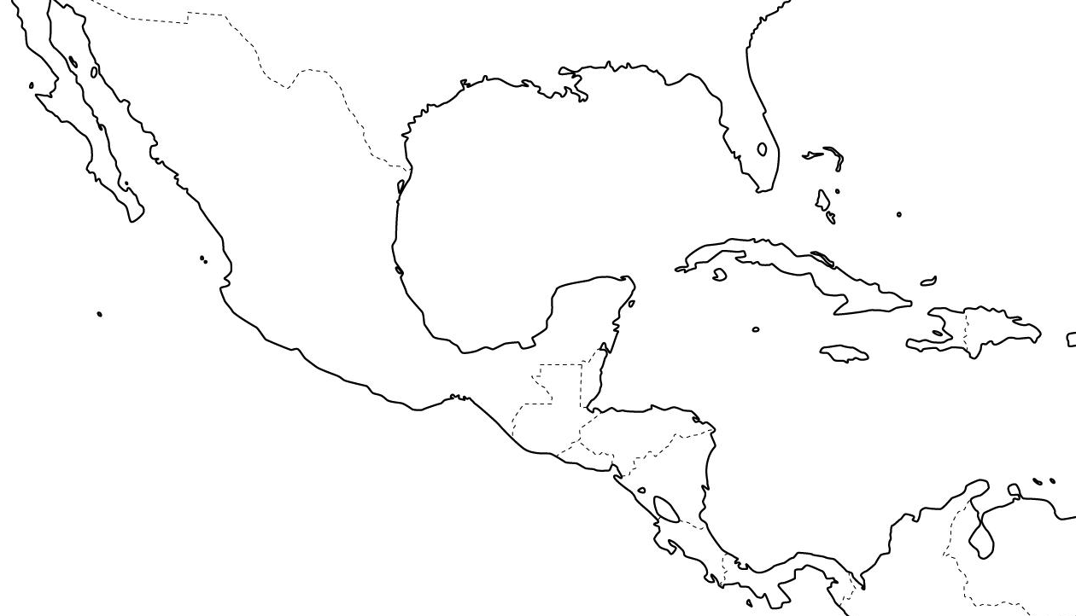
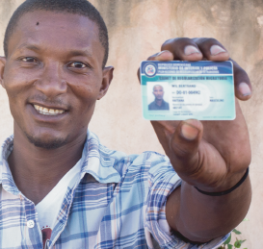
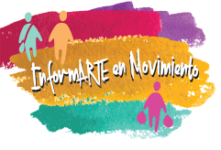
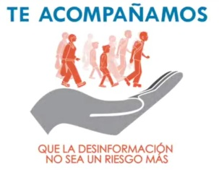

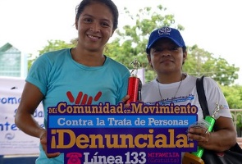

Slide 4
“InformArte en Movimiento” Campaign
Prevent risks associated with irregular migration with an emphasis on children and adolescents
Raise awareness on right and alternatives to irregular migration
Facilitate community communication tools for young leaders
Generate tools to measure the impact

Slide 5
Activities and products
Flyers, posters, merchandising
Illustrated book with stories about migrant children
Community mural paintings
Cinema forums
Community festivals
Communication workshops
Community radio (about to start)
Online community
Impact measurement

Slide 6
¿Why adopt this campaign?
Time sensitivity
Lessons learned
Existing synergies
Already being implemented
Online component based on community interventions
Platform open to new messages
Not branded

Slide 7
¿What does it mean to «adopt» the campaign?
Strenghthen syrnergies to increase the impact of community actions
Form social media network to make viral the participation (engagement)

