Slide 1
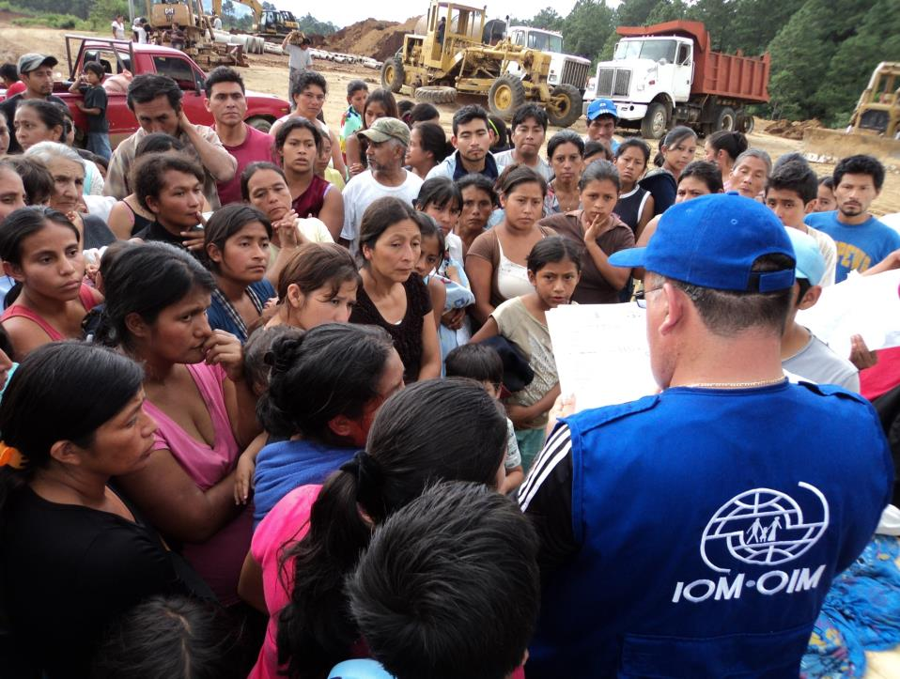
REGIONAL STRATEGY FOR CENTRAL AND NORTH AMERICA AND THE CARIBBEAN
Robert G. Paiva
Regional Director
IOM

Slide 2
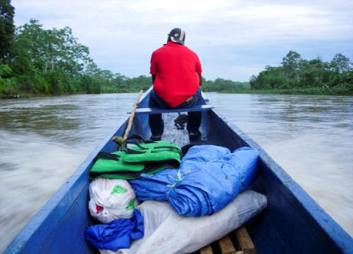

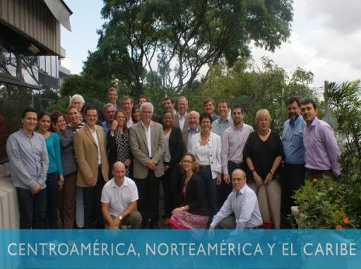
BACKGROUND
Part of a global comprehensive planning policy
Objective - as much as possible adjust the work of the Organization to priorities of associates and beneficiaries
PREPARATION
Analysis of trends, needs and impact of migration
Active participation of all our Offices and HQ.

Slide 3
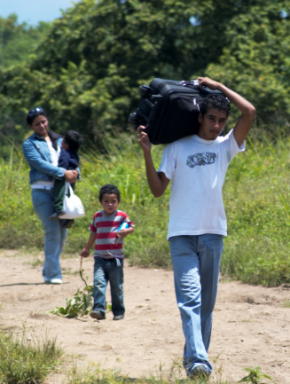
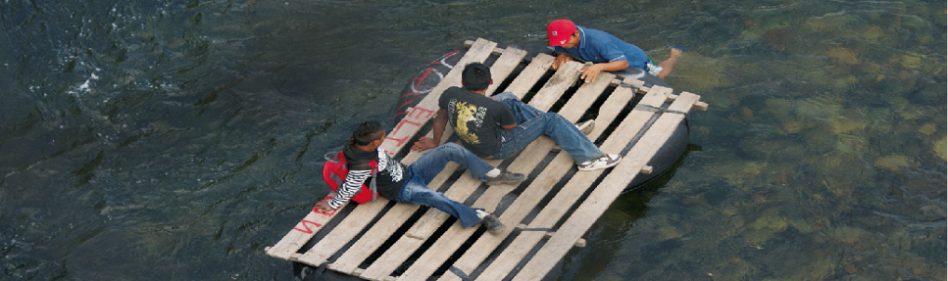
ANALYSIS
Main migration region in the world
Contribution of migrants to regional development
Not properly acknowledged
Highly vulnerable migrants
Irregular migration vulnerability factor
Alarming trends: growing flow of migrant children; violence is cause of migration and risk for children; climate change; high irregular migration

Slide 4


7 STRATEGIC WORKING AREAS
Protecting vulnerable migrants
Stronger migration mgm’t
Making health a priority
Response to crises and emergencies
Awareness on climate change and disasters
Improving migration policies
Enhancing benefits of organized migration
Proteger a los migrantes vulnerables
Fortalecer la gestión migratoria
Hacer de la salud una prioridad
Responder ante crisis y emergencias
Sensibilizar sobre cambio climático y desastres
Mejorar las políticas migratorias
Potenciar los beneficios de la migración

Slide 5
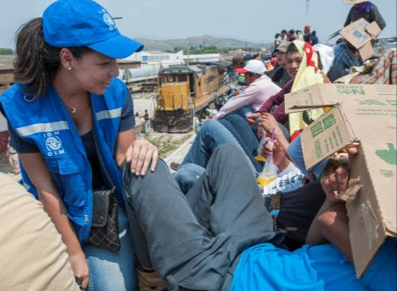
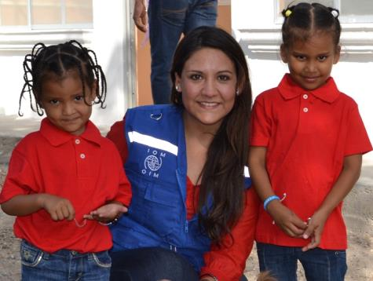
1. ProteCTING THE MOST VULNERABLE
Especially children, women, indigenous populations, domestic and temporary workers, extracontinents, LGBTI community, the disabled, the elderly and crime victims;
Recognizing vulnerability of irregular migrants;
Capacities to create and consolidate comprehensive protection schemes comprising prevention, reintegration and restitution of rights

Slide 6
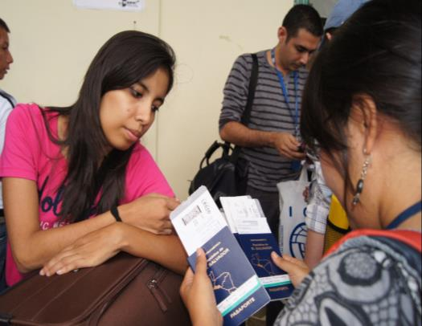
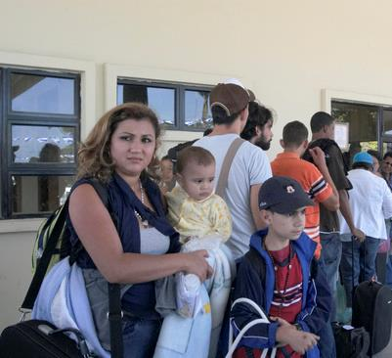
2. Strengthening migration management
Broad approach of migration management, comprising not only borders but also regular migration and rights of migrants;
Fostering development of comprehensive migration policies;
Stronger legal, procedural, human, administrative, operative and technological capacity

Slide 7
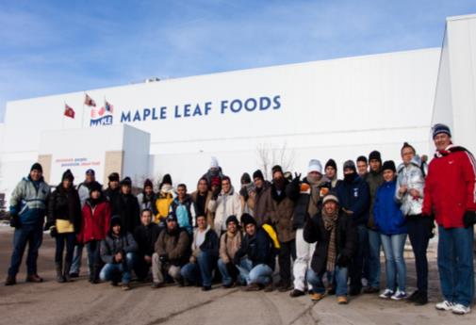
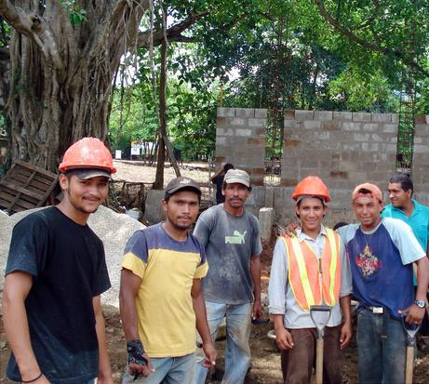
3. ENHANCING BENEFITS OF MIGRATION
Acknowledging and improving contribution of migration to development;
Fostering crosscutting nature of migration and migrants rights in development agendas;
Promoting integration and reintegration of migrants;
Linking diasporas with their countries of origin

Slide 8
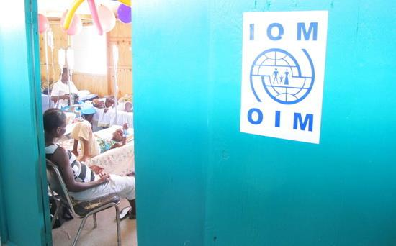
4. HEALTH AS A MIGRATION PRIORITY
Recognizing migrants’ vulnerability to health inequities due to inadequate and excluding policies;
Favoring knowledge as the basis for designing migration and health policies;
Promoting migrant-inclusive policies;
Awareness on determinants of migrants’ health

Slide 9
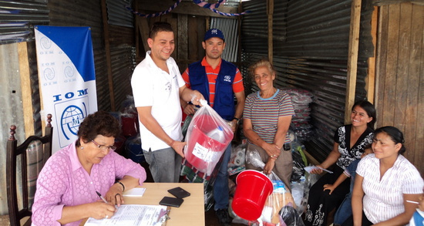
5. RESPONDING APPROPRIATELY AND EFFECTIVELY
TO EMERGENCIES
Using IOM’s “Migration Crisis Operational Framework - MCOF” as a tool;
Reducing risks and enhancing recovery capacities;
Helping to reintegrate populations displaced by disasters and violence and support community stabilization and transition

Slide 10
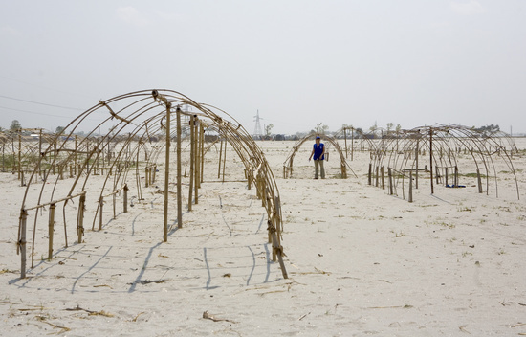
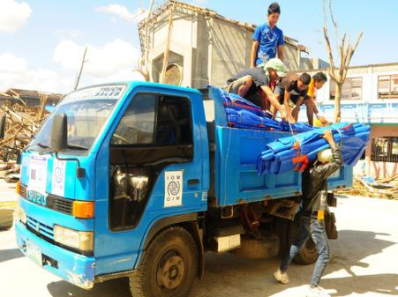
6. Awareness raising on climate change and disaster prevention
Ours is one of the most vulnerable regions to climate change;
Lack of policies to address environmental migration;
Reducing vulnerability of most exposed populations;
Supporting authorities to manage environmental migration;
Enhancing resilience and recovery capacities of origin, transit, destination and return communities of environmental migrants

Slide 11
HELPING GOVERNMENTS TO IMPROVE THEIR MIGRATION POLICIES
Recognizing the link between migration and practically all aspects of social life;
Highlighting potential of migration to help face important challenges in the region;
Supporting governments to develop migration policies that are explicit, comprehensive, harmonized, and that have a rights approach;
Addressing migration from all its viewpoints

Slide 12

Strengthening
Gender
Sustainability
Rights
4 CROSSCUTTING APPROACHES
Protecting vulnerable migrants
Stronger
migration
mgm’t
Making health a priority
Response to crises and emergencies
Awareness on climate change and disasters
Improving migration policies
Enhancing benefits of organized migration

Slide 13
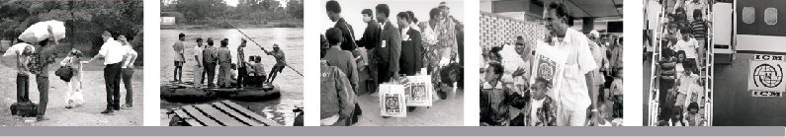
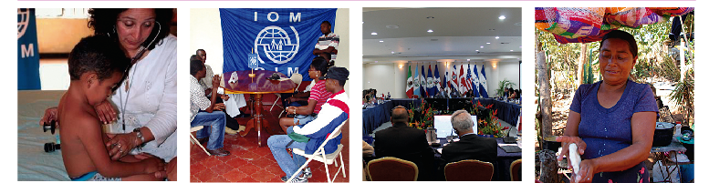
¿ QUESTIONS, COMMENTS ?
¡ THANK YOU !

