Slide 1





CONSULAR PROTECTION
FOR MIGRANT WORKERS
WORKSHOP
Panama City, Panama
25–26 April 2018
Notes:
Importance of bilateral agreements and negociation (see IOM Module C, Slide 4);
negotiation for cooperation between Labour Ministries and Chancelleries/Consulates.
Regional consultation processes – RCM
Functions: What role Chancelleries and Labour Ministries can have.
Challenges: recruiting agencies - what is the challenge for consular agents?
(this will also be addessed during the Day One group activity)
Skills recognition – role of Consulates?
Enhance employablity – so they are more directed at strategic sectors.

Slide 2
GROUP ACTIVITY
VULNERABILITIES OF
MIGRANT WORKERS

Slide 3
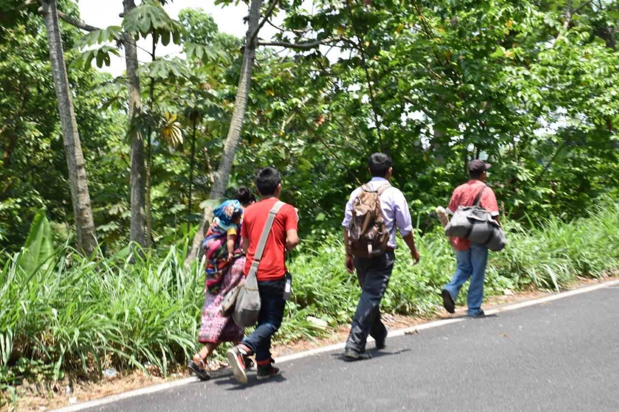
Migrants have different characteristics and protection needs depending on the phase of the migratory cycle they are in (pre-migration phase, migratory phase, and post-migration phase).
These characteristics and protection needs will also be different if the migration occurs with regular or irregular status:
  Irregular migrants are in an especially vulnerable condition that should be taken into account.

Slide 4
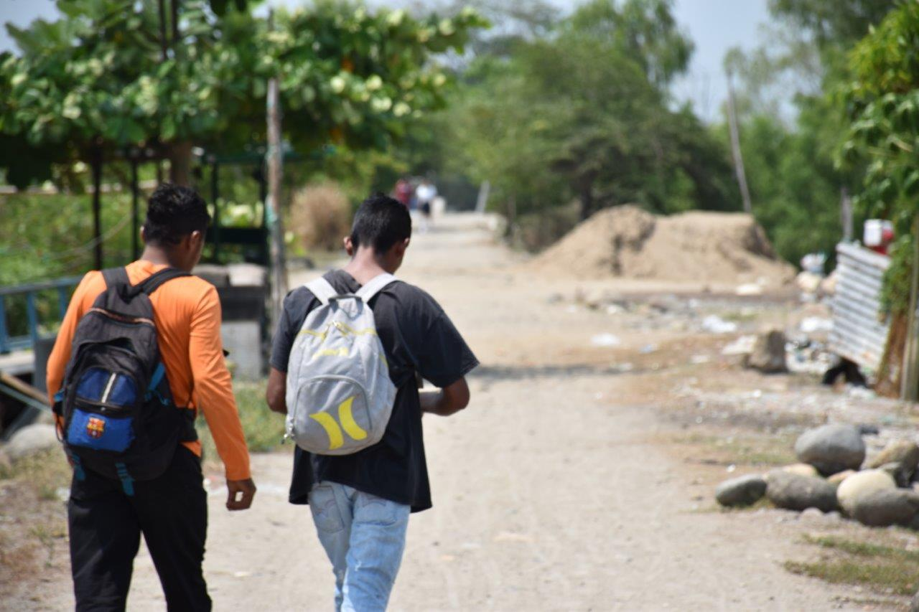
It is necessary to make known
the special protection needs of
all migrants during their migratory process, but especially the needs of those who migrate irregularly, as they are doubly vulnerable.

