Slide 1
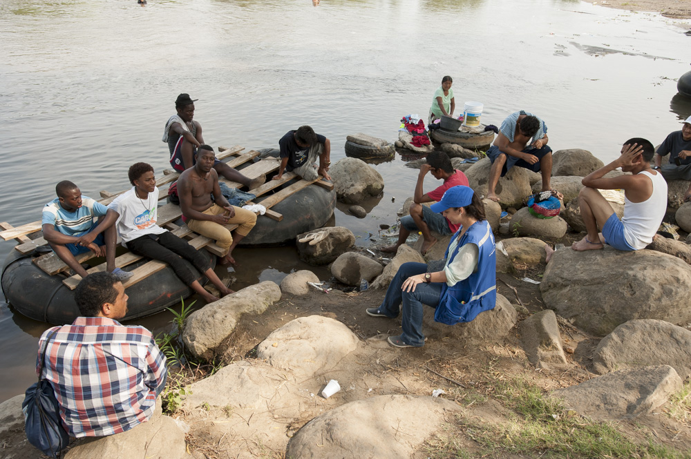

The Plan of IOM to Strengthen the Management of Extracontinental, Cuban and Haitian Migration Flows
Submitted for Discussion
Version of May 2016
International Organization for Migration

Slide 2
  The Plan of IOM to Strengthen the Management of Extracontinental, Cuban and Haitian Migration Flows
  International Organization for Migration (IOM)
  July 12, 2016
    Challenges relating to the management of these migration flows
    The Plan of IOM
    The way forward

Slide 3
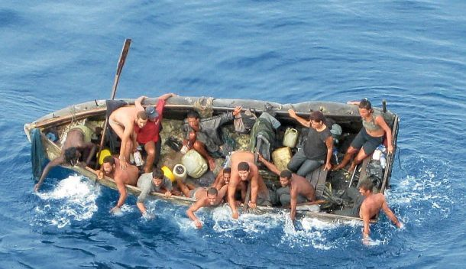
Challenges relating to the management of extracontinental, Cuban and Haitian migration flows in the Americas

Slide 4
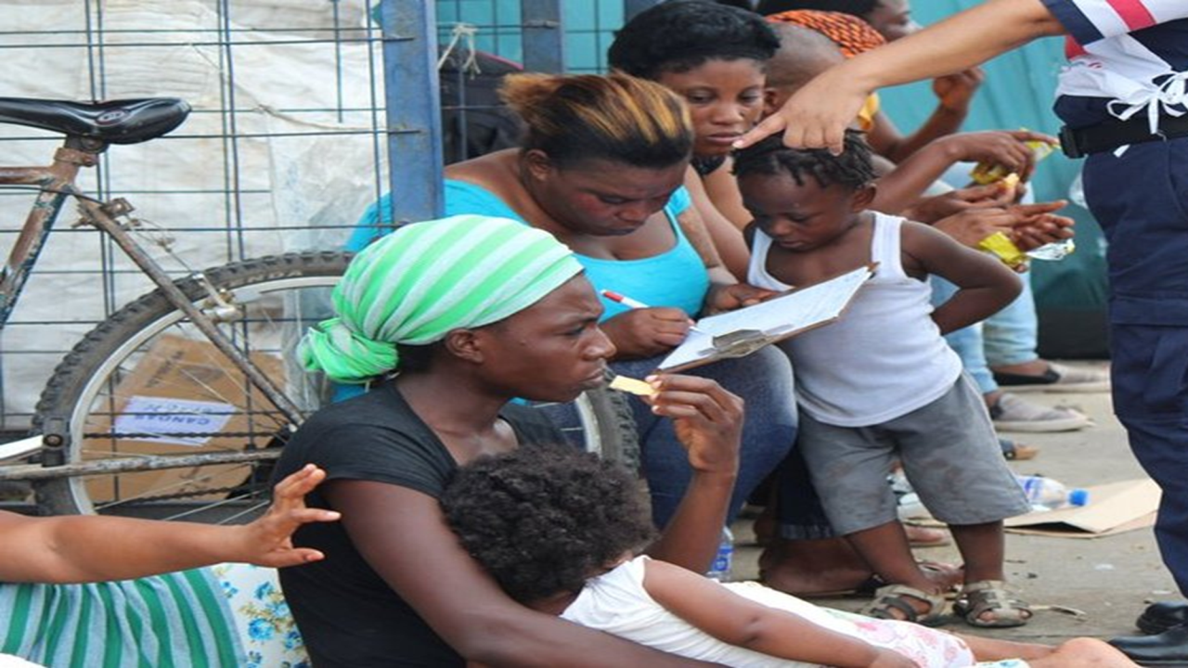
What are we observing?
A rapidly changing situation;
The mixed nature and composition of the migration flows;
An increasing number of migrants in vulnerable situations;
A significant volume of migration movements, which are expected to further increase.
Notes:
While the direction of the flows is aimed towards Europe, the diversity of nationalities, as well as the diversity of land and sea migration routes, irrefutably confirm the inter-regional, and indeed global, nature of the issue.
The current phenomenon is the result of a combination of factors across countries of origin, transit and destination, with several countries simultaneously playing multiple roles.
Responses must thus be comprehensive, integrated, responsive to shifts in movement and adaptable to the multiple challenges and diverse roles each country holds

Slide 5
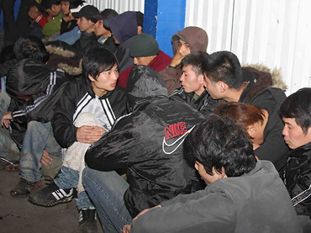
What is driving these persons to migrate?
Security – Violence and lack of security caused by civil wars, armed groups, extremists and terrorists;
Economic factors – High unemployment rates, limited opportunities, economic decline;
Social factors – Limited access to basic services and social services. Some cultures perceive migration as a step towards maturity.
Environmental factors – Environmental degradation causing droughts, desertification, extreme climatic events;
Greater difficulty to migrate to other areas;
The fear that migrating will become more difficult.
Notes:
Drivers of irregular and forced migration are context-specific and include a multitude of factors
Furthermore, the unavailability of legal migration channels; increasingly easy access to information through social media and other channels; the existence of powerful and from the perspective of migrants-to-be well-functioning smuggling networks; and the growing interconnectedness of societies and countries further impact decisions to move. Add to this demographic imbalances between a youthful South and an ageing North, and it becomes clear that in many contexts forced and irregular migration cannot be comprehensively addressed through actions by and in countries of origin and transit alone. An absence of reliable, trusted information on safe migration choices or conversely the prevalence of unverified rumors and speculation among migrants also drives individuals to take risky decisions.
In Libya, jobs in low-skilled and skilled sectors, which previously absorbed over 2.5 million migrant workers, have continued to evaporate due to insecurity and political clashes. Current estimates suggest that only one million migrant workers are presently in Libya and those living in increasingly precarious situations. Due to weak or lack of provision of basic services or livelihood opportunities, many migrants in North Africa might look to better opportunities in Europe. IOM's DTM Round 4 report for Libya where latest data clearly identifies some 264,000 migrants considered most vulnerable in Libya; IOM is estimating that there could be some 700,000-1,000,000 migrants in Libya total – however we don’t know how many of these migrants intend to cross the Med as this is difficult to estimate – we do not have the data and furthermore, migrants can change their minds based on circumstances and the fluid situation in Libya; Libya is considered a FINAL destination for many migrants, though this can change if living or working conditions are unsustainable; Moreover, we need to point out that thousands of migrants are also returning to home countries from Libya. We should therefore avoid speculation and placing over-emphasis on numbers (rather than the conditions, situations of migrants) without hard data because this risks pouring petrol on the flames of EU panic about new “invasions”.

Slide 6

Main Challenges
For countries of origin:
Lack of information;
Brain drain;
Migrant smuggling networks getting stronger;
Economic, social and family-related factors.
For countries of transit and asylum:
Reception and accommodation;
Basic needs and access to services;
Assistance for migrants in vulnerable situations;
Migrant smuggling and trafficking networks;
Potential conflict;
    Providing international protection.
Notes:
Countries of Entry/First Asylum: in the EU: Greece, Italy … (also Spain, Cyprus and Malta)
There is urgent need to put in place additional reception capacity at the points of entry, to allow for decent and effective accommodation, compliance with child protection standards, assistance, registration and screening of the thousands of people arriving every day – to identify those who are in need of protection, those to be relocated to other European countries, and people who do not qualify for refugee protection and for whom effective and dignified return mechanisms have to be put in place. Moreover in all situations, decisions related to children should be taken guided by what is in their best interests.
IOM feels that the current situation, if not addressed quickly and comprehensively, will lead to a fragmentation of the routes and additional challenges for migrants and countries. Much more has to be done to crack down on smugglers and traffickers – but in ways that allow their victims to be protected – and only as part of a more comprehensive, balanced solution of which opening more safe, legal channels is paramount and the surest way to undermine the smuggling networks’ business model.

Slide 7
Main Challenges
Providing specialized services:
Not necessarily available in border regions and in the required languages and with the required cultural approach.
Rights of migrants;
Health care;
Psychosocial assistance;
Legal aid and referral mechanisms;
Awareness-raising and information;
Shelter;
Assistance for victims of trafficking;
Boys, girls and adolescents, especially those who are unaccompanied;
Stranded migrants.
Notes:
Let’s not forget the Migrants
Migrant rights need to be upheld and not lost at the expense of increasing border controls
Changing the discourse, improving public perceptions of migration, fighting racism & xenophobia as migrants are often scapegoated for systemic problems and exploited for political gain
Vulnerable migrants and those who fall outside of existing international protection regimes
Long-term challenges need to be immediately addressed: migrant integration, social cohesion and reducing recourse to radicalism
Please see the latest Med Sit Rep for an update on how/where IOM is addressing these challenges.

Slide 8

OBJECTIVES OF THE PLAN
To protect migrants.
Objective: To protect the life, integrity, dignity, rights and health of migrants by, among others, reducing the risks they face during their migration process.
2. To address the drivers of irregular migration.
Objective: To reduce the drivers of irregular migration and to promote real possibilities to enable persons to migrate in a regular manner or stay in their country of origin.
3. To promote safe, orderly and dignified migration.
Objective: To create the necessary conditions to ensure that migration takes place in a safe, orderly and dignified manner.
4. To promote alliances to address these flows and generate development for migrants.
Objective: To create structural conditions to provide assistance and dignified solutions to migrants and make the necessary changes to generate positive impacts of migration.
Notes:
More detail in the Oct 2015 Response Plan attached.
Short to medium-term priorities
SAR and emergency assistance to save lives
Contingency planning & early warning information sharing mechanisms
Direct assistance and support services
Counselling & referral mechanisms
Data collection, analysis & research
Technical support to partner governments(training to reception workers & law enforcement officials, transport, equipment, capacity building
Sustained humanitarian assistance in countries of origin and transit (e.g Syria, Afghanistan, Libya)
Medium to long-term priorities
Fair and balanced dialogue & cooperation between countries of origin, transit and destination
Strategic support to governments to address migration drivers, empowerment of migrants for the promotion of sustainable development
Stabilization, transition and resilience programmes
Awareness-raising and promotion of safe and regular migration options (including new approaches to labour mobility)
Promote social integration and address xenophobic tensions
Medium to long-term priorities
Migrant Resource and Response Mechanisms (MRRMs)
Diaspora engagement
Humanitarian Border Management
Increased resettlement and relocation
AVRR
Counter-smuggling & counter-trafficking
Strengthen cooperation with partners and donors

Slide 9
Structure of the Plan
• Immediate Actions. Urgent actions that should be taken immediately to safeguard the lives and meet the immediate needs of migrants.
• Very Urgent Actions. Actions that should be taken within the next six months, at the latest.
• Urgent Actions. Actions that should be taken within the next twelve months, at the latest.
• Medium- and Long-term Interventions. Actions that should be taken within the next two years, at the latest.
43 proposed actions

Slide 10
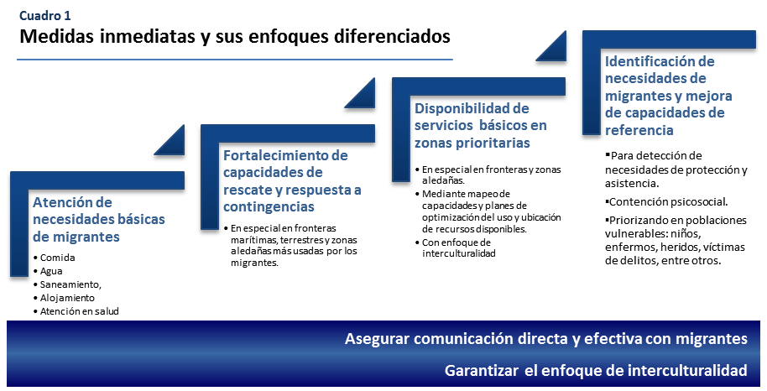
  Table 1
  Immediate Actions and their Differentiated Approaches

Slide 11
Immediate Actions (to be taken as soon as possible)
Meeting the basic needs of migrants, particularly food, water and sanitation, accommodation and health care.
Strengthening rescue capacities and contingency planning at land and sea borders to be able to provide assistance to large numbers of migrants.
Mapping capacities to provide assistance to extracontinental migrants at the borders and developing a plan to facilitate access to services.
A strategy to facilitate access to basic services with an intercultural approach for migrants.
Strengthening capacities for the registration, detection and referral of migrants in vulnerable situations to competent specialized authorities.
Providing psychosocial assistance to persons who have suffered stress or trauma during their migration process.

Slide 12
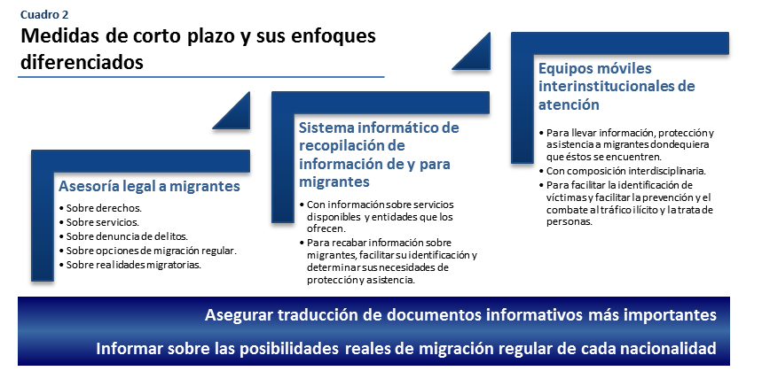
  Table 2
  Short-Term Actions and their Differentiated
  Approaches

Slide 13
Very Urgent Actions (to be taken within the next 6 months)
Legal aid for migrants, including the development of instruments and mechanisms to provide information about rights, services, alternatives and crime reporting.
Inter-institutional mobile teams providing information and assistance to extracontinental migrants.
An information system on protection and assistance needs of migrants.
An information system on services and assistance available to migrants.

Slide 14
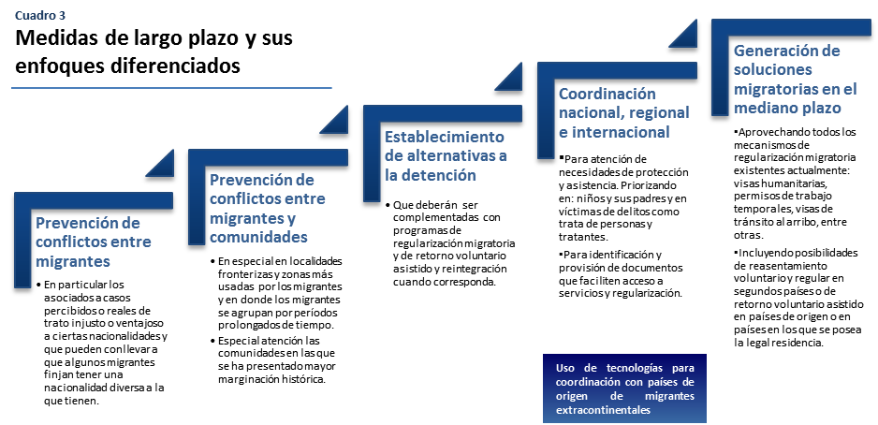
  Table 3
  Long-Term Actions and their
  Differentiated Approaches

Slide 15
Urgent Actions (to be taken within the next 12 months)
A strategy on prevention of conflict among migrants.
An awareness-raising and information strategy to prevent conflict between migrants and communities.
Identifying alternatives to detention: programme assessments, implementation, and monitoring and evaluation.
An assessment of existing mechanisms in current legislation that could be alternatives which enable extracontinental migrants to stay or travel.
Strengthening coordination between national actors.
Strengthening binational coordination, particularly coordination between border authorities.
Strengthening humanitarian visa programmes.
Programmes on resettlement in third receiving countries.
Temporary worker programmes, together with the private sector.
Voluntary assisted return and reintegration programmes.

Slide 16
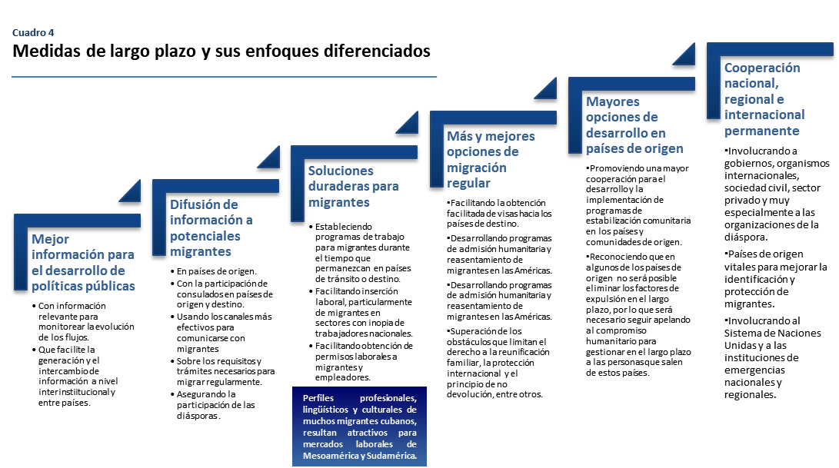
  Table 4
  Long-Term Actions and their Differentiated
  Approaches

Slide 17
Short- and Medium-Term Actions (to be taken within the next 24 months)
An information system and exchange of information for public policymaking.
A strategy to inform potential migrants about alternatives to irregular migration, including the requirements for obtaining visas and work permits.
Information dissemination and awareness-raising about the right to international protection, non-refoulement, the family unit and existing travel and stay permits in countries in the region.
Legal aid for migrants relating to existing legal mechanisms to migrate regularly to the desired countries of destination, including the option to apply for refugee status in the country of origin.
Information campaigns in countries of origin and destination (oriented toward the diaspora) about alternatives to irregular migration to the most common countries of destination of extracontinental migrants.
A strategy on coordination with countries of origin and first entry to the continent, with the aim of combating migrant smuggling and trafficking networks.
A strategy to harmonize the visa regime in countries in the region in order to facilitate regular migration.
Strengthening the capacities of immigration authorities and airline staff to identify false and forged documents.
Establishing and strengthening permanent migration intelligence programmes to improve the effectiveness of the actions to combat migrant smuggling and trafficking.
Strengthening the capacities of national authorities to identify migrant smugglers and traffickers and their victims among groups of extracontinental migrants.

Slide 18
Strengthening the capacities of national authorities to identify continental migrants among groups of extracontinental migrants to prevent migrant smuggling and trafficking.
Strengthening the capacities of national authorities on prosecution of the crimes of migrant smuggling and trafficking committed against extracontinental migrants.
A strategy to facilitate visas to travel to countries of destination.
Collecting information on the work profiles of extracontinental migrants and designing labour integration programmes for them.
Developing labour migration programmes in countries of transit and destination.
Developing programmes for admission and readmission for humanitarian reasons and resettlement of migrants.
Establishing programmes to generate a second option of regular migration for migrants who are unable to stay in the country.
Developing voluntary assisted return and reintegration programmes.
A strategy to promote regular migration through identifying and eliminating the obstacles that hinder the right to family reunification, international protection, the principle of non-refoulement, etc.

Slide 19
Human security and community stabilization programmes in countries of origin.
A strategy to strengthen the humanitarian commitment of countries of the Americas with citizens from countries in crisis.
Mobilizing extracontinental diasporas in countries of transit and destination to promote inclusion into the development of their communities of origin.
A strategy on awareness-raising and access to authorities in the countries of origin of extracontinental migrants.
A strategy on awareness-raising and access to authorities in countries of first entry to the Americas of extracontinental migrants.
A strategy to position the matter on the inter-regional agenda.
A strategy to position the matter on the regional agenda.
A strategy to position the matter on the sub-regional agenda.
A strategy to position the matter on the national agenda, including the private sector and civil society.
A strategy to position the matter within the framework of the United Nations country teams.

Slide 20

Thank you

