Slide 1
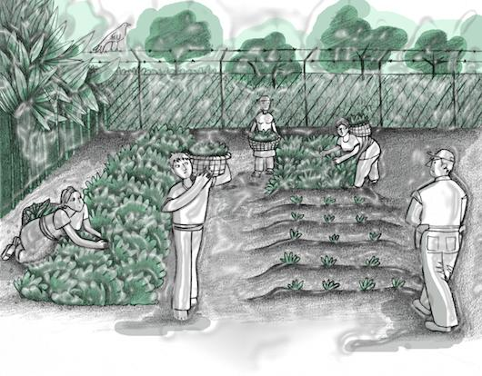

TRAFFICKING IN PERSONS FOR THE PURPOSE OF LABOUR EXPLOITATION IN CENTRAL AMERICA:
AN EXPLORATORY STUDY

Slide 2
Objectives
To identify, systematize, and analyse available information about trafficking in persons for the purpose of labour exploitation in Central America;
To help to gather knowledge about the characteristics, dynamics, routes and populations affected by this crime;
To help understand and provide a context for trafficking in persons for the purpose of labour exploitation within the broad framework of socioeconomic, labour, and migration policy and the general institutional response.

Slide 3
OBJECTIVES
To identify specific protection and assistance needs of surviving victims of trafficking for the purpose of labour exploitation;
To formulate recommendations for relevant government authorities, NGOs and other stakeholders with the aim of preventing the crime;
To develop appropriate strategies for the detection and identification of situations of trafficking in persons for the purpose of labour exploitation and to improve interventions for surviving victims.

Slide 4
CONCEPTUALIZING TRAFFICKING IN PERSONS FOR THE PURPOSE OF LABOUR EXPLOITATION
Attracting persons with the aim of subjecting them to forced labour or services through coercion, deception, force, abuse of power or a vulnerable situation.
This means that:
The labour or services are provided under threat of punishment.
The work is carried out in an involuntary manner (ILO).

Slide 5
WHERE AND WHEN THE RESEARCH STUDY WAS CONDUCTED
Countries:
Guatemala
El Salvador
Nicaragua
Costa Rica
Honduras (unpublished)
Field work conducted in 2011

Slide 6
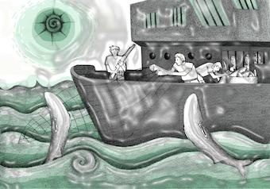
Sources:
Interviews with key informants;
Reviews of publications and newspapers;
Reviews of judicial and administrative records;
Consultation workshops with experts;
Interviews with surviving victims.
Interviews with 65 officers:
(15 ES, 18 GT, 9 NI, 8 HN, 14 CR)

Slide 7
Country | Number and Gender of Surviving Victims | Victimization Scenarios | Destinations
El Salvador | 41 32 men 9 women | Maquilas Plantations 1 | El Salvador Costa Rica
Nicaragua | 7 7 women | Household work Services | Nicaragua Costa Rica Argentina
Guatemala | 264 240 men 24 women | Household work Plantations Laundry services Services | Guatemala Mexico Spain United States
Honduras | 35 32 men 3 women | Plantations Household work Criminal activities: taking apart cars | Honduras Mexico Rumania Guatemala
Costa Rica | 37 37 men | International fishing Criminal activities | Costa Rica Mexico
TOTAL | 384

Slide 8
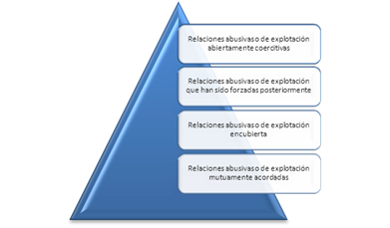
some results
An extreme expression of a continuum of exploitation and abusive relationships in the workplace that can easily become openly coercive.

Slide 9
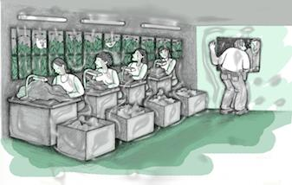
Some results
2) The globalization of labour markets and the transformation of the social and economic model, especially the liberalization of markets and the de-regularization of labour processes, seem to have an impact on the prevalence of this mode of trafficking in persons.

Slide 10
SOME RESULTS
3) Common victimization scenarios:
Household work
Maquilas
Agro-industrial activities
Service sector
Criminal activities
Other: construction
4) Common characteristics of these scenarios:
Insufficiently regulated or informal economic activities
Use of (irregular) migrant labour

Slide 11
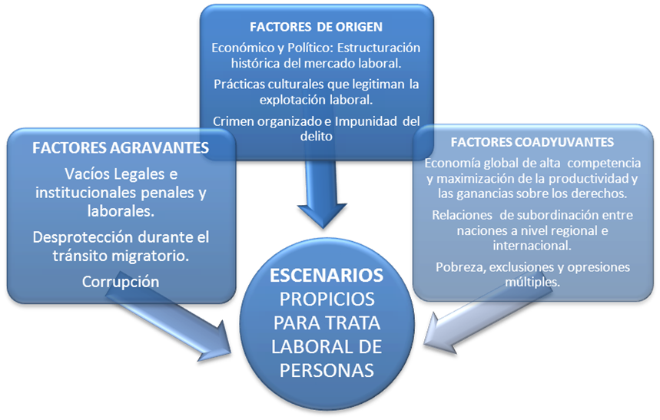
ROOT CAUSES
Economic and political: the historic structure of the labour market;
Cultural practices which legitimize labour exploitation;
Organized crime and impunity.
AGGRAVATING FACTORS
Legal voids and absence of criminal and labour institutions;
Lack of protection during migration;
Corruption.
CONTRIBUTING FACTORS
A highly competitive global economy and maximization of the productivity and profits above rights;
Relationships of subordination between nations, at a regional and international level;
Poverty, multiple types of exclusion and oppression.
SCENARIOS
PROMOTING
TRAFFICKING IN
PERSONS FOR THE
PURPOSE OF
LABOUR
EXPLOITATION

Slide 12
SOME RESULTS
5) Link between trafficking in persons for the purpose of labour exploitation and labour migrant smuggling. Contractors.
“Usually, contractors charge fees from workers – sometimes thousands of dollars – to cover costs related to transportation, visas and others, including the profits of the contractors. Workers, the majority of whom live in poverty, often have to obtain loans with high interest rates to be able to collect the money to pay the fees; sometimes contractors ask them to give something as a guarantee (deeds of their homes, land, cars) to ensure that they comply with the terms of their individual employment contracts.”

Slide 13
Some results
6) Mostly men of all ages, except in the household work sector.
Usually groups of victims. This is a challenge, due to the number and gender = availability of services/programmes.
7) Internal trafficking for the purpose of labour exploitation exists in every country as well as trafficking for the purpose of labour exploitation between Mesoamerican countries, according to labour migration patterns.

Slide 14
SOME RESULTS
8) The attraction and subjugation mechanisms are similar to other expressions of the crime. The following can be highlighted:
Subjugation due to debt
Constant surveillance
Physical violence
Threats
“…[He] took me to work in the corn fields, and my fingers became full of sores and on top of them my wounds bled. Those that tried to escape from the corn fields were killed. They killed a woman… When I saw that it was true that they were murderers I had to comply with everything, do what they said. At night they always watched the mud walls to prevent us from escaping…”
(Surviving victim)

Slide 15
SOME RESULTS
9) Institutional response:
Lack of knowledge – lack of information;
Limitations in definition/typification – labour exploitation is not a crime;
Administrative labour crime versus criminal / human rights;
Few cases are investigated / no sentences
Labour sector, limited participation in prevention, inquiry, regulation; weaknesses in identification; situations of trafficking in persons are not explored among returned or deported migrants.

