Slide 1








Ministerio de Gobernación
General Directorate of
Migration and Immigration
Republic of Nicaragua
Migration and
Immigration Act

Slide 2

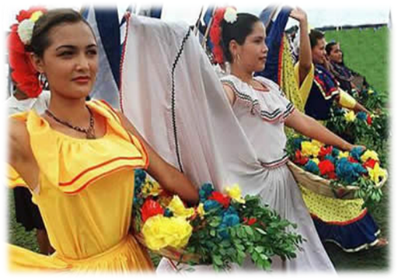



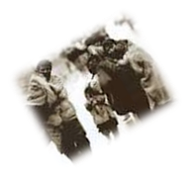
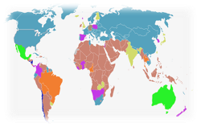
REGULATORY BODY:
Political Constitution of Nicaragua
Act 655, Refugee Protection Act
(Published in the Official Newspaper; July 9, 2008)
Act 761, General Migration and Immigration Act
(Published in the Official Newspaper; August 6-7, 2011)

Slide 3


Ministry of the Interior
General Directorate of Migration and Immigration
The spirit of this law is to respect human rights.
The law recognizes that every person in national territory enjoys State protection and recognition of the rights that are inherent to each human person.
Foreign nationals and Nicaraguan nationals have the same rights (except for political rights).
To promote and protect the human rights of migrant workers and their families, without any distinction whatsoever.
The migration policy of the State shall regulate migration flows that favour the social, political, economic, and demographic development of Nicaragua, in accordance with public security and ensuring respect for human rights.

Slide 4

Ministry of the Interior
General Directorate of Migration and Immigration
STRUCTURE OF ACT 761:
TITLE 1: General Provisions
TITLE 2: National Council of Migration and Immigration
TITLE 3: Attributions and Structure
TITLE 4: On Documents, Rights, and Obligations of Foreign Nationals
TITLE 5: Categories, Immigrations Status, and Special Permits to Stay
TITLE 6: A National Record of Foreign Nationals
TITLE 7: The Nicaraguan Nationality
TITLE 9: Immigration Documents and Visas
TITLE 10: Residence Card and Identity Card and Travel Documents to Travel Abroad
TITLE 11: On Entry, Stay, Exit, Return, and Reasons for Denying Admittance
TITLE 12: On Financial Matters and the Special Immigration Fund
TITLE 13: Means of Transportation, Enterprises, and Hotels

Slide 5

Ministry of the Interior
General Directorate of Migration and Immigration
STRUCTURE OF ACT 761:
TITLE 14: On Irregular Migration and Related Punishment
TITLE 15: Deportation, Expulsion, and Extradition
TITLE 16: Administrative Resources and Procedures
TITLE 17: Organic Structure and Operations of the General Directorate of Migration and Immigration
TITLE 18: General, Transitory, and Final Provisions

Slide 6






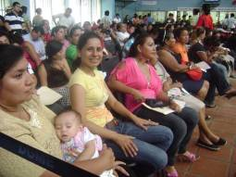


Act No. 761. General Migration and
Immigration Act
PROTECTING MIGRANTS
STRENGTHENING AND MODERNIZING MIGRATION MANAGEMENT
STRENGTHENING BORDER SECURITY
The Migration
Journey

Slide 7




PROTECTING MIGRANTS
Nicaragua, based on Article 46 of the Political Constitution and Consideration II of Act 761, General Migration and Immigration Act, recognizes that every person in national territory enjoys State protection and recognizes the rights that are inherent to every human person, unrestricted respect, promotion, and validity of the rights established in various international instruments ratified by Nicaragua. This guarantees comprehensive protection.
In addition, our Act 761 establishes protection for refugees, stateless persons, asylum seekers, and victims of trafficking in persons, particularly women, girls, and boys. Furthermore, it establishes complementary protection through humanitarian visas for every migrant victim of human rights violations.

Slide 8

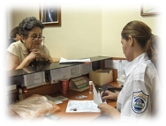
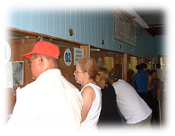



PROTECTING
MIGRANTS
Regularization of the migration status is envisioned for foreign nationals that marry or live in common marriage with a Nicaraguan national; boys, girls, and adolescents subject to expulsion and repatriation; persons exceeding their authorized stay; and persons engaged in unauthorized activities.
Coordinated efforts with various government an non-governmental organizations such as MI FAMILIA, CEPAD/UNHCR, IOM, SERVICIO JESUITA, to provide additional assistance to meet the needs of migrants in vulnerable situations.

Slide 9

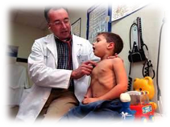
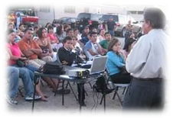
PROTECTING
MIGRANTS
A term of 48 hours to 60 working days is established for repatriation or deportation, either on their own or through their Embassy or the General Directorate of Migration and Immigration.
Describes the rights of foreign nationals during procedures of internment, deportation, or expulsion, as well as stay at the national shelter for migrants:
Information about their procedure
Their rights and obligations
Consular protection
Applying for refugee status
Regularizations
Assisted return
Medical assistance
Food
Access to justice
Visits
Family unity
Dignified treatment
Exemption from fines in case of poverty

Slide 10





CATEGORIES OF MIGRANTS
Migrant Workers
Establishes the status of temporary migrant worker for all foreign nationals entering the country to work for a specific period of time with the objective of engaging in economic, social, cultural, academic, scientific, and religious activities. Migrant workers shall be granted a special permit to stay and work for up to one year.
STRENGTHENING AND
MODERNIZING MIGRATION MANAGEMENT
Trans-border Workers
Daily entry and exit is authorized for workers working in the border region.
Maximum Stay for Travellers in Transit
The maximum authorized stay for foreign
nationals in transit in national territory is
five days.

Slide 11

Temporary Residents
Should live in the country for a period of one to three years – this period may be extended – or while engaging in activities, causes, or for the purposes that determined their admission. Temporary residents are classified under the following priority sub-categories:
STRENGTHENING AND
MODERNIZING MIGRATION MANAGEMENT
Scientists
Professionals
Technicians
Specialized Staff
Entrepreneurs
Directors
Managers
Business Agents
Journalists
Students
Persons belonging to a Religious Order
Artists
Sportsmen
Refugees
Stateless Persons
Asylum Seekers
Administrative or Operative Staff of National or International Enterprises
Independent Workers or Workers in a Relationship of Dependency

Slide 12


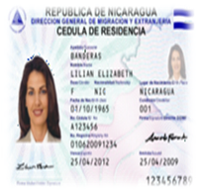
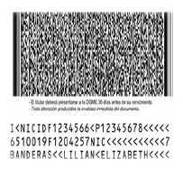
STRENGTHENING AND
MODERNIZING MIGRATION MANAGEMENT
Categories of Permanent Residents
Permanent residents may be admitted into any of the following immigration sub-categories:
Immigrant
Immigrant with capital
Retired resident
Spouses, children, or parents of the above-mentioned persons
Foreign nationals with affinity links or blood relatives of Nicaraguan nationals, understood as spouse, parents, and under-age children
Refugees
Temporary residents that have stayed in the country for more than three years in a regular manner may apply for permanent residence status
Foreign nationals of Central American countries and persons from countries with which Nicaragua has signed agreements on dual nationality may be directly granted permanent residence status, provided that the principle of reciprocity applies.

Slide 13


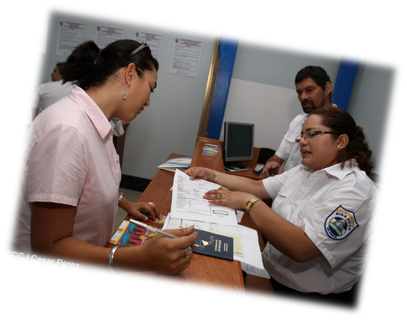
Retired Residents:
A retired resident is a person that proves that he or she receives a stable financial income from abroad, in accordance with Act No. 694, “Law on Promoting the Entry of Retired Residents”, published in the Official Newspaper No. 151, August 12, 2009
STRENGTHENING AND
MODERNIZING MIGRATION MANAGEMENT
Investing Immigrant
The status of immigrant with capital or investor shall be determined by the Ministry of Public Works, Industry, and Commerce through a certificate of registration.

Slide 14


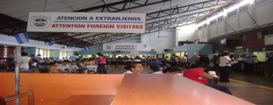

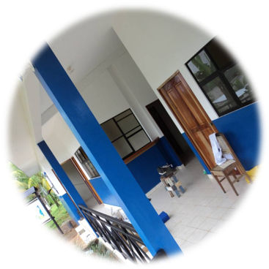
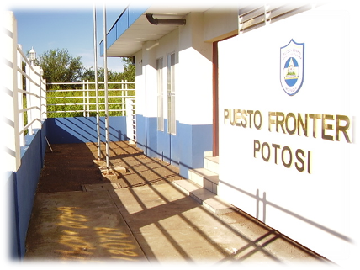

STRENGTHENING BORDER SECURITY
Headquarters
Sarapiqui Border Post
Potosi Border Post

Slide 15


Slide 16


Slide 17
Short-term Goal:
Approval of the Bylaws to Act 761; General Migration and Immigration Act
CHALLENGES:
To make adjustments to the structure of the General Directorate of Migration and Immigration (DGME), in accordance with relevant legislation

Slide 18
Ministry of the Interior
General Directorate of Migration and Immigration
Thank you!

