Slide 1

Ministry of Foreign Affairs
General Consular Directorate
Report: “Seminar/Workshop on Capacity-Building of Consular Authorities to Protect the Labour Rights of Migrants”
Managua, Nicaragua, May 3-4, 2012

Slide 2
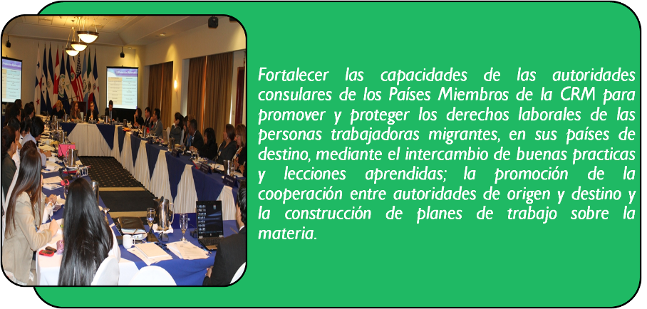
“Seminar/Workshop on Capacity-Building of Consular Authorities to Protect the Labour Rights of Migrants”
I. Objective
To build the capacities of consular authorities in Member States of RCM
to promote and protect the labour rights of migrant workers in countries of destination
through exchanging best practices and lessons learned; promoting cooperation between authorities of origin and destination and developing work plans on this matter.

Slide 3
“Seminar/Workshop on Capacity-Building of Consular Authorities to Protect the Labour Rights of Migrants”
II. Presentations
International legal framework for the protection of the rights of migrant workers
Designing and implementing explicit policies for the protection of migrant workers
Basic considerations for the design and implementation of policies and actions to protect the rights of migrant workers
Experiences of protecting migrant workers under inter-institutional cooperation schemes: policy options for countries of destination
Experiences of protecting migrant workers in the consular sphere: policy options for countries of origin

Slide 4
“Seminar/Workshop on Capacity-Building of Consular Authorities to Protect the Labour Rights of Migrants”
III. Establishing Working Groups
GROUP 1:
Protecting the labour rights of migrant workers in countries of origin, transit, and destination
GROUP 2:
Policy on preventing trafficking in persons for labour exploitation purposes through consular authorities

Slide 5
“Seminar/Workshop on Capacity-Building of Consular Authorities to Protect the Labour Rights of Migrants”
IV. Group I Plan of Action
To develop guidelines or manuals on the protection of migrant workers, to be used as the basis for systematic training efforts oriented toward all relevant officers addressing specific topics (trafficking and labour exploitation, human rights, etc.)
To develop systematic campaigns, beginning in the country of origin. To develop a communication strategy including dissemination of information about labour rights, oriented towards persons that have decided to migrate.
To promote the signing of memos of understanding between countries, considering compliance with and respect for accepted minimum standards relating to labour conditions for the enjoyment of decent work, in accordance with ILO parameters.
To promote the signing of and compliance with ILO multilateral instruments relating to the protection of the rights of migrant workers.

Slide 6
“Seminar/Workshop on Capacity-Building of Consular Authorities to Protect the Labour Rights of Migrants”
IV. Group I Plan of Action
To improve relations with relevant authorities in countries of destination. To increase the presence in relevant spaces for analysis and discussion of the topic of migration and to improve the knowledge about domestic legislation relating to rights and obligations in regard to labour.
To develop and promote return programmes, in accordance with the needs of migrant populations and in coordination with communities of origin.
To improve the transparency of recruiting processes, defining and organizing them in procedures manuals; to disseminate them and promote compliance in regard to hiring requirements. To enrich such processes with experiences from other countries.
To promote the signing of agreements on portability of labour benefits.

Slide 7
“Seminar/Workshop on Capacity-Building of Consular Authorities to Protect the Labour Rights of Migrants”
IV. Group I Plan of Action
To secure financing to complement the allocated funds, to be used mainly for actions to protect migrant workers.
To promote education as the first solution to prevent migration out of need.
To share information and procedures for the management of labour migration flows with allied States.
To promote dignified employment opportunities, with the aim of reducing the causes of labour migration.

Slide 8
“Seminar/Workshop on Capacity-Building of Consular Authorities to Protect the Labour Rights of Migrants”
V. Group 2 Plan of Action
Awareness-raising of consular officers regarding the topic of trafficking in persons for labour exploitation purposes.
Online training for consular officers and foreign service officers on the topic.
To develop a Protocol for Consular Action in regard to trafficking in persons for labour exploitation purposes.
To implement awareness-raising, dissemination, and prevention campaigns oriented toward migrant populations on the topic of trafficking in persons for labour exploitation purposes, through consulates (posters, videos, etc.)
To establish consular networks in countries of transit and destination in order to exchange best practices in addressing labour exploitation.
To work in coordination with local authorities addressing the topic.

Slide 9
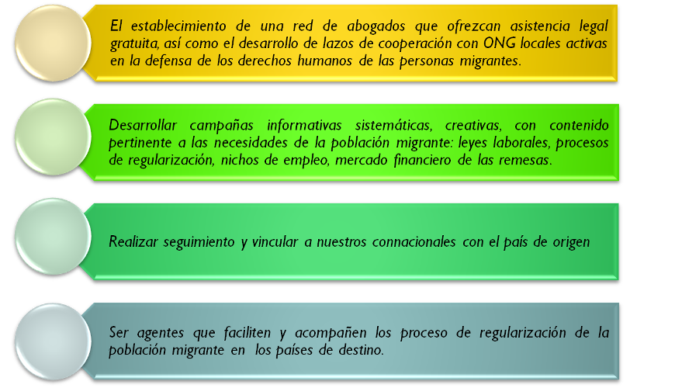
“Seminar/Workshop on Capacity-Building of Consular Authorities to Protect the Labour Rights of Migrants”
VI. Challenges in Protecting Migrant Workers:
Establishing a network of lawyers that provide free legal aid and developing cooperation links with local NGOs actively involved in protecting the human rights of migrants.
Developing systematic and creative information campaigns that include contents relating to the needs of migrant populations: labour legislation, regularization processes, employment opportunities, the financial market of remittances.
Implementing follow-up actions and establishing links between nationals abroad and their country of origin.
Facilitating and accompanying the regularization process of migrant populations in countries of destination.

Slide 10
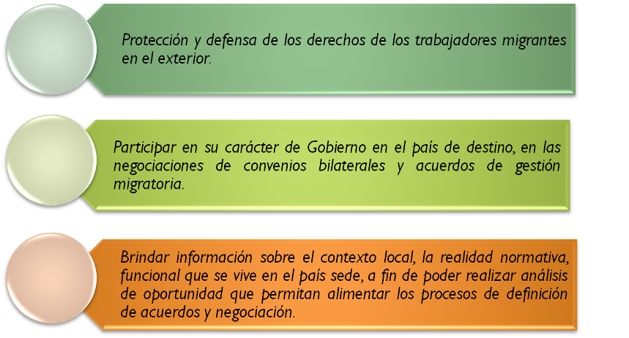
“Seminar/Workshop on Capacity-Building of Consular Authorities to Protect the Labour Rights of Migrants”
VI. Challenges in Protecting Migrant Workers:
Protecting the rights of migrant workers abroad.
Participating, as a government, in negotiations about bilateral agreements and migration management agreements in the country of destination.
Providing information about the local context, and functional norms in the host country, with the aim of conducting an opportunity analysis to enrich processes to establish agreements and negotiate.

Slide 11
“Seminar/Workshop on Capacity-Building of Consular Authorities to Protect the Labour Rights of Migrants”
Specific Actions to Protect Migrant Workers
through their Consulates
To initiate a process of reflection and awareness-raising in regard to the phenomenon of migration and its specific manifestation through migrant workers, identifying urgent demands of this population addressed by consulates.
To train consular officers on protection of migrant workers and domestic legislation in countries of destination.
To develop manuals or guidelines for action on protection of migrant workers, including the topic of trafficking in persons for exploitation purposes, as tools for consular officers.

Slide 12
Thank you!!!
General Consular Directorate
Ministry of Foreign Affairs of Nicaragua
De donde fue el cine González 1 cuadra al Sur, sobre Avenida Bolívar, Managua
Tel: (505) 2244 8066

