Slide 1


Nicaragua
Advances in Consular Protection
Liaison Officer Network for Consular Protection
XIX Regional Conference on Migration
June 24, 2014

Slide 2
CAPACITY-BUILDING FOR CONSULAR MANAGEMENT
Directorate of Migration Affairs
To promote and consolidate efforts implemented at a national level and by our consulates to establish policies, programmes and projects oriented toward managing migration flows in an orderly manner and with full respect for the human rights of migrants, viewing migration as a development factor for involved countries.
To help address new challenges and paradigms relating to the consular role, such as PROTECTION OF THE RIGHTS OF MIGRANT WORKERS AND MEMBERS OF THEIR FAMILIES.

Slide 3
CAPACITY-BUILDING FOR CONSULAR MANAGEMENT
Appointment of Consuls
General Consuls – Spain, Ecuador, Bolivia and Kuwait
First Consul – Miami and Panama
Vice-Consul – Tapachula

Slide 4
CAPACITY-BUILDING FOR CONSULAR MANAGEMENT
Virtual Diploma Programme:
Developed as one of the primary actions of a project for protection of the rights of Nicaraguan migrants in Spain. 12 consular officers have been trained on protection and human rights.

Slide 5
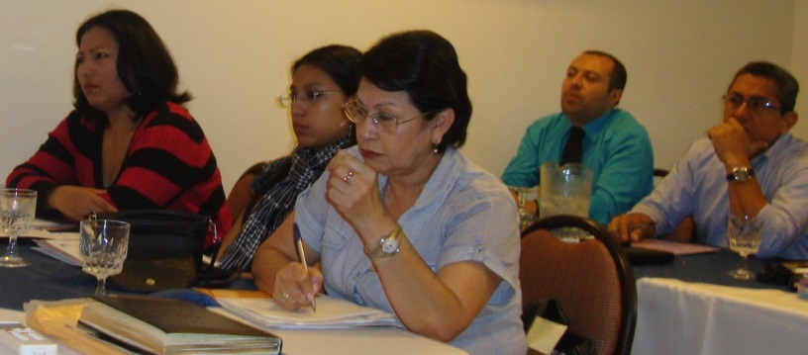
CAPACITY-BUILDING FOR CONSULAR MANAGEMENT
Consular Protection and Labour Migration with a Gender Approach:
Workshops: Three workshops were held in Costa Rica y Panama for our consular officers. The following institutions participated: Immigration, Ministry of Labour, Social Security, ILO and IOM.

Slide 6
CAPACITY-BUILDING FOR CONSULAR MANAGEMENT
Online training for consuls accredited in the US on the Deferred Action for Childhood Arrivals (DACA) process.
Training on the CONSULNIC consular management system.
- Improved administrative management, timely management of services, and lower costs.

Slide 7
ADVANCES IN THE STRATEGY FOR THE PROTECTION OF MIGRANTS
Implementing consular registration at our consular offices abroad (First Quarter 2014).
Expanding the issuance of the Consular Registration Card (Costa Rica, El Salvador, Panama, Houston, Los Angeles, Miami, Spain and most recently, Guatemala – May 27, 2014).
Actions to position the Consular Registration Card before relevant authorities in countries of destination of Nicaraguan migrants.

Slide 8
CONSULAR REGISTRATION CARD

Slide 9
ADVANCES IN THE STRATEGY FOR THE PROTECTION OF MIGRANTS
Ensuring the issuance of identity documents for regularization processes of Nicaraguan nationals.
Birth certificate and certificate of good conduct
Ordinary passports and/or temporary passports
Consular Registration Card
Replacing Nicaraguan driver’s licences with Spanish driver’s licences.

Slide 10
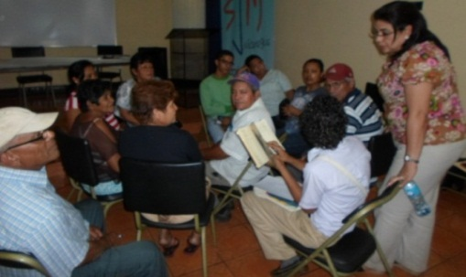
ESTABLISHMENT OF
STRATEGIC ALLIANCES TO STRENGTHEN CONSULAR MANAGEMENT
Comité Intersindical de Atención al Migrante (Committee of Trade Unions for Assistance to Migrants)
Servicio Jesuita para Migrantes – SJM (Jesuit Service for Migrants of Nicaragua)
Municipal Registers and Central Civil Status and Registration Office
Mexican Coalition in New York

Slide 11
THANK YOU

