Slide 1
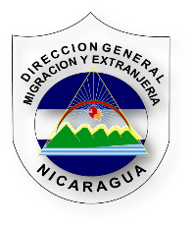
XX Vice-Ministerial Meeting of the
Regional Conference on Migration (RCM)
Integration, Return and Social and Productive Reintegration of Migrants
General Directorate of Migration and Immigration
Nicaragua

Slide 2
Introduction
Good afternoon, Vice-Ministers, Heads of Delegation, President pro tempore of RCM, Technical Secretariat.
We are commemorating 20 years of working for the benefit of regional and extra-regional migrants. As a result of this effort, our countries have taken on new regulations, laws, agreements, recommended public policies and a new approach to the phenomenon of migration. Today, migrants are considered to be a source of development, generators of material and intellectual wealth, proving throughout history that each one of our countries is the result of cultural diversity inherited through migration.
Nicaragua, due to its economic conditions and geographic position, is primarily a country of origin and transit of regional and extra-regional migrants.

Slide 3
Since 2007, our Government of Reconciliation and National Unity, headed by Commander Daniel Ortega, has developed and designed policies under the guidelines of the National Plan for Human Development (PNDH), with programmes focused on a Christian, socialist and supportive model, achieving sustainable growth of more than four digits and a level of citizen security that places us in a privileged position in Latin America.
The decrease of more than 3% in the flow of Nicaraguan migrants is an indicator of better economic and social conditions for Nicaraguans, who find reintegration options in the country through social and economic programmes promoted by the Government of Nicaragua.

Slide 4
Our economic model is supportive, and our public policies and practices are based on the reality of Nicaraguan families – their needs, aspirations and current situation.
This structural solidarity encompasses all families; victims of natural disasters; persons in difficult situations; women; young people; indigenous and afro-descendant populations; disabled persons; etc.
The only way to transform Nicaragua is by transforming Nicaraguans, through the following programmes:

Slide 5
In 2007-2011, more than 500,000 persons were taught to read and write.
More than100,000 peasant women benefited from a programme entitled “Hambre Cero” (zero hunger) and more than 123,000 female entrepreneurs of small businesses in the city benefited from a programme entitled “Usura Cero” (zero usury). In addition, economic development programmes such as “Bono Productivo” (productive parcel), promoting agricultural cooperatives, credit and agricultural inputs, have been implemented.
1,100,000 persons, the majority of whom are young people and women, actively participate each year in supporting social programmes such as vaccination campaigns, cleaning campaigns, literacy and post-literacy programmes, reforestation, a programme entitled “Amor y Amor” (love and love) for younger children, “Operación Milagro” (operation miracle), building and improving homes of poor people, educational and sports centres, etc.

Slide 6
Young people play a leading role in the implementation of projects: assistance to children, indigenous and afro-descendant populations; legal titles for more than 300,00 properties for women; demarcation and titling of community land at the Caribbean coast; and the right to credit for small manufacturers, farmers and craftsmen.
The human and constitutional right to free and universal health care and education has been restored (Articles105 & 121 of the Political Constitution of the Republic, respectively).
Free health care for all citizens in hospitals and health centres, including lab tests with high tech equipment. Dozens of hospitals and health centres have been renovated throughout the country and new ones have been built, mainly in inland areas where people had never before had access to health care.

Slide 7
In Nicaragua, school meals are a programme intended to restore one of the rights of Nicaraguan children, benefiting all schools located in the 153 municipalities of Nicaraguan territory.
Enlarging facilities to better serve pregnant Nicaraguan women and women about to give birth, through the construction and rebuilding of maternal/child centres throughout the national territory.
To think of development in Nicaragua necessarily involves to envision education for young people and adults, from a fresh perspective and with the commitment required by the new century, the fight against poverty and the challenges related to globalization. Therefore, the Nicaraguan Government promotes programmes for free education of young people and adults: comprehensive education, science and technology, language training and higher education.

Slide 8
A new legal order, with the passing of more than 300 bills, in order to establish a modern and dynamic State, in accordance with international standards; typifying and punishing the crimes that have arisen from social contradictions; Law against Trafficking in Persons, No. 896; Migration and Immigration Law, No. 761; Legal System for Border Management, No. 749; Sovereign Security, No. 750; Comprehensive Law on Violence Against Women, No. 779; and Family Code, No. 870.
A citizen security model headed by the National Police Force, with participation of families and communities; a preventive, proactive and community-based model.

Slide 9
Results from the Implementation of Act No. 896, Law Against Trafficking in Persons, 2015
10 cases prosecuted for trafficking in persons
55 victims rescued (44 women and 11 men)
5 cases convicted
5 legal proceedings with preventive detention
16 cases prosecuted for migrant smuggling
10 with a conviction
35 adults
20 persons under18 years of age
36 related persons detained
6 undergoing legal proceedings
44 related persons detained
118 migrants rescued, from Cuba, Ecuador, El Salvador, Asia and Africa

Slide 10
Assistance for Returned Migrants
The General Directorate of Migration and Immigration, in coordination with the Ministry of Foreign Affairs, implements efforts to receive Nicaraguans repatriated from Mexico and the United States through El Guasaule border post and Augusto C. Sandino International Airport, respectively.
Upon returning, Nicaraguans are pleased with the treatment they receive from Nicaraguan authorities. The majority of them are glad to be back and send messages through the media warning others to avoid the risks associated to migration and to seek alternatives in our country, enjoying security and tranquillity without the risks of threat, violence and death that they faced during migration.
Upon their return, they are not subject to discrimination and integrate into the various social projects promoted by the government in their communities.

Slide 11
Nicaraguans abroad keep in touch with their families, maintain their idiosyncrasy, are responsible and avoid breaking the law. They have proven this in Costa Rica, as the primary country of destination. Thank you, our Costa Rican brothers and sisters, if you recognize our migrants as a source of productivity and development.
We will continue implementing policies on regularization of regional and extra-continental migrants, guaranteeing the lives and human rights of migrants. We are a country with limited financial resources, but we are working to grow and provide new and better opportunities. Our doors are open to our brothers and sisters seeking refuge. We have done this in the past, when we were victims of cruel wars; and today, we have statistics about nationals from neighbouring countries seeking refuge, fleeing from violence.
Thanks to the members and international, regional and Central American organizations such as RCM, IOM, OCAM, regional observers, for promoting initiatives to protect our migrants, who seek options that are currently being developed in our country. Our goal is to be able – in the not too distant future – to manage our own resources, with appropriate distribution of wealth, where all productive, political and social forces converge and it is not necessary to migrate to be able to survive.

Slide 12
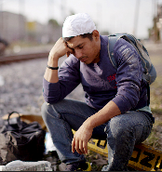
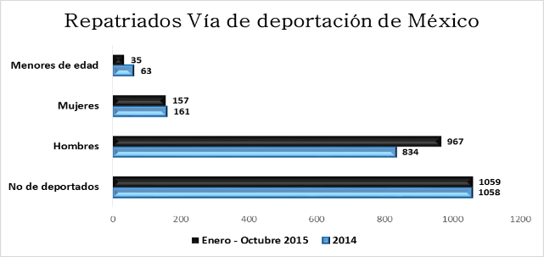
At the national level, our statistics show an increase of 0.09% for Nicaraguan migrants returned from Mexico in 2015 so far, compared to 2014.
Year | Number of Deported Persons | Men | Women | Children and Adolescents
2014 | 1058 | 834 | 161 | 63
January-October 2015 | 1059 | 967 | 157 | 35

Slide 13
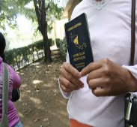
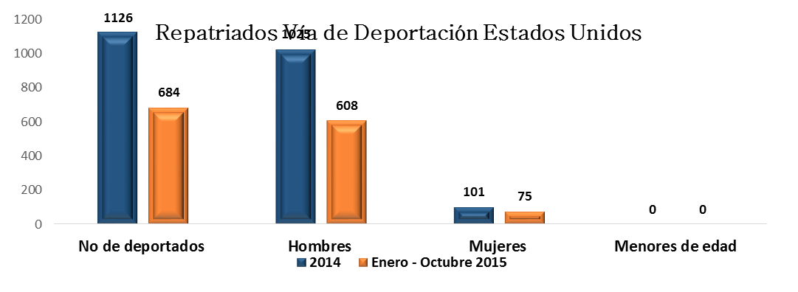
Furthermore, statistics show a decrease of 64.61% for Nicaraguan migrants returned from the United States in 2015 so far, compared to 2014.
Year | Number of Deported Persons | Men | Women | Children and Adolescents
2014 | 1126 | 1025 | 101 | 0
January-October 2015 | 684 | 608 | 75 | 0

Slide 14
THANK YOU

