Slide 1

COMBATING ORGANIZED CRIME
IN CENTRAL AMERICA
REGIONAL COALITION
AGAINST TRAFFICKING
IN PERSONS

Slide 2
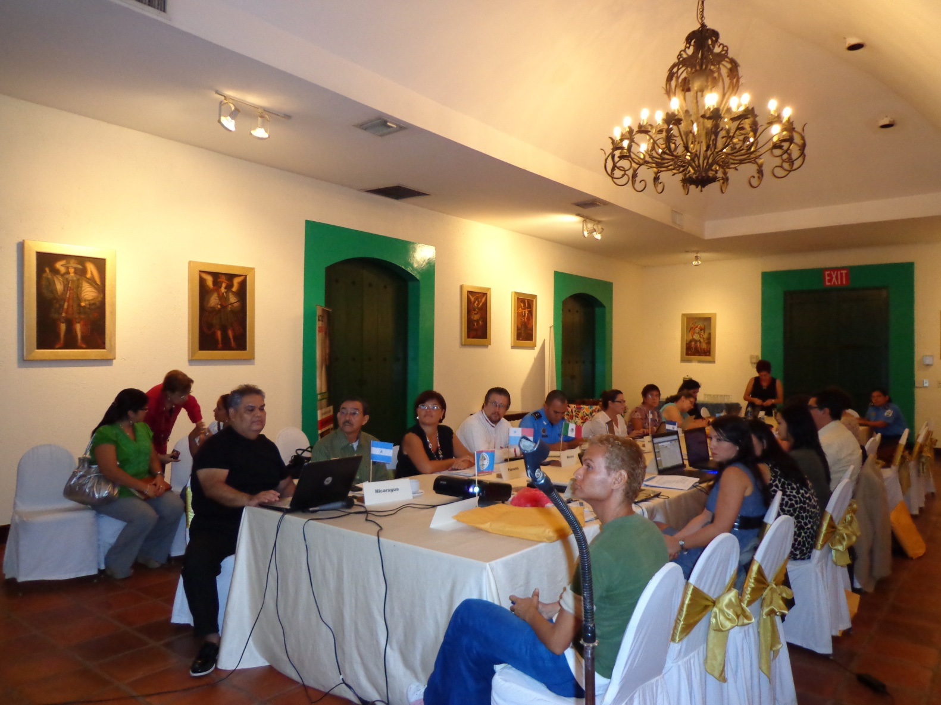
LEON VIRREINAL, JULY- 2012

Slide 3
MIGRANT SMUGGLING AND TRAFFICKING
“With the signing of the United Nations Convention against Transnational Organized Crime in Palermo, Italy, in December 2000, the international community demonstrated the political will to answer a global challenge with a global response. If crime crosses borders, so must law enforcement. If the rule of law is undermined not only in one country, but in many, then those who defend it cannot limit themselves to purely national means. If the enemies of progress and human rights seek to exploit the openness and opportunities of globalization for their purposes, then we must exploit those very same factors to defend human rights and defeat the forces of crime, corruption and trafficking in human beings.”
Kofi A. Annan
UN Secretary-General

Slide 4
MIGRANT SMUGGLING AND TRAFFICKING
Protocol against the Smuggling of Migrants by Land, Sea, and Air, supplementing the United Nations Convention Against Transnational Organized Crime
Article 2. Statement of purpose
The purpose of this Protocol is to prevent and combat the smuggling of migrants, as well as to promote cooperation among States Parties to that end, while protecting the rights of smuggled migrants.
• To effectively prevent and combat migrant smuggling;
• International cooperation and information exchange;
• The need to provide migrants with humane treatment and full protection of their rights.

Slide 5
MIGRANT SMUGGLING AND TRAFFICKING
Protocol to Prevent, Suppress, and Punish Trafficking in Persons, especially Women and Children, supplementing the United Nations Convention against Transnational Organized Crime
Purpose:
To prevent and combat trafficking in persons, with a special focus on women and children;
To protect and help victims of trafficking, with full respect for their human rights; and
To promote cooperation between States Parties to achieve these purposes, with a special focus on women and children.

Slide 6
“Law enforcement, immigration or other relevant authorities of States Parties shall, as appropriate, cooperate with one another by exchanging information, in accordance with their domestic law…”.
“States Parties shall provide or strengthen training for law enforcement, immigration and other relevant officials in the prevention of trafficking in persons. The training should focus on methods used in preventing such trafficking, prosecuting the traffickers and protecting the rights of the victims, including protecting the victims from the traffickers. The training should also take into account the need to consider human rights and child- and gender-sensitive issues and it should encourage cooperation with non-governmental organizations, other relevant organizations and other elements of civil society”.

Slide 7
The Sphere of Implementation of the Palermo Protocol
“This Protocol shall apply, except as otherwise stated herein, to the prevention, investigation and prosecution of the offences established in accordance with article 5 of this Protocol, where those offences are transnational in nature and involve an organized criminal group, as well as to the protection of victims of such offences”.

Slide 8
The General Situation of Migrant Smuggling and Trafficking
According to the study of the United Nations Office against Drugs and Crime named “Globalization of Crime…”, published in Vienna in 2010, approximately 3 million Latin American migrants are victims of migrant smuggling through the southern border of the United States each year. The same source estimates that revenues from migrant smuggling are 6.6 billion dollars annually.

Slide 9
RESPONSES BY COUNTRY
GUATEMALA
Advances are being made in strengthening the system to prosecute and punish the crime of trafficking in persons;
It is expected that a special unit in the prosecutor’s office, a magistrates’ court, and a trial court will be in place in late September to implement the SVET Law;
The issue of sexual tourism is being addressed together with tour operators and the Chamber of Tourism in the country.

Slide 10
RESPONSES BY COUNTRY
El Salvador
Significant changes have been made in regard to institutional responses to address the crime of trafficking in persons;
The President of the Republic signed a government decree to establish a National Council composed of representatives from 7 institutions as the political coordinating and executing body.

Slide 11
RESPONSES BY COUNTRY
Panama
The Law against Trafficking in Persons was passed this year. The Law establishes a National Committee. The Committee is developing a national policy against trafficking in persons.

Slide 12
RESPONSES BY COUNTRY
Costa Rica
National Coalition against Migrant Smuggling and Trafficking in Persons, with participation of 27 institutions (meetings);
A bill developed by consensus, to be approved by the Legislative Assembly;
Immediate Response Teams have assisted 80 victims and actions have been coordinated to restore their rights.

Slide 13
RESPONSES BY COUNTRY
Honduras
The bill of the Law against Trafficking in Persons was approved by National Congress on April 25, 2012;
Inter-institutional Committee against Commercial Sexual Exploitation and Trafficking in Persons;
The Law will enable registering victims and reintegrating them into their families and communities;
Immediate Response Team (inter-institutional);
Establishment of an emergency line to report the crime.

Slide 14
RESPONSES BY COUNTRY
Nicaragua
PREVENTION: 17 departmental boards of the National Committee against Trafficking in Persons (CNCTP);
Awareness-raising and training of 22.000 members of CNCTP – EVERYONE!!!
Institutionalizing Geographic and Social Mapping;
77 victims have been assisted (2011-2012) and 10 survivors have been reintegrated into society;
8 sentences thus far in 2012;
Acts 735 & 779;
Audio-visual material: “CONTRACORRIENTE” (Crosscurrent).

Slide 15
ADVANCES IN JOINT RESPONSES:
Trafficking in Persons
National Guidelines;
Regional Guidelines to Combat the Crime of Trafficking in Persons in Central America;
A regional strategy for comprehensive assistance to and accompaniment of victims;
Operational Programme of the Regional Action Framework;
A communications strategy in 5 countries;
A Memo of Understanding;
Establishment of the Regional Coalition against Trafficking in Persons.

Slide 16
ADVANCES IN JOINT RESPONSES:
Migrant Smuggling
Regional guidelines for the preliminary identification of profiles and referral mechanisms for migrant populations in vulnerable situations:
Nicaragua;
Honduras;
El Salvador;
Costa Rica.

Slide 17
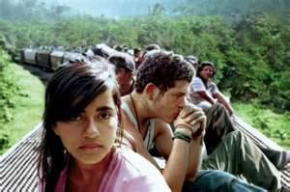
ADVANCES IN JOINT RESPONSES:
Migrant Smuggling
A proposal of guidelines for the development of a regional strategy to address the issue of irregular Cuban nationals in transit.

Slide 18
Challenges and Recommendations
    To promote actions that enable the prevention and punishment of migrant smuggling and trafficking, in accordance with international agreements signed by Costa Rica;
    To prevent, through the legal system, the risks of associating security exclusively to the phenomenon of migration;
    The importance of a balance between control and integration – to determine if immigration control respecting human rights is possible;
    To establish administrative actions respecting human dignity and to consider alternatives to detention.

Slide 19
Challenges and Recommendations
To reaffirm the commitment to international human rights regulations;
To respect the principle of non-refoulement;
To train border officials on human rights;
To establish coordinated efforts for the expedited and orderly return of migrants;
To request cooperation from relevant organizations;
Schemes to support countries in the region;
Shared responsibility between States (origin, transit, and destination).

Slide 20
National Coalition against Trafficking in Persons,
Nicaragua
Tel. 505-2222-3968
www.migob.gob
Management of Migrant Smuggling and Trafficking
Tel: 2290-2814, 2299-8043
Fax: 2290-2789
trataytrafico@migracion.go.cr

Slide 21
Regional Coalition against Trafficking in Persons
Coordinated by: Nicaragua
Executive Secretary: Costa Rica
Member: Guatemala

Slide 22
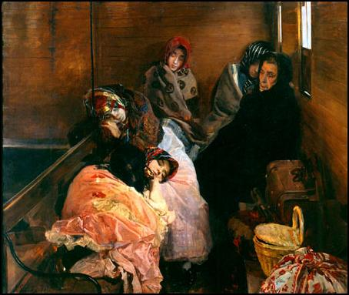
THANK YOU

