Slide 1


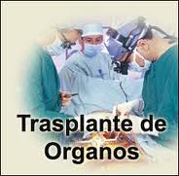
ACT NO. 847
LAW ON DONATION AND TRANSPLANT OF HUMAN ORGANS, TISSUES AND CELLS
NICARAGUA

Slide 2
Article 1. Objective of the Law
The objective of the Law is to establish provisions to regulate the donation and keeping and removal of organs, tissues and cells of living persons or human corpses to be transplanted for therapeutic or teaching purposes and for research on human beings.
Article 2. Authority and Implementation Sphere
This Law is of public order and social interest and the Ministry of Health is the guiding institution for the implementation of this Law, its Bylaws and the provisions established by this institution to this end.
Altruism
Absence of profit
Confidentiality
Ethics
Voluntary
Free of charge
Social integration
Solidarity
Non-Discrimination
Integrity
Art. 3 Guiding Principles

Slide 3


Article 5. Conditions for Determining the Need for a Transplant
Transplantation procedures may only be practiced on Nicaraguans or foreign nationals with permanent resident status that have lived in the country for a minimum of five years, once the usual preventative therapeutic methods have been exhausted and the person can only improve his or her quality of life through a transplant. These practices should be determined through rules, guidelines and protocols approved by the Ministry of Health to this end.
Article 6. Certification and Authorization
The transplant of organs, tissues and cells shall only be performed in public or private health facilities by registered health professionals certified and authorized for such task by the Ministry of Health. Autologous transplants shall be performed in health facilities certified and authorized by the Ministry of Health, in accordance with regulations established to this end.

Slide 4

Article 7. Prohibition of Smuggling and Commercialization
Smuggling and commercializing organs, tissues and cells is prohibited. Natural or legal persons that participate in the removal or transplant of organs under such conditions and persons that give and receive financial compensation for donating and receiving shall be punished in accordance with this Law and Act No. 641, “Penal Code of the Republic of Nicaragua”.
Article 9. Consent by a Living Donor
A living person can express his or her will to donate organs, tissues and cells through any written means, including a testament, with due notification to the family. The act of donating organs, tissues and cells by living persons may always be revoked until the moment of the surgical intervention.

Slide 5

Article 26. Registration and Accreditation
The transplant of organs, tissues and cells may only be performed by health professionals that are duly registered at the Ministry of Health for this purpose, in accordance with the provisions of Act No. 423, General Health Act, published in the official newspaper “La Gaceta” No. 91 on May 17, 2002 and accredited by the National Committee for Donation and Transplant of Organs, Tissues and Cells, in accordance with this Law and its Bylaws.

Slide 6
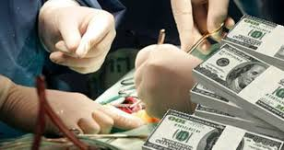
Article 61. Reform to Act No. 641:
Article 346. Smuggling, removal, keeping, transfer and transplant of human organs, tissues and cells
Any person who, without the appropriate authorization or based on economic interest, favours or benefits, imports, exports, transfers, removes, transplants, keeps or has in his or her power organs, tissues and cells of him or herself or of another person, whether living or deceased, shall be punished with five to ten years imprisonment and special disqualification for the same period from practising the profession, trade or activity related to the behaviour.
The publication, announcement or offer through any means to engage in any of the behaviours established in this Article shall be punished with a maximum punishment equivalent to the minimum punishment for such crimes and a minimum punishment of half of the punishment for such crimes.

Slide 7

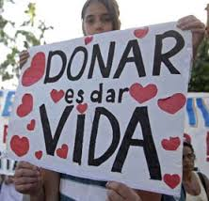
Thank you

