Slide 1


Regional Conference on Migration (RCM)
NICARAGUA
PRESIDENT PRO-TEMPORE 2014
“For a region free of trafficking in persons”
Thursday, June 26, 2014

Slide 2
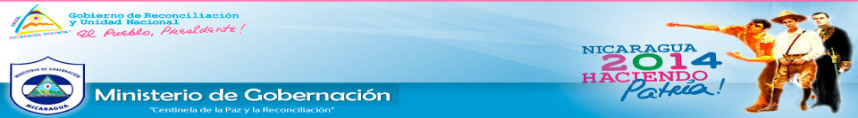

A GOVERNMENT PRIORITY
Trafficking in persons is a crime and a human rights violation that is perpetrated in almost every country in the region. Trafficking in persons involves exploitation of victims, usually through forced labour or commercial sexual activity by a criminal organization or “trafficker”.
Trafficking in persons is the theme of the public agenda of the Government of Reconciliation and National Unity and a priority task in the Strategic Plan of the Ministry of the Interior.

Slide 3












NATIONAL COALITION AGAINST TRAFFICKING IN PERSONS
The National Coalition Against Trafficking in Persons (CNCTP) was established in 2004, coordinated by the Ministry of the Interior, with the objective of identifying, preventing, protecting and rehabilitating victims and effectively punishing the perpetrators of this crime.
Ministries and
State Institutions
Civil Society
Organizations

Slide 4
COUNTRY EXPERIENCE
CAPACITY-BUILDING
The National Coalition Against Trafficking in Persons (CNCTP) meets every 2 months (6 times a year).
CNCTP includes the following working committees:
Capacity-building;
Awareness-raising and training;
Prosecution of the crime;
Assistance and reintegration of victims of trafficking;
Communication;
Departmental Committees of the National Coalition.
Chairs the Board of the Regional Coalition Against Trafficking in Persons;
Participates in in the Global Committee Against Trafficking in Persons chaired by His Holiness Francis I.

Slide 5




TRAINING AND AWARENESS-RAISING
Validation, printing materials and training on the “Protocol for the Repatriation of Boys, Girls and Adolescents Victims of Trafficking”
Training for all members of CNCTP
22,000 Nicaraguans made aware and willing to combat the crime
2007: “Abre tus ojos
2008-2009“ prevention campaigns under the Agreement Against Violence and Trafficking in Persons, SCH/AECID
2011: Regional Campaign Against Labour Trafficking, together with IOM
2012-2013: “Alerta y Pilas Puestas” regional campaign against commercial sexual exploitation – Meeting Points
2013: “Los Caminos de la Vida” regional campaign, ECPAT – IADB – CR
2014: “Juega por la Vida” global campaign, Vatican City

Slide 6
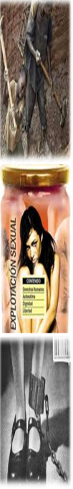


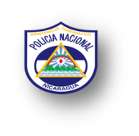


Prosecution of the Crime
In 2007-2013, 127 cases of trafficking in persons and 229 persons were investigated, 87 charges submitted, 69 judgments issued.
279 victims were rescued, including 251 women and 28 men.
Establishment of the Police System to Combat and Address Trafficking in Persons.
Coordinating efforts with 17 Departmental Committees Against Trafficking in Persons.
National Days to review cases for prosecution.

Slide 7

Prosecution of the Crime
REGIONAL POLICE INTERVENTIONS:
Five regional interventions against trafficking in persons were implemented in 2010-2013, led by the Unit Against Trafficking of the National Police Force of Nicaragua and coordinated by the INTERPOL Regional Office and the Commission of Heads and Directors of Police Forces of Mexico, Central America, the Caribbean and Colombia:
PACTO I
PACTO II
PACTO III
LIBERTAD
LIBERTAD II
A meeting of Heads of Police Forces on Trafficking in Persons in the Region is currently been held in El Salvador to plan the upcoming regional intervention against trafficking in persons.

Slide 8
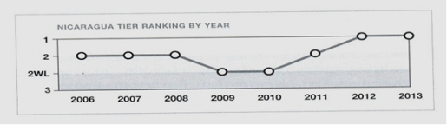
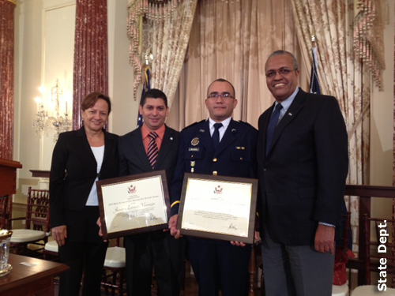
Prosecution of the Crime
According to the State Reports for 2012, 2013 and 2014, Nicaragua is the only Central American country that fully complies with the minimum standards for eradication of trafficking in persons.
Therefore, the Department of State recognized the work of the following State institutions: the Public Prosecutor’s Office and the National Police Force, recognizing two civil servants as “HEROES ACTING TO END MODERN-DAY SLAVERY” in 2013.

Slide 9
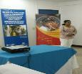
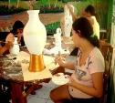
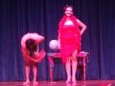
ASSISTANCE – REINTEGRATION – DISSEMINATION
Assistance to Victims
A shelter for victims of trafficking is in place at “Comisarías de la Mujer”;
Strengthening Línea 133 Information and Guidance Centre (Ministry of Family, Adolescents and Children – MIFAN).
Reintegration
10 adult victims have been reintegrated after working hard for 4 years to overcome physical and psychological consequences.
Communication and Dissemination
2 soap operas: “Loma Verde” and “Contracorriente”;
15 theatre shows in different locations in the country.

Slide 10

[REGIONAL COALITION AGAINST TRAFFICKING IN PERSONS]
Two meetings of CNCTP: Nicaragua and Panama
Exchanging BEST PRACTICES: Mexico, Ecuador, Salvador, San Andrés, Paraguay
Regional Guidelines to combat the crime in the region
Regional Strategy for Assistance to Victims
Regional Protocol for Geographical and Social Mapping in the Region
Regional Study on the Situation of Trafficking in Persons in the Region
Regional Communication Strategy – Regional Campaign
A Central American Agreement was developed together with CCJ to combat commercial sexual exploitation and trafficking in persons

Slide 11
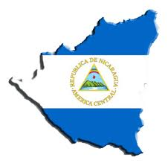
A Special Bill of Nicaragua:
GENERAL STRUCTURE: VIII chapters with 55 articles.
I. ON GENERAL PROVISIONS
II. ON INSTITUTIONS TO COMBAT TRAFFICKING IN PERSONS
VIII. ON TEMPORARY AND FINAL PROVISIONS
VII. Reforms to TITLE II, CRIMES AGAINST LIBERTY
III. ON THE RIGHTS OF THE VICTIMS
IV. ON THE RIGHTS OF FOREIGN VICTIMS IN NATIONAL TERRITORY
VI. ON PROCEDURAL PROVISIONS
ON RESTORING RIGHTS

Slide 12

Objective of the Law:
The objective of this Law is to prevent, investigate, prosecute and punish the crime of trafficking in persons and related crimes and to provide assistance and protection to victims, witnesses and other persons related to the investigation and criminal proceedings.
In addition, the Law establishes specific effective mechanisms to safeguard, protect and restore the right to dignity, liberty, integrity and security of each person as well as the free development of each person, especially boys, girls and adolescents and women in vulnerable situations.
This Law is of public order and shall be applied to perpetrators of the crime of trafficking in persons and related crimes at an internal or external level.
Implementation Sphere:

Slide 13


Interest of the State:
Recognizes individuals, families and communities as the beginning and end of its activity and is structured in order to ensure the common good, taking on the task of promoting the human development of each and every Nicaraguan national based on Christian values; solidary, democratic and humanistic practices; and universal and general values.
Recognizes that every person has the right to respect for his or her physical, psychological and moral integrity; that no one should be subjected to torture, procedures, punishment or cruel, inhuman or degrading treatment; that infringing this right is a crime and is punished by law; and particularly, that no one should be subjected to servitude, slavery and any mode of trafficking, which are prohibited in all their forms and manifestations.

Slide 14
Thank you
“We should unite, not to be together but to act together...”

