Slide 1


BEST PRACTICE
IN PREVENTION AND ASSISTANCE TO UNACCOMPANIED MIGRANTA BOYS, GIRLS AND ADOLESCENTS
NATIONAL SYSTEM FOR INTEGRAL FAMILY DEVELOPMENT
.
Second Meeting of the Ad Hoc Group on Migrant Boys, Girls and Adolescents
April 15-16, 2015

Slide 2
Protocol for the Assistance to Unaccompanied or Separated Migrant Boys, Girls and Adolescents in Shelters
Inter-institutional Board on Unaccompanied Migrant Boys, Girls and Adolescents

Slide 3
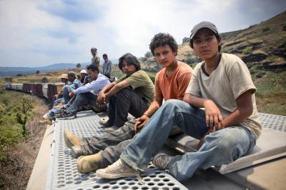
Inter-institutional Board on Unaccompanied Migrant Boys, Girls and Adolescents

Slide 4
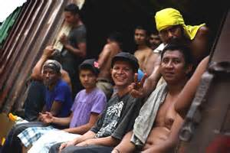
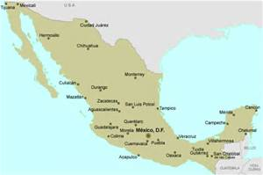
General Objective
To strengthen inter-institutional coordination in order to exchange information and develop actions and mechanisms that enable ensuring the rights and protection of unaccompanied migrant boys, girls and adolescents in national territory and restoring their rights.

Slide 5
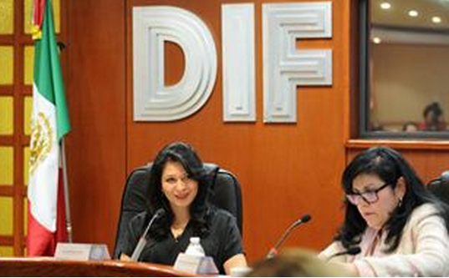
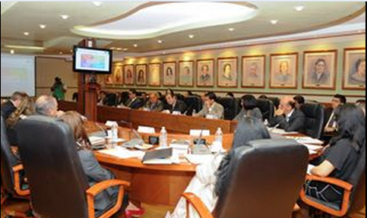
Reactivation of the Board and its Technical Team
June 11, 2014:
Reactivation of the Board.
July 245, 2014:
Efforts of the Technical Team of the Board were initiated.

Slide 6
Members of the Board
Secretariat of Communications and Transport
Secretariat of Social Development
Secretariat of Public Education
Secretariat of the Interior
Secretariat of Foreign Affairs
Secretariat of Health
Secretariat of Labour and Social Welfare
National System for Integral Family Development (DIF)
National Public Prosecutor's Office
National Women’s Institute
Special Prosecutor's Office on Violent Crime against Women and Human Trafficking
Social Security Institute of Mexico
National Institute of Migration
National Coordinator of State Agencies for Migrant Affairs (CONOFAM)
National Human Rights Commission
Youth Integration Centres
International Committee of the Red Cross (ICRC)
Appleseed - Mexico
Centro de Derechos Humanos Fray Matías de Córdova, A. C.
International Detention Coalition
World Vision Mexico
United Nations High Commissioner for Human Rights (UNHCR)
United Nations Children’s Fund (UNICEF)
International Organization for Migration (IOM)
Mexican Commission to Assist Refugees (COMAR)

Slide 7
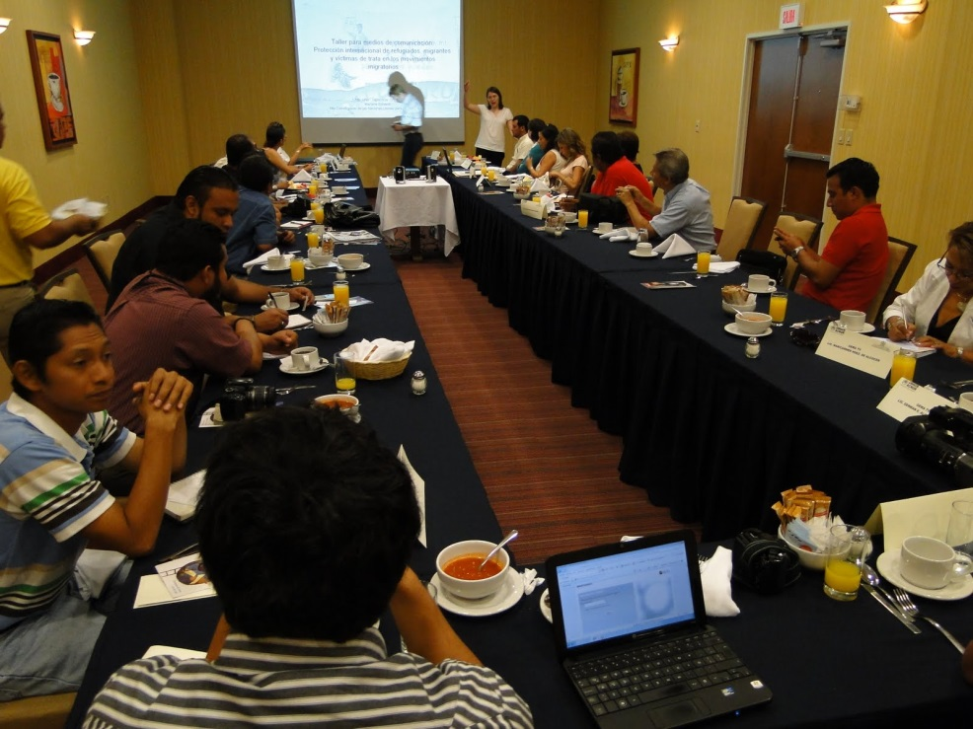
Training staff from shelters providing assistance to unaccompanied migrant boys, girls and adolescents
Actions of the Board
Tapachula, Chiapas, July 22-23, 2014
The training was developed and implemented by the National System for Integral Family Development (DIF) and the Office of the United Nations High Commissioner for Refugees (UNHCR).

Slide 8
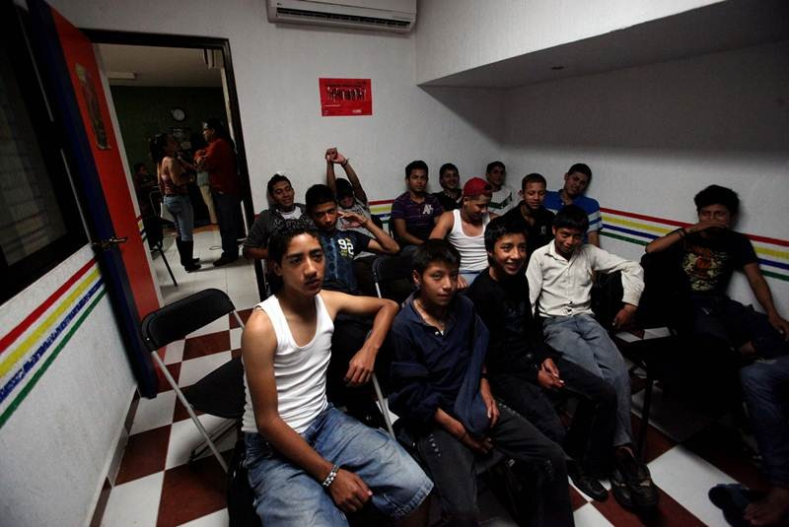
Actions of the Board
Developing a national directory of public and private shelters providing assistance to unaccompanied migrant boys, girls and adolescents
Jointly developed by the National System for Integral Family Development (DIF) and the National Institute of Migration.

Slide 9
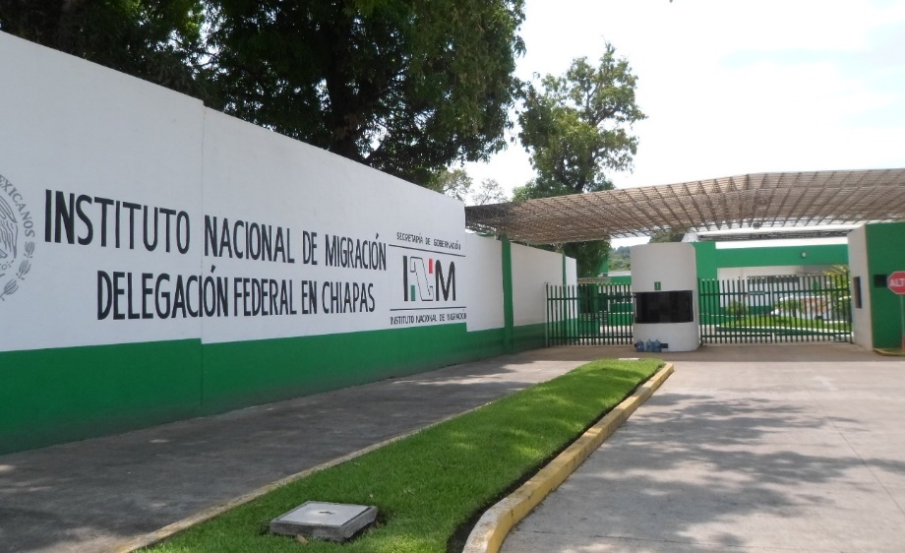
Actions of the Board
Strengthening consular assistance for unaccompanied migrant boys, girls and adolescents
The problems experienced with consuls at migration stations were analysed, as a joint effort of the National Institute of Migration and the Secretariat of Foreign Affairs.

Slide 10
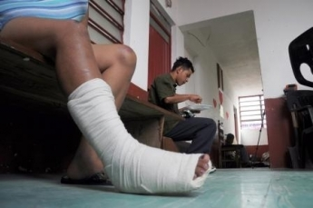
Actions of the Board
Health care for unaccompanied migrant boys, girls and adolescents
The Secretariat of Health is establishing a range of services in order to provide a scheme of vaccines and comprehensive assistance for pregnancy, addictions and access to insurance (Seguro Popular), among others.

Slide 11
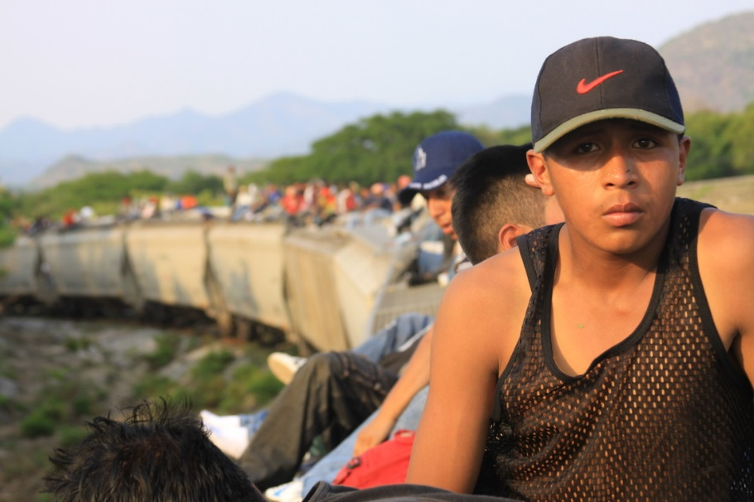
Actions of the Board
Education services for unaccompanied migrant boys, girls and adolescents
The Secretariat of Public Education, through its Directorate of Basic Education, is seeking to establish links to enable access to scholarships and identity documents for unaccompanied migrant boys, girls and adolescents – aliens as well as Mexicans.

Slide 12
Actions of the Board
Developing materials for migrant boys, girls and adolescents by INMUJERES

Slide 13
Actions of the Board
DIF and the National Institute of Migration and the Mexican Commission to Assist Refugees are jointly developing a proposal for an inter-institutional information system aimed at collecting accurate information about migrant boys, girls and adolescents.
Units and shelters providing assistance to unaccompanied migrant boys, girls and adolescents
YEAR | BOYS, GIRLS AND ADOLESCENTS
2013 | 21,109
2014 | 25,418

Slide 14
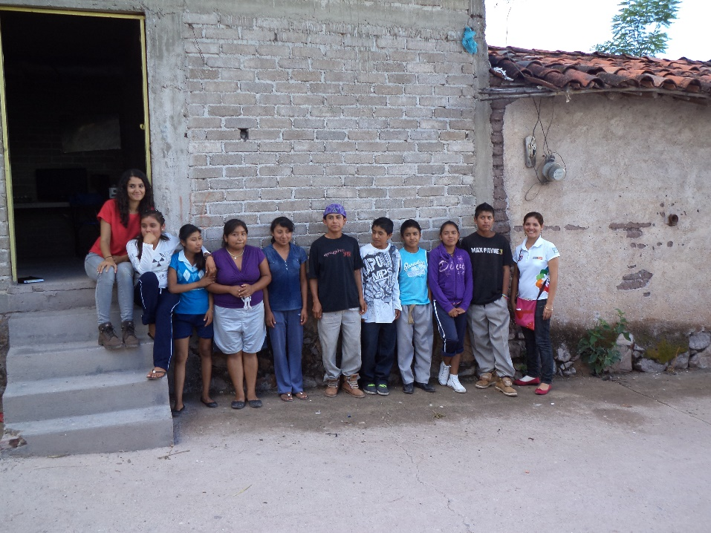
Protocol for the Assistance to Unaccompanied or Separated Migrant Boys, Girls and Adolescents in Shelters

Slide 15
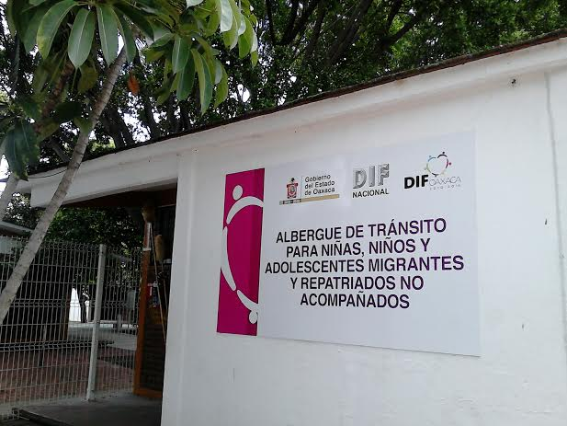
Objectives
To establish procedures for action to provide assistance to unaccompanied or separated migrant boys, girls and adolescents, and to establish a process for comprehensive assistance and promote the effective and informed participation of migrant boys, girls and adolescents that migrate by themselves or that have been separated from their families.
To identify, determine and understand the various characteristics of boys, girls or adolescents that migrate in order to provide differentiated assistance to each migrant boy, girl or adolescent.

Slide 16
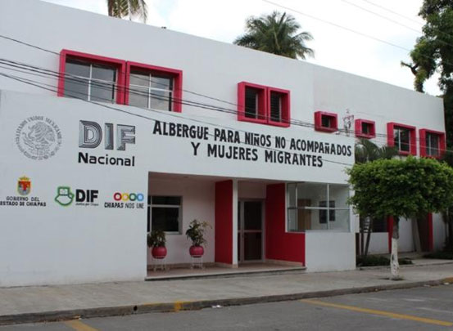
Objectives
To strengthen and homologate the criteria and the performance of staff working at shelters, considering the best interest of the child at all times for the boys, girls and adolescents that are under their care and protection in the units and shelters that implement the Protocol.
The assistance will be provided through the DIF and DIF DF state systems, the DIF municipal systems and civil society organizations.

Slide 17
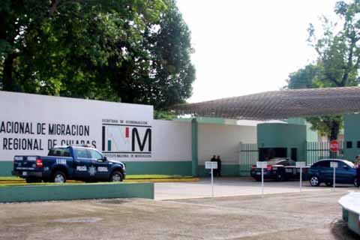
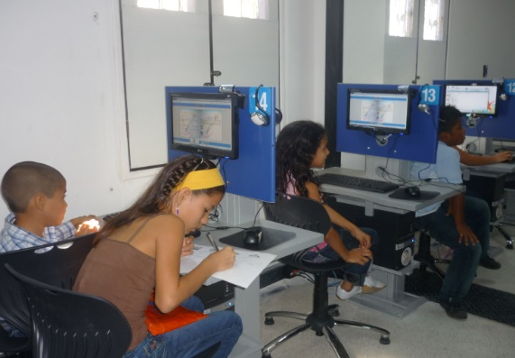
Guidelines
Assistance should be provided in a progressive manner, considering the medium and long term and strengthening the unaccompanied or separated migrant boys, girls and adolescents.

Slide 18
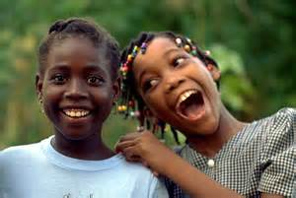
Evaluation Mechanism
The inclusion of a mechanism to assess the best interest of the child should be highlighted. The mechanism enables making informed decisions based on the best interest of each migrant boy, girl or adolescent.
Assessing the best interest of the child will be a constant for the entire duration of the stay of the boy, girl or adolescent in the unit or shelter providing care and protection.

Slide 19
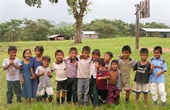
A Mechanism to Identify Migration Profiles
The Protocol establishes mechanisms to identify differentiated migration profiles that enable identifying and meeting the specific needs of each boy, girl or adolescent, ensuring the full enjoyment of his or her human rights.

Slide 20
Human Rights of Boys, Girls and Adolescents
This Protocol is based on the Convention on the Rights of the Child and the General Act on the Rights of Boys, Girls and Adolescents, considering the following principles and rights:
The best interest of the child;
Non-discrimination;
Life, survival and development;
Participation;
The right to an identity;
The right to substantive equality;
The right to due process, etc.

Slide 21
On-going efforts in matters of assistance, protection and restoration of the rights of unaccompanied migrant boys, girls and adolescents
Signing an agreement with the International Red Cross.
Signing an agreement with the National Population Council.

