Slide 1
Actions against Immigration and Labour Defrauders
GENERAL DIRECTORATE OF
PROTECTION FOR MEXICANS ABROAD
Guatemala City, Guatemala, December 2014
1

Slide 2
The Origin of Fraud
GENERAL DIRECTORATE OF
PROTECTION FOR MEXICANS ABROAD
Rumours: False Expectations (immigration reform, work visas available)
Lack of information: Lack of access to legal means and reliable information sources

Slide 3
What are the impacts?
GENERAL DIRECTORATE OF
PROTECTION FOR MEXICANS ABROAD
Property Damage
Damaging subsequent opportunities to gain access to real migration benefits

Slide 4
What actions have been taken?
GENERAL DIRECTORATE OF
PROTECTION FOR MEXICANS ABROAD
Information campaigns –
Use of social networks to counteract the shortage of resources, partnerships with NGOs
Establishing national information call centres
Access to free legal aid (guidance and advice)
Increasing governmental supervision in both countries

Slide 5
H2 Visa Labour Fraud – Red Flags
GENERAL DIRECTORATE OF
PROTECTION FOR MEXICANS ABROAD
Recruitment
Offering inexistent jobs
Charging excessive fees (indebtedness of workers)
Cases of trafficking in persons
How to create mechanisms to improve the supervision of a unilateral programme?

Slide 6
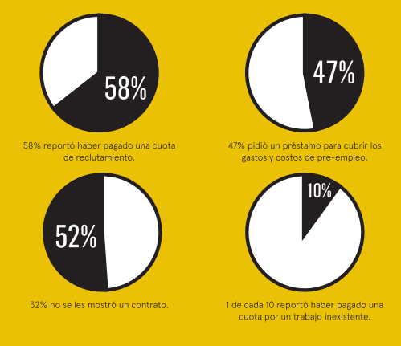
Principal abuses during recruitment, a study conducted by CDM.
CDM (Centro de los Derechos del Migrante – Centre for Migrants’ Rights) conducted a study entitled “REVELANDO EL RECLUTAMIENTO” (Revealing Recruitment) (with the following key results):
The study shows that the interest rates paid by workers vary – from 5% to 79%.
Fees vary – from $50 to $15,000. The average identified under the study was approximately $6,500.
http://www.cdmigrante.org/revelando-el-reclutamiento-fallas-fundamentales-en-el-programa-de-trabajo-temporal-h-2-y-recomendaciones-para-el-cambio/

Slide 7
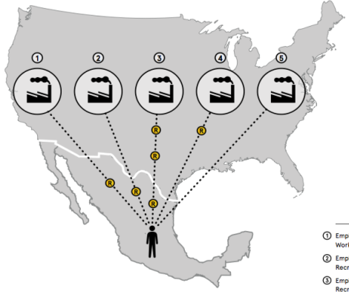

Principal abuses during recruitment,
a study conducted by CDM
Abuses and violations of the rights of workers begin during recruitment in Mexico and affect the work experience in the United States.
DOL
DHS
(USCIS)
DOS
Verbal Understanding
Company
Recruiting Agency in
the United States
Recruiting
Agency in
Mexico
Independent
Contractor
Worker

Slide 8
Information Campaigns
Designed with NGOs.
Toll-free telephone information lines in Mexico and the United States to provide information about certified recruiters and legitimate employment offers.
Operated by STPS in Mexico and SRE in the United States.

Slide 10
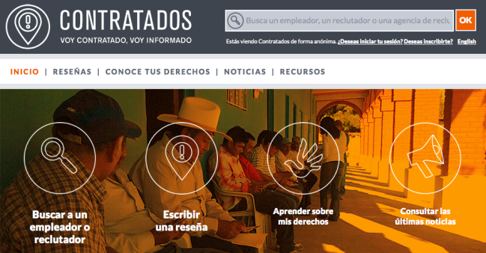
Disseminating campaigns developed by NGOs
Help build the movement of informed migration. Visit contratados.org and write a brief description and improve the hiring and employment conditions.

Slide 11
Labour Rights Week
GENERAL DIRECTORATE OF
PROTECTION FOR MEXICANS ABROAD
The specific objective of the Secretariat of Foreign Affairs is to widely disseminate the concept that consular assistance for Mexican workers whose labour rights have not been respected is a priority and a permanent action of the Government of Mexico.
Numerous activities are carried out to promote labour rights, with participation of federal and state authorities and union leaders as well as the media and the Mexican community.
6 annual broadcasts have been conducted since 2009.

Slide 12
Labour Rights Week
GENERAL DIRECTORATE OF
PROTECTION FOR MEXICANS ABROAD
2014 EDITION
Main theme: “Todos tenemos derechos en el trabajo” (“We all have workplace rights)”;
50 participating consulates;
793 federal and state agencies, unions, etc.;
40,886 persons served;
Participation of 13 South American and Central American consulates: Guatemala, Peru, El Salvador, Colombia, Ecuador, Honduras, Nicaragua, Costa Rica, Philippines, Dominican Republic, Argentina, Uruguay, Bolivia.

Slide 13
Labour Rights Week
GENERAL DIRECTORATE OF
PROTECTION FOR MEXICANS ABROAD
2014 EDITION
Renewing the Joint Declaration between the Secretariat of Foreign Affairs and the Department of Labour (SRE-DOL);
Negotiating and signing a Memo of Understanding between the Secretariat of Foreign Affairs and the Equal Employment Opportunity Commission (EEOC, Spanish acronym);
Mirror activities in foreign delegations of SRE, a pilot project (Guanajuato, Veracruz, Sinaloa, Morelia, Zacatecas); mainly focused on informing workers that hold or aspire to hold a H2 visa. More than 100 participants attended each workshop.

Slide 14
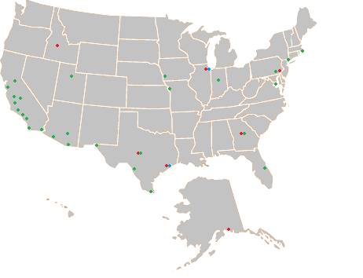
GENERAL DIRECTORATE OF
PROTECTION FOR MEXICANS ABROAD
Agreements with Agencies of the Department of Labour
113 current agreements exist between 50 consulates and agencies of the US Department of Labour, OSHA, WHD, EEOC and NLRB.
14
Notes:
La protección diplomática tiene ciertas características que la diferencian de la protección consular, destacando las siguientes:
Generalmente debe llevarse a cabo sólo cuando se han agotado todos los recursos internos disponibles en el Estado receptor.
La autoridad a la que se deben dirigir las reclamaciones es la Secretaría o Ministerio de Relaciones Exteriores del Estado territorial y deben fundarse en la violación de una norma internacional que se le deba al Estado que protege.
Es la acción que ejerce un sujeto de Derecho Internacional respecto a otro sujeto de Derecho Internacional en favor de ciertos individuos que tienen vínculos determinados con él.
La titularidad de la acción corresponde al Estado o ente dotado de subjetividad jurídico-internacional y no al particular perjudicado. Por lo tanto, esta acción es una facultad discrecional del Estado de origen del individuo afectado en cuanto a su ejercicio o no, el modo y forma de plantear la defensa jurídica y su transacción, desistimiento, renuncia o cualquier otra forma de solución directa o indirecta de la controversia.

Slide 15
Labour Protection Mechanisms in the United States
GENERAL DIRECTORATE OF
PROTECTION FOR MEXICANS ABROAD
General inquiries and guidance in labour matters:
*Lost wages;
*Security in the workplace;
*Risk and accident prevention in the workplace.
Agreement with US labour agencies to disseminate information about their services and channel applications.
  *Risk prevention in the workplace – Occupational Safety and Health Administration OSHA);
  *Protection of salaries – Wage and Hour Division (WHD);
  *Promoting equality in the workplace – Equal Employment Opportunity Commission (EEOC);
  *Promoting the right of workers to join, participate or collaborate in a union: National Labor Relations Board (NLRB).

Slide 16
Labour Rights
GENERAL DIRECTORATE OF
PROTECTION FOR MEXICANS ABROAD
Every worker, regardless of his or her migration status, has the right to:
A contract in Spanish;
Minimum wage (a minimum of US$7.25 per hour);
Payment of overtime;
Timely and prompt payment;
Payments with a receipt;
Holidays;
A safe and hygienic workplace.

Slide 17
Labour Rights
GENERAL DIRECTORATE OF
PROTECTION FOR MEXICANS ABROAD
Every worker, regardless of his or her migration status, has the right to:
Receive training in the language that they understand about risks, methods to prevent damages and standards that apply in the workplace;
The necessary tools and equipment to perform the work safely;
Access to shade and drinking water.

Slide 18
Labour Rights
GENERAL DIRECTORATE OF
PROTECTION FOR MEXICANS ABROAD
Every worker, regardless of his or her migration status, has the right to:
Not be discriminated against based on race, colour, gender, national origin, age or disability;
Equal opportunities in the workplace;
Return to Mexico before the contract expires;
Report abuses without fear of retaliation.

Slide 19
Remember…
GENERAL DIRECTORATE OF
PROTECTION FOR MEXICANS ABROAD
… to ask about:
The complete information about the employer;
The general employment conditions;
The type of work you will perform;
The name and address of the company;
The salary and the number of working hours;
Confirming the information with the Consulate.

Slide 20
Remember…
GENERAL DIRECTORATE OF
PROTECTION FOR MEXICANS ABROAD
To give your correct data and avoid alias;
To read your work contract, which you should receive before initiating the visa procedures;
Once the contract has expired, the employer should cover transportation costs for your return to Mexico;
Not to sign anything that you do not understand (in Spanish or English);
It is illegal to charge you a fee to ensure that you get the job;
Nobody may take away your passport or your work visa or any other identity document;
To visit the closest consulate of your country to receive assistance;
To have the emergency number of the consular offices in the United States: 1855 4636 395.

Slide 21
GENERAL DIRECTORATE OF
PROTECTION FOR MEXICANS ABROAD

Slide 22
GENERAL DIRECTORATE OF
PROTECTION FOR MEXICANS ABROAD
22
Notes:
La protección diplomática tiene ciertas características que la diferencian de la protección consular, destacando las siguientes:
Generalmente debe llevarse a cabo sólo cuando se han agotado todos los recursos internos disponibles en el Estado receptor.
La autoridad a la que se deben dirigir las reclamaciones es la Secretaría o Ministerio de Relaciones Exteriores del Estado territorial y deben fundarse en la violación de una norma internacional que se le deba al Estado que protege.
Es la acción que ejerce un sujeto de Derecho Internacional respecto a otro sujeto de Derecho Internacional en favor de ciertos individuos que tienen vínculos determinados con él.
La titularidad de la acción corresponde al Estado o ente dotado de subjetividad jurídico-internacional y no al particular perjudicado. Por lo tanto, esta acción es una facultad discrecional del Estado de origen del individuo afectado en cuanto a su ejercicio o no, el modo y forma de plantear la defensa jurídica y su transacción, desistimiento, renuncia o cualquier otra forma de solución directa o indirecta de la controversia.

Slide 23
Immigration Fraud – Red Flags
GENERAL DIRECTORATE OF
PROTECTION FOR MEXICANS ABROAD
Executive Actions – the DACA Experience
Ideas relating to the high costs of consulting with an attorney
Lack of sufficient organizations authorized by the Board of Immigration Appeals to provide immigration services
Confusion regarding the role of a public notary

Slide 24
GENERAL DIRECTORATE OF
PROTECTION FOR MEXICANS ABROAD
TOOLS:
Building and strengthening local coalitions and networks; migration clinics with universities, increasing the number of certified organizations;
External legal aid programme;
Potentiating our documentation and protection services.

Slide 25
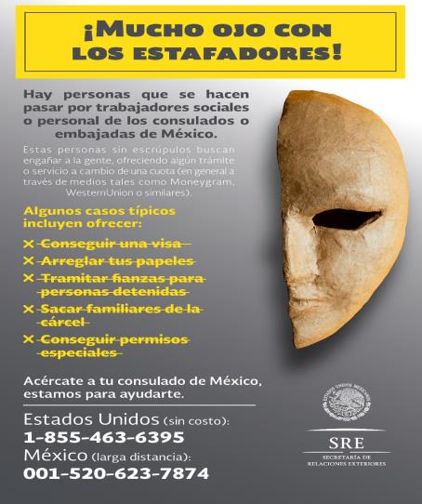
GENERAL DIRECTORATE OF
PROTECTION FOR MEXICANS ABROAD
TOOLS:
PREVENTATIVE PROTECTION CAMPAIGNS

Slide 26

GENERAL DIRECTORATE OF
PROTECTION FOR MEXICANS ABROAD
26

Slide 27
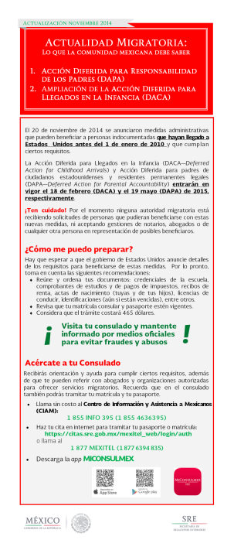
GENERAL DIRECTORATE OF
PROTECTION FOR MEXICANS ABROAD
27

Slide 28
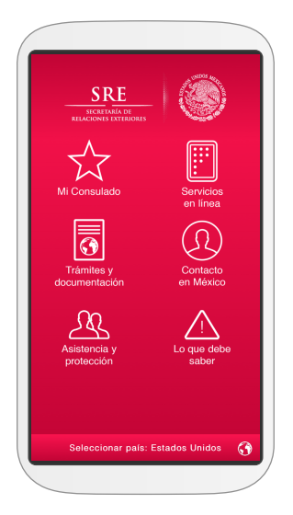

GENERAL DIRECTORATE OF
PROTECTION FOR MEXICANS ABROAD
28

Slide 29
GENERAL DIRECTORATE OF
PROTECTION FOR MEXICANS ABROAD
29

Slide 30
GENERAL DIRECTORATE OF
PROTECTION FOR MEXICANS ABROAD
30

Slide 31
GENERAL DIRECTORATE OF
PROTECTION FOR MEXICANS ABROAD
31

Slide 32
GENERAL DIRECTORATE OF
PROTECTION FOR MEXICANS ABROAD
32

Slide 33
GENERAL DIRECTORATE OF
PROTECTION FOR MEXICANS ABROAD
Questions
and Answers
Thank you for your attention.
33

