Slide 1


(Repatriation
Mexico is with you)

Slide 2

HUMAN REPATRIATION PROGRAMME
The Human Repatriation Programme seeks to establish a strategy to favour coordination of efforts between:
The three levels of government;
Civil society;
International organizations; and
The private sector.
To benefit repatriated Mexican migrants.

Slide 3

HUMAN REPATRIATION PROGRAMME
The OBJECTIVE is to ensure better conditions for the return to national territory of Mexicans repatriated from the US.

Slide 4



HUMAN REPATRIATION PROGRAMME
CIVIL SOCIETY (NGOs)
  Shelters
  Food
  Personal hygiene areas
  Health care
  International
  organizations
INTER-INSTITUTIONAL GOVERNMENTS
  Federal
  State (OFAMs)
  Municipal
PRIVATE SECTOR
  Transport companies
  Various donations

Slide 5







SUPPORT PROVIDED BY THE PROGRAMME
The following support is provided:
Information and
guidance
Water and
one meal
Health
care
Local
transfers
Referral to
shelters
Telephone
calls
A proof of reception of
repatriated Mexicans

Slide 6


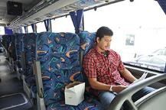

















INTER-INSTITUTIONAL
COORDINATION
Promotes the assessment of skills and experience acquired.
With the purpose of incorporating them into the national productive market in the short term.

Slide 7
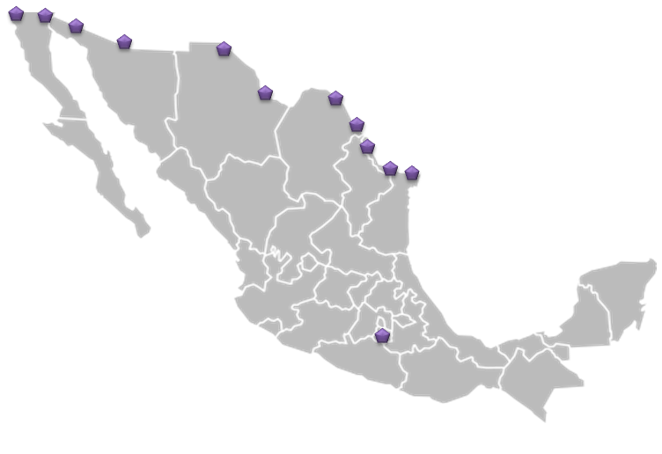
PROGRAMME MODULES
1
2
 | Repatriation Modules
1 | Tijuana
2 | Mexicali
3 | Nogales
4 | Ciudad Juárez
5 | Ojinaga
6 | Ciudad Acuña
7 | Piedras Negras
8 | Nuevo Laredo
9 | Matamoros
3
4
5
6
7
8
9
The Programme includes 9 repatriation modules throughout the country.

Slide 8
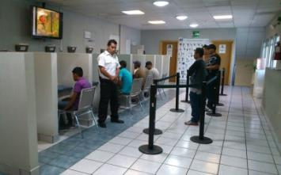


HUMAN REPATRIATION PROGRAMME
From January 1 to November 5, 2015, 139,472 repatriation events were recorded by the modules. 92% of the repatriated persons accepted one or several types of support offered (128,352).

Slide 9
ASSISTANCE PROCESS
IN THE MODULES
INTERVIEW
RECORDING SIOM
PROOF OF REPATRIATION AND CURP
FOOD
INFORMING ABOUT SUPPORT
HEALTH CARE
TELEPHONE CALLS
TRANSPORT
REFERRALS

Slide 10
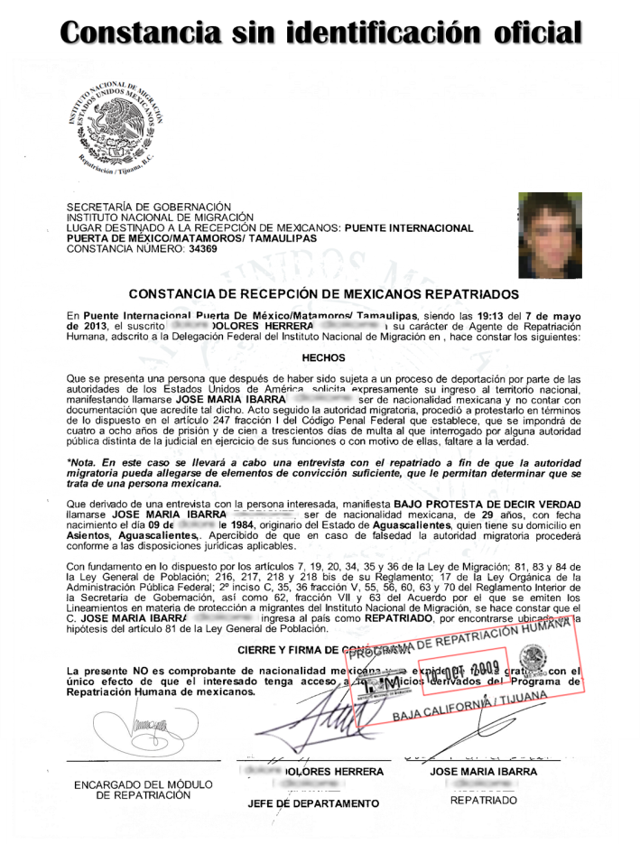
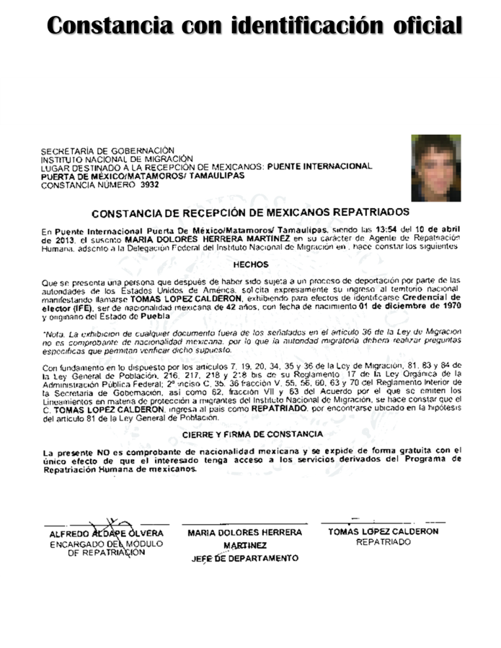
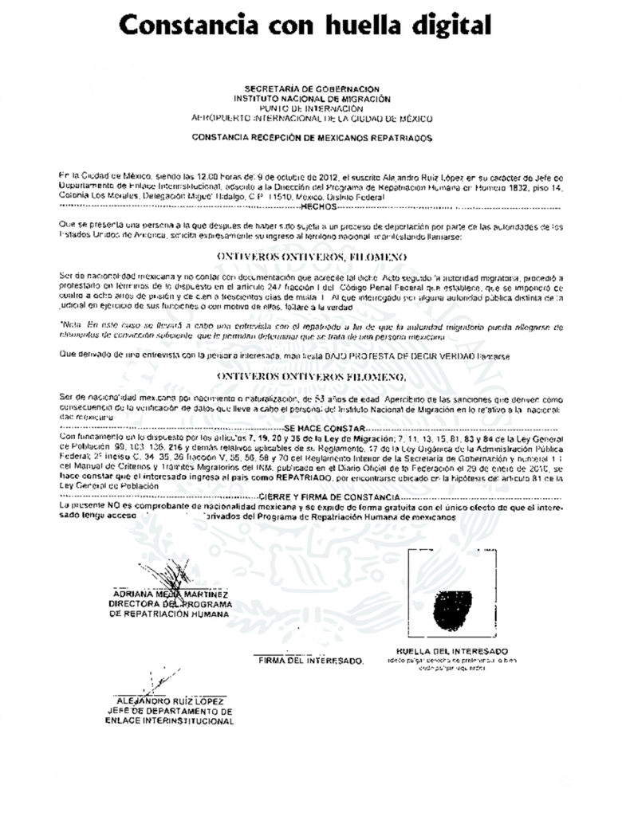



PROOF OF REPATRIATION

Slide 11
STATISTICS
Repatriation events of Mexicans from the US, by federative repatriation entity, 2011 – 2015
(January 1 – November 5, 2015)
Source: Centre for Migration Studies. Migration Policy Unit. Secretariat of the Interior – SEGOB. Based on information recorded at the official repatriation points of the National Institute of Migration.
Preliminary information from the report of the Federal Delegations of the Northern Border.

Slide 13
REPATRIATION PROCEDURE WITHIN MEXICO
(PRIM)

Slide 14
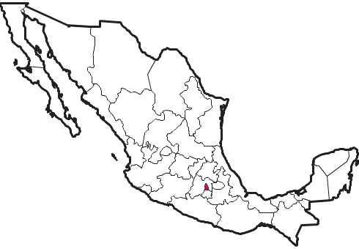
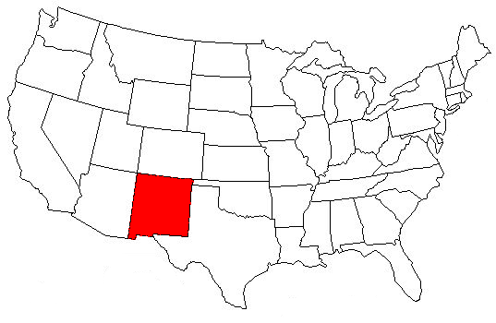
REPATRIATION PROCEDURE
WITHIN MEXICO (PRIM)
MEXICO
UNITED STATES
TERMINAL 2, MEXICO CITY INTERNATIONAL AIRPORT, FEDERAL DISTRICT
DETENTION CENTRE IN OTERO, NEW MEXICO
BINATIONAL AGREEMENT BETWEEN BOTH COUNTRIES ON SAFE, ORDERLY AND DIGNIFIED REPATRIATION

Slide 15
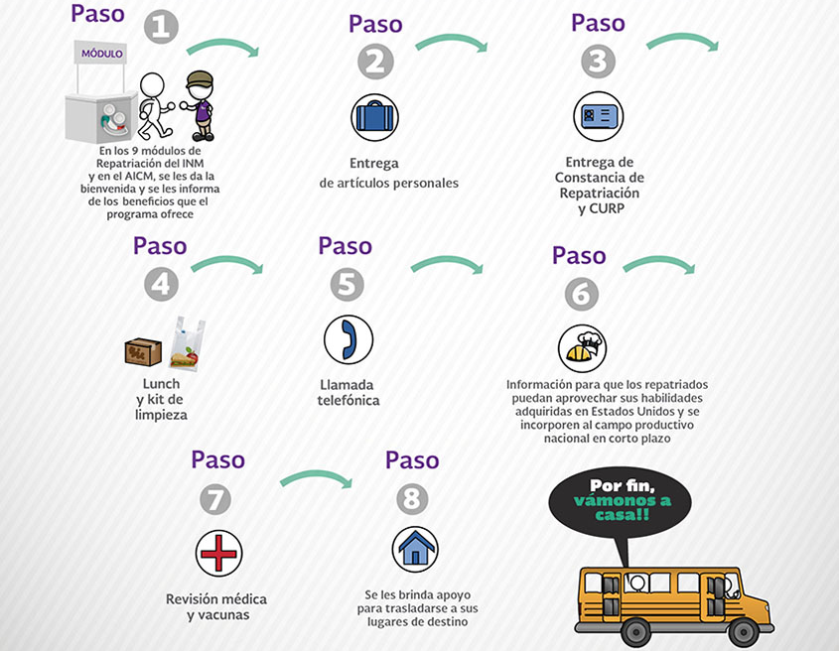
REPATRIATION PROCEDURE
WITHIN MEXICO (PRIM)

Slide 16
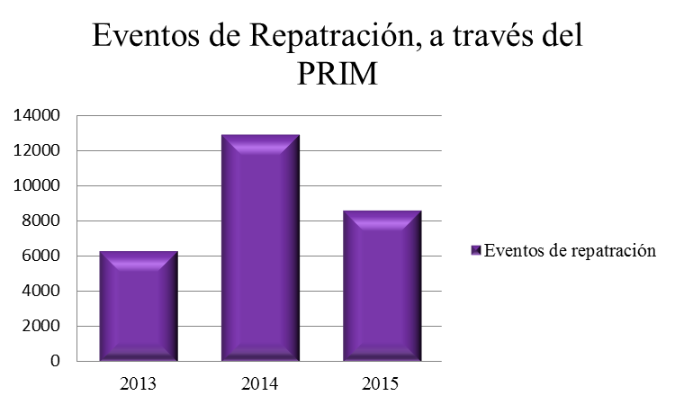
REPATRIATION PROCEDURE
WITHIN MEXICO (PRIM)
Repatriation events through
30,572 repatriation events have been conducted since 2013
PRIM
Repatriation events
2013: Since July 11, 2013 (45 flights, 6,326 events)
2014: Throughout the year (96 flights, 12,928 events)
2015: Until Flight No. 84, November 5, 2015, 11,318 events.

