Slide 1
Comprehensive Consular Protection System (SIPC)
GENERAL OFFICE OF
PROTECTION TO MEXICANS ABROAD
Avenida Juárez núm. 20, Col. Centro, Del. Cuauhtémoc, , C.P. 06010, México, D.F.,
Tels.: (55) 3686 - 5100 http://www.sre.gob.mx
29

Slide 2
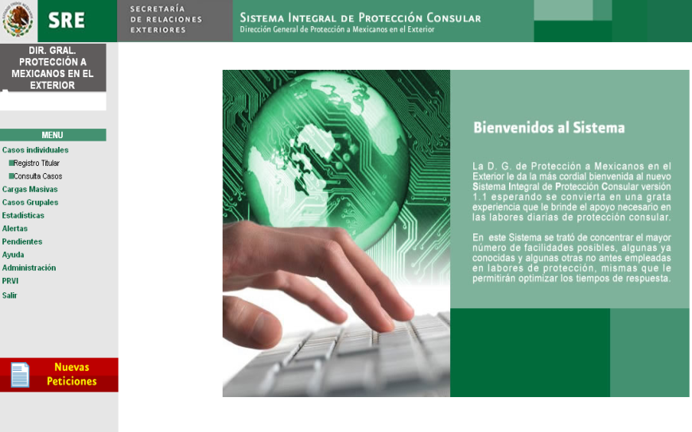
GENERAL OFFICE OF
PROTECTION TO MEXICANS ABROAD
Comprehensive Consular Protection System (SIPC)
A computer tool that enables recording and following up on cases of protection of Mexicans abroad, sharing information to be managed in real time;
The implementation of this tool facilitates and expedites the processing of requests and follow-up actions and in addition, helps monitor protection needs and assess the performance of consular representations.

Slide 3
GENERAL OFFICE OF
PROTECTION TO MEXICANS ABROAD
General Context
The SIPC was established with the objective of creating a tool which enables monitoring and following up on cases of persons who have received protection, managed by the Secretariat of Foreign Affairs through the General Office of Protection for Mexicans Abroad (DGPME), with support from the Consulates of Mexico around the world and delegations abroad, in order to be able to exchange information in real time, regardless of office hours and distances, and to promote the use of a unified assistance methodology.
The objective is to add value to this case-recording and follow-up tool, which has already been tested, by designing this system as a source of consular intelligence. The new SIPC will generate statistical data to be used as strategic information by the DGPME. In addition, it will enable a generalized practice of responding to requests in a more expedited, effective and accurate manner.
The information that can be viewed in the SIPC will not only be about the cases assisted. Information exists that can be included in the same system (see below under “Available databases for the DGPME”). This information will enable decision-making and designing protection actions to meet arising needs.

Slide 4
GENERAL OFFICE OF
PROTECTION TO MEXICANS ABROAD
SIPC – A tool to follow up on cases
SIRME
Statistical unit
Case management unit
THE PROPOSED NEW SIPC
THE CURRENT SIPC
SIPC
A Consular Intelligence System
Strategic information unit
SIRME unit
Reporting and statistics unit
Management unit
CIAM unit

Slide 5
GENERAL OFFICE OF
PROTECTION TO MEXICANS ABROAD
Limitations and Opportunities
Information Systematization
Data are currently recorded through the basic case unit. This does not allow processing data in an expedited manner to know how many persons have received assistance in each category.
Experience shows that confusion exists among the users of the SIPC in regard to classifying cases under the different categories. For example, a case of divorce is classified under “civil”. As a result, the staff in charge of systematizing the final data invest time in verifying if each case is classified under the appropriate category.
With the current system, transferring cases from one category to another creates discordance in historical data. For example, 10 cases of “penal” were recorded in the first quarter of 2012, and only 8 cases are recorded for the second quarter because 2 cases have been reclassified under another category. This change is not visible in the system, making it difficult to understand the statistical behaviour of the historical series.

Slide 6
GENERAL OFFICE OF
PROTECTION TO MEXICANS ABROAD
Limitations and Areas of Opportunity
Training
One of the main obstacles to accurate data processing is the lack of training of consular officers to record data in the SIPC. This could be addressed through an updated handbook on use of the software, as well as new training mechanisms; for example, online training.

Slide 7
GENERAL OFFICE OF
PROTECTION TO MEXICANS ABROAD
Open Government
The new SIPC will comply with the Open Government requirements established in the General Law on Transparency and Access to Public Information, which considers several changes in regard to the obligation of institutions to publish information about their actions on their websites.
To this end, users will be able to access the data that are published.

Slide 8
GENERAL OFFICE OF
PROTECTION TO MEXICANS ABROAD
Databases and Information Available to the DGPME
The list below includes the databases that could be analysed with the new SIPC, as well as the tools and systems with which the new SIPC will interact:
Previous information from the current SIPC:
Assisted cases and resolved cases.
Registration System for Mexicans Abroad (SIRME):
Voluntary registration of Mexicans abroad.
Strategic information generated by consulates:
Repatriation of unaccompanied migrant boys, girls and adolescents at the border;
Persons who died while attempting to cross the border in an irregular manner;
Risk incidents while attempting to cross the border in an irregular manner;
Mexicans rescued at the southern border of the United States while attempting to cross the border in an irregular manner;
Statistics of cases of family law: international return of boys, girls and adolescents, child support, legal guardianship and international adoptions;
Visits to prisons and prison inmates;
Statistics on events relating to migration laws and actions.

Slide 9
GENERAL OFFICE OF
PROTECTION TO MEXICANS ABROAD
Databases and Information Available to the DGPME
Centre for Information and Assistance to Mexicans (CIAM):
Recording calls and requests.
Comprehensive Consular Management System (SIAC):
Documents and document issuance procedures.
System for the Programmatic/Budgetary Management of Representations of Mexico Abroad (SIGEP):
Budget for the execution of programmes on protection to Mexicans abroad.
Online requests for recording and following up on cases of unaccompanied migrant boys, girls and adolescents:
Repatriation and follow-up on cases of unaccompanied migrant boys, girls and adolescents at the border.

Slide 10
GENERAL OFFICE OF
PROTECTION TO MEXICANS ABROAD
Databases and Information Available to the DGPME
Centre for Information and Assistance to Mexicans (CIAM):
Recording calls and requests.
Comprehensive Consular Management System (SIAC):
Documents and document issuance procedures.
System for the Programmatic/Budgetary Management of Representations of Mexico Abroad (SIGEP):
Budget for the execution of programmes on protection to Mexicans abroad.
Online requests for recording and following up on cases of unaccompanied migrant boys, girls and adolescents:
Repatriation and follow-up on cases of unaccompanied migrant boys, girls and adolescents at the border.

Slide 11
GENERAL OFFICE OF
PROTECTION TO MEXICANS ABROAD
General Recommendations and Suggestions
Conceptual definition of what is understood as a case of protection:
Establish standard criteria of which cases should be recorded as protection cases, and the difference between protection and assistance and guidance;
Clearly define each sphere and category to avoid confusion in data collection.
Classifying data:
Rethink the classification of spheres or categories. While these correspond to the legal nature of the procedures in the United States, it is recommended to assess if this is the most expedited and comprehensible way to systematize information;
Consider the potential incorporation and/or elimination of options in the system, since the data reveal too many “Other” options; it is recommended to establish completing the “Specify” box as mandatory when selecting “Other”.
Expand categories, such as PRIM, recovery of belongings and under-age persons in the Juvenile Referral Process; the option to include categories of future programmes or operations would be maintained;
Use language with a gender perspective;
Ensure with the provider that back-up information is always available to the Secretariat of Foreign Affairs (SRE);
Enable uploading and downloading files in various formats;
Review the existing options in order to adjust them to the the current reality.

Slide 12
GENERAL OFFICE OF
PROTECTION TO MEXICANS ABROAD
General Recommendations and Suggestions
Systematizing case information
The new primary measurement unit should be “persons” and not “cases”. A person may have more than one case and will have a single record, as before. A note will be added on the change in the methodology, as required, and the variation will be explained.
Geo-referenced databases, and not only by district. This will facilitate observing the demand for services, trends and the location of the Mexican population in cities and/or counties, especially in districts encompassing more than one state (USA) or country (rest of the world).
In addition, request categories will be established for the cases. More than one request may exist for each case. The cases will not have specific categories, since in reality each case involves several actions and requests relating to various topics and procedures.

Slide 13
GENERAL OFFICE OF
PROTECTION TO MEXICANS ABROAD
General Recommendations and Suggestions
Pedro Hernández López
2012 Case
2013 Case
Request for assistance in criminal matters
Request for assistance in administrative matters
Request for assistance in labour matters
Request for assistance in migration matters
Enables knowing exactly how many persons have been assisted by the consulates.
Having systematized data classified under the categories of “persons”, “cases” and “requests” would enable reporting information according to specific needs.

Slide 14
GENERAL OFFICE OF
PROTECTION TO MEXICANS ABROAD
Comprehensive Consular Protection System (SIPC)
A computer tool that enables recording and following up on cases of protection of Mexicans abroad, sharing information to be managed in real time;
The implementation of this tool facilitates and expedites the processing of requests and follow-up actions and in addition, helps monitor protection needs and assess the performance of consular representations.

