Slide 1
LABOUR MOBILITY
MEXICO-CANADA
Ana Luisa Vallejo
Director for Information on
Protection Policies

Slide 2

LABOUR MOBILITY MECHANISM
In August 2007 Mexico and Canada signed the Joint Action Plan 2007-2008, through which the Labour Mobility Working Group (LMWG) was established.
In 2008 it was agreed to launch a pilot programme in the construction and tourism sectors.
In Mexico, the Ministry of Labour and Social Welfare (STPS) recruits and shortlists employees free of charge.

Slide 3





Operation
Information
Contact
Registration of
Job Offer
Data
Verification
Promotion of Job Offers
The STPS and SRE, through their representation and consulates in Canada promote the mechanism with employer groups and associations.
Interested employers are contacted by the General Coordination of the National Employment Service (CGSNE).
Employers register their job offers on the Mechanism’s website:
https://simolint.stps.gob.mx/Temporary_Employees/
The representative of the STPS and consulates in Canada verify the existence and legitimacy of the employer, as well as recorded information.
The CGSNE, through their offices, the Employment Portal and the Employment Observatory will publish temporary job offers of Canadian employers.
Recruitment
Selection
Documentation
Application
and Eligibility
Follow-up
The Offices of the National Employment Service (OSNE) identify possible workers and the CGSNE sends their work profiles to Canadian employers.
Canadian employers select employees and send the information to CGSNE, together with the job offer.
OSNE provides the information to workers to process their temporary work permit and visa.
Workers in person directly request their temporary work permit and visa at the Canadian Embassy.
CGSNE follows up on the trip, stay in Canada, and return to Mexico of involved workers.

Slide 4
In 2011, Mexico and Canada decided to move from pilot programmes to a broader scheme.
In the implementation period of the Labour Mobility Mechanism until April 2012, 245 workers have travelled to Canada:
199 Alberta | 7 Saskatchewan
37 British Columbia | 2 Yukon

Slide 5
Although the results are modest, progress has been made in the learning process to implement seasonal worker programmes through the Labour Mobility Mechanism.

Slide 6

YOUTH MOBILITY
The Memorandum of Understanding on Youth Mobility between Mexico and Canada was signed on May 27, 2010 and entered into force on November 1, 2010.
The MOU aims at facilitating cultural exchanges that enable allow young people from both countries to gain a better understanding of the culture and society in the host country through travel, work, and life experiences.

Slide 7
The following are considered eligible:
Students enrolled in a higher education institution with an interest in completing a part of their curriculum in another country through a promise of an employment contract related to their professional area or field.
Students enrolled in an educational institution with an interest in obtaining a temporary employment in the host country during their school holidays.
Young citizens, including graduates from higher education institutions with an interest in gaining work experience or practice in their professional area or field through a promise of an employment contract to strengthen their professional development.

Slide 8
SEASONAL AGRICULTURAL WORKER PROGRAMME
The Seasonal Agricultural Worker Programme (PTAT) initiated in 1974 with the signing of the Memorandum of Understanding between the Mexican government and the Canadian government.
The Programme is a bilateral cooperation model that promotes a temporary, orderly, and safe migration flow of Mexican agricultural workers and ensures the respect for their labour, social, and human rights.

Slide 9
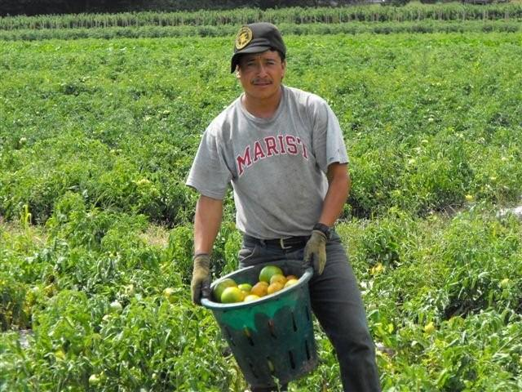
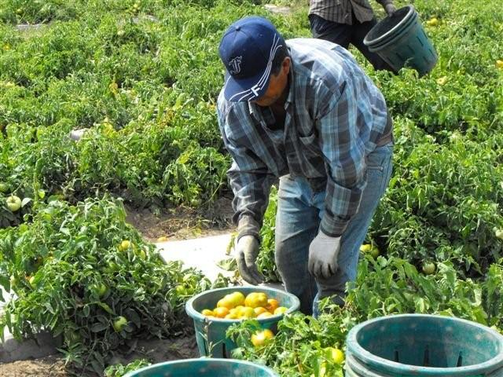
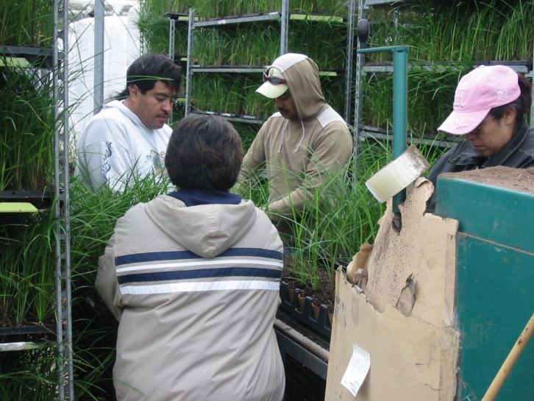
SEASONAL AGRICULTURAL WORKER PROGRAMME

Slide 10
To date, 225,182 Mexican agricultural workers have participated in the programme.

Slide 11

PTAT
OF UNDERSTANDING
Canada The Canadian government regulates the admission of workers, specifies the required number of workers, and gives notice of job cancellations. | Mexico The Mexican government recruits and selects workers, integrates and processes documentation, and sends information about the employees and their date of arrival in Canada to relevant authorities.

Slide 12
The following are considered eligible:
Mexicans | Farmers, labourers, or workers in activities related to agriculture in rural areas
Age 22-45 | Education: Minimum 3rd. grade and maximum 9th grade
Men and women, married or in common-law relationships | As an exception, single persons with dependents

Slide 13
Guidelines
Obligations of the Employer: Not to exceed 40 hours or six working days a week. Provide accommodation, meals, and transportation for workers. Cover all health-related costs for workers and provide all security measures according to law. Pay at least the minimum wage. Deposit part of the wage in an account for the worker’s family. | Obligations of the Employee: Work for the same employer throughout the entire period. Undergo a trial period of 14 days. Commit to returning to the country of origin. Reimburse the employer the cost of immigration procedures and other services provided. Instalments are subject to revision.

Slide 14
CONSIDERATIONS
Mechanisms that reduce conflicts between workers and employers:
  Existence of a mutual agreement (Memorandum of Understanding between Canada and Mexico) that provides a specific legal framework governing programme operations.
  Clearly defined roles of relevant authorities in both countries to monitor compliance with the programme in areas of their competence.
  A continuous inspection of the programme and regular meetings of relevant authorities at a national and international level.
  Timely intervention by consular staff to provide preventive information and protection.

Slide 15
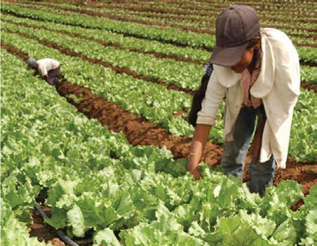
Approximately seven out of ten workers (70%) go back the following season as nominal workers.
Each year about one third (30%) of new workers are included (selection workers).
STPS keeps a list of 300 reserve workers to replace workers that are unable to join PTAT.
In 2011, Mexican consulates in Canada received only 27 complaints against PTAT employers, of a total of 16,494 hired workers.

