Slide 1

ACTIVITY REPORT 2014

Slide 2
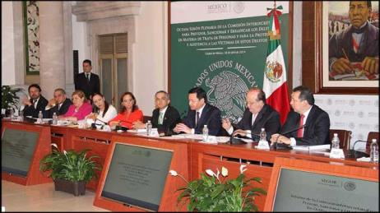
The General Law on Trafficking in Persons establishes that the INTER-SECRETARIAL COMMISSION TO PREVENT, PUNISH AND ERADICATE THE CRIMES OF TRAFFICKING IN PERSONS AND FOR THE PROTECTION AND ASSISTANCE OF VICTIMS OF THESE CRIMES (CI) is responsible for preparing an annual activity report, with input from all institutions of the three levels of government.

Slide 3
The report of the Inter-Secretarial Commission is divided into different sections describing the actions implemented by federal, state and municipal authorities to eradicate trafficking in persons:
REPORT FROM CI
2014
PROTECTION AND ASSISTANCE TO VICTIMS
PROSECUTION OF THE CRIME
INTERNATIONAL COOPERATION
LEGISLATIVE ADVANCES
INTER-INSTITUTIONAL COLLABORATION
PREVENTION: DISSEMINATION AND TRAINING

Slide 4
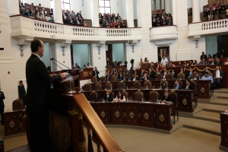
LEGISLATIVE PROGRESS
The report provides a breakdown of the actions within the existing legal framework about national and international regulations governing the actions to combat trafficking in persons, including data generated by the National Congress and federative institutions in their legislative spheres.

Slide 5
LEGISLATIVE ADVANCES
LEGISLATIVE HARMONIZATION LEVELS
HARMONIZED
 | HAVE ISSUED A NEW LAW OR EXPRESSLY REFORMED THEIR LAW TO HARMONIZE IT WITH THE GENERAL LAW, AND HAVE REPEALED THE CRIMINAL TYPE FROM THEIR CODES, OR THEIR CODES REFER TO THE GENERAL LAW.
PARTIALLY HARMONIZED
 | HAVE SUBMITTED REFORMS TO THEIR CODE BUT HAVE NOT ISSUED A NEW LAW OR EXPRESSLY REFORMED THEIR LAW TO HARMONIZE IT WITH THE GENERAL LAW.
 | HAVE ISSUED A NEW LAW (SUBSEQUENT TO THE GENERAL LAW) BUT HAVE NOT REFORMED THEIR CODE.
 | HAVE HARMONIZED THEIR CODES IN ACCORDANCE WITH THE GENERAL LAW BUT DO NOT HAVE A LAW ON THIS MATTER.
NOT HARMONIZED
 | HAVE NOT REPEALED THE CRIMINAL TYPE OF TRAFFICKING IN PERSONS FROM THEIR LAW.
 | HAVE NOT REPEALED THE CRIMINAL TYPE OF TRAFFICKING IN PERSONS FROM THEIR CODE AND HAVE NOT REFORMED THEIR LAW.
 | HAVE NOT REPEALED THE CRIMINAL TYPE OF TRAFFICKING IN PERSONS FROM THEIR CODE AND DO NOT HAVE A LAW ON THIS MATTER.

Slide 6
LEGISLATIVE ADVANCES
Level of Harmonization
Percentage

Slide 7
LEGISLATIVE ADVANCES
Number of Entities,
by Level
Of the 32 entities that were examined, 62.50% are in the range of harmonized entities and 37.50% are entities without harmonization.

Slide 8
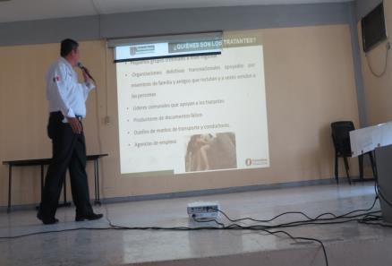
PREVENTION:
DISSEMINATION AND TRAINING
This section provides an overview of the actions implemented by institutions from the three levels of government, submitted to the Technical Secretariat of the Inter-Secretarial Commission, including training, awareness-raising and dissemination.

Slide 9
PREVENTION:
DISSEMINATION AND TRAINING
Training and Awareness-Raising
Trained | TOTAL
Civil Servants and General Public | 262,433
Dissemination
Persons reached through dissemination | TOTAL
Civil Servants and General Public | 2’466,893
Notes:
El número de difusión respecto a personas impactadas se extrajo del Informe Ejecutivo de la Comisión Intersecretarial para Prevenir, Sancionar y Erradicar los Delitos en materia de Trata de Personas y para la Protección y Asistencia a las Víctimas de estos Delitos 2013.

Slide 10
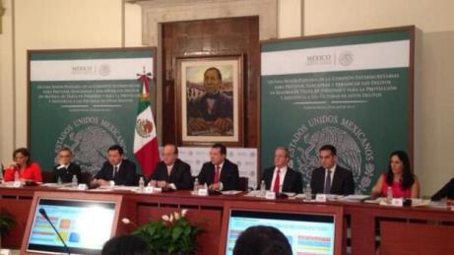
INTER-INSTITUTIONAL COLLABORATION
The State of Mexico, being aware of the phenomenon of trafficking in persons, has taken on the commitment to implement a series of actions to coordinate and establish links with institutions and entities from the three levels of governments in order to further the effectiveness of programmes, strategies, mechanisms and lines of action oriented toward the prevention, investigation and prosecution of these crimes.

Slide 11
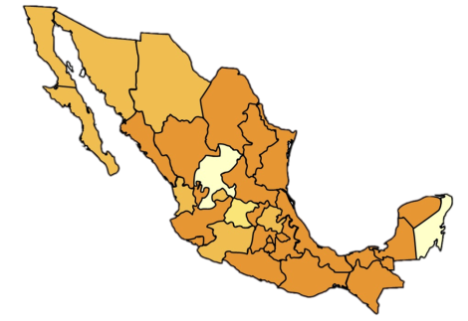
INTER-INSTITUTIONAL COLLABORATION
Establishment and Integration of Inter-Secretarial Commissions on Trafficking in Persons in Federative Entities
Have established Commissions | Campeche Chiapas Coahuila Colima Distrito Federal Durango Estado de México Guerrero Jalisco Morelos Nuevo León | Oaxaca Puebla Querétaro San Luis Potosí Sinaloa Tabasco Tamaulipas Tlaxcala Veracruz Yucatán | Total 21
Commissions are in the process of being established | Aguascalientes Baja California Baja California Sur Chihuahua Hidalgo Michoacán Nayarit Sonora |  | Total 8
A Committee established by INM | Guanajuato |  | Total 1
A Commission is not in place | Quintana Roo Zacatecas |  | Total 2
Commissions Established in 2014
Campeche Coahuila Colima Distrito Federal Durango Estado de México Guerrero Jalisco Morelos Tabasco Veracruz
Total 11

Slide 12
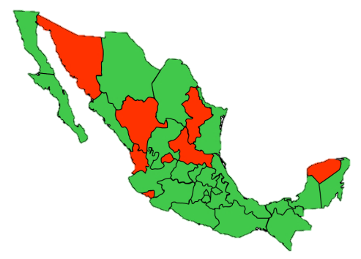
INSTITUTIONS SPECIALIZING IN THE PROSECUTION OF THE CRIME OF TRAFFICKING IN PERSONS, 2015
Baja California
Baja California Sur
Campeche
Chiapas
Chihuahua
Coahuila
Distrito Federal
State of Mexico
Guanajuato
Guerrero
Hidalgo
Jalisco
Michoacán
Morelos
Oaxaca
Puebla
Querétaro
Quintana Roo
Sinaloa
Tabasco
Tamaulipas
Tlaxcala
Veracruz
Zacatecas
SPECIALIZED INSTITUTIONS ARE IN PLACE IN 24 FEDERATIVE ENTITIES
Aguascalientes
Colima
Durango
Nayarit
Nuevo León
San Luis Potosí
Sonora
Yucatán
SPECIALIZED INSTITUTIONS DO NOT EXIST IN 8 FEDERATIVE ENTITIES
* Information updated to October 12, 2015

Slide 13
ESTABLISHMENT OF ASSISTANT PUBLIC PROSECUTOR’S OFFICES, PROSECUTOR’S OFFICES, UNITS AND AGENCIES SPECIALIZING IN PROSECUTION OF THE CRIME OF TRAFFICKING IN PERSONS, 2015
Establishment of Assistant Public Prosecutor’s Offices, Prosecutors’ Offices, Units and Agencies Specializing in Trafficking in Persons
1 | Assistant Public Prosecutor’s Offices
10 | Prosecutor’s Offices
9 | Units
4 | Specialized Agencies
8 | None
At the federal level, a Special Prosecutor’s Office for the Crimes of Violence Against Women and Trafficking in Persons (FEVIMTRA) of the Public Prosecutor’s Office (PGR) is in place.
* Information updated to October 12, 2015

Slide 14
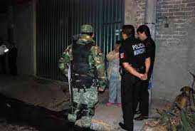
PROTECTION AND ASSISTANCE TO VICTIMS
The institutions that make up the Inter-Secretarial Commission implement actions oriented toward providing comprehensive assistance to victims of trafficking in persons, including health care, psychological and social assistance, legal aid and all types of assistance required to ensure the prompt and effective social reintegration of victims.

Slide 15
PROTECTION AND ASSISTANCE TO VICTIMS
VICTIMS
Total 2,010
By type of administration | Federal 918
 | State 1,092
ASSISTANCE AND SERVICES
Total 20,681
By type of administration | Federal 17,475
 | State 3,206

Slide 16

PROSECUTION OF THE CRIME
One of the challenges is to promote effective procurement, investigation and prosecution of the crime of trafficking in persons. Therefore, actions are implemented to investigate and punish the perpetrators of this crime.

Slide 17
PROSECUTION OF THE CRIME
Prior investigations and sentences for the crime of trafficking in persons
Prior Investigations
NATIONAL
615
Federal
229
State
386

Slide 18
ADMINISTRATION OF JUSTICE
Sentences Pronounced for the Crime of Trafficking in Persons
No. | Entity | 2014
1 | Baja California | 5
2 | Chiapas | 49
3 | Chihuahua | 2
4 | Federal District | 31
5 | Guerrero | 2
6 | Hidalgo | 1
7 | Jalisco | 6
8 | Mexico | 10
9 | Michoacán de Ocampo | 1
10 | Morelos | 3
11 | Nuevo León | 1
12 | Oaxaca | 1
13 | Puebla | 9
14 | Querétaro | 1
15 | Sinaloa | 2
16 | Sonora | 2
17 | Tabasco | 1
18 | Tlaxcala | 6
19 | Veracruz | 3
20 | Yucatán | 1
General Total |  | 137
Disaggregated Sentences, Local Level
20 Federal Entities
2014 | Number of Victims | Number of Sentences | Number of Sentenced Persons
Figures | 271 | 137 | 205
*The 12 entities that are not included in the list reported 0 pronounced sentences.

Slide 19
ADMINISTRATION OF JUSTICE
Sentences Pronounced for the Crime of Trafficking in Persons
Sentences at the Federal Level
Number of Sentences
Sub-total | 8
Disaggregated Sentences, Federal Level
2014 | Number of Victims | Number of Sentences | Number of Sentenced Persons
Figures | 5 | 7 | 8

Slide 20
ADMINISTRATION OF JUSTICE
Grand Total
2014 | Number of Sentences | Number of Victims | Number of Sentenced Persons
Figures | 144 | 275 | 212
Total number of sentences pronounced by the Supreme Courts of Justice in 2009-2014 | 543 At the national level

Slide 21

INTERNATIONAL COOPERATION
The members of the Inter-Secretarial Commission was actively involved with the international community with the aim of developing effective practices in combating the crime of trafficking in persons and providing comprehensive assistance to victims.
Collaboration Schemes | Memos of Understanding | Task Groups | Strategic Alliances
27 | 11 | 5 | 11

Slide 22



INTERNATIONAL COOPERATION
The Inter-Secretarial Commission participated in meetings to exchange effective practices in matters relating to trafficking in persons in the following countries:
Second Consultative Meeting on Strengthening Partnerships with National Rapporteurs on Trafficking in Persons and Equivalent Mechanisms, held on May 21-22 in Bangkok, Thailand.
XIX Regional Conference on Migration (RCM), June 23-25.
Meeting of the Liaison Officer Network to Combat Migrant Smuggling and Trafficking, held on November 24 in Managua, Nicaragua.
IV Meeting of National Authorities on Trafficking in Persons, held on December 4-5 in Brasilia, Brazil.

Slide 23
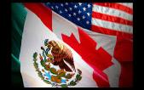


INTERNATIONAL COOPERATION
And representing Mexico abroad, the Inter-Secretarial Commission participated in the following meetings:
Trilateral Technical Meeting on Best Practices in Assistance to Victims of Trafficking between Canada, Mexico and the United States, held in Washington, D.C. on September 22.
Work meeting organized by the Colombian Agency for Reintegration in Bogotá, Bucaramanga and Barrancabermeja, Colombia, on September 8-11.
Global Online Child Sexual Abuse Summit held in London, England on December 9-11.

