Slide 1


Validation workshop for document

Slide 2

Workshop methodology
Space for collaborative dialogue, where knowledge is shared and possibilities for group work are created
The World Café

Slide 3
The World Café
Connection
Contribution
Community
Committed actions
Powerful questions on important questions!

Slide 4

Roles
Reporter:
Stays at the table
Synthesizes each question
Transmits the work acommplished by the table to the new members who arrive at the table
Presents the conclusions during the plenary session
Teamwork
Contribute and participate with their experiences
They change tables after the questions are completed and they are told.

Slide 5
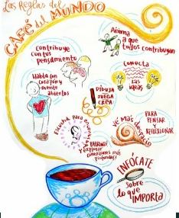
To consider:
Contribute ideas.
Be respectful.
Listen carefully.
Use all the tools at your disposal (flipcharts, physical and digital documents).
A question guide will be established that will allow for the generation of ideas, understanding, and innovative and creative action plans.
As much as possible, do not use your phones.

