Slide 1
Preliminary Identification of Profiles
International Organization for Migration

Slide 2
Objective:
To provide Member States with general guidance on the development and implementation of mechanisms for the preliminary identification of profiles and referral of migrant populations in vulnerable situations.

Slide 3
Key Concepts:
  Preliminary identification of profiles;
  Indicators;
  Referral mechanisms;
  Critical protection and assistance route;
  Risk assessment;
  Vulnerable situations.

Slide 4
Guiding Principles:
  International Human Rights Law, International Refugee Law and International Humanitarian Law;
  Principle of equality and non-discrimination (gender, nationalitiy, ethnic origin and sexual orientation);
  Principle of special protecion for boys, girls and adolescents and the best interest of the child.

Slide 5
Guiding Principles:
  Principle of confidentiality;
  Principle of no revictimization;
  Principle of respect for diversity and multiculturalism.

Slide 6
Populations in highly vulnerable situations:
  Unaccompanied and/or separated boys, girls and adolescents;
  Boys, girls and adolescents in other vulnerable situations (victims of sexual violence, pregnant adolescents, exploitation);
  Victims of trafficking in persons.

Slide 7
Populations in highly vulnerable situations:
  Refugees and refuge seekers;
  Extra-continental migrants and refugees;
  Victims of violence and crime;
  Women victims of sexual and/or gender-based violence, pregnant women travelling by themselves, especially pregnant adolescents.

Slide 8
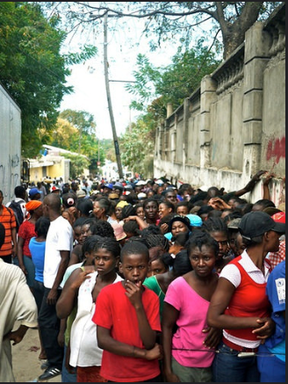
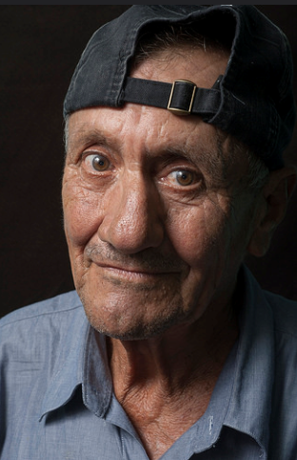
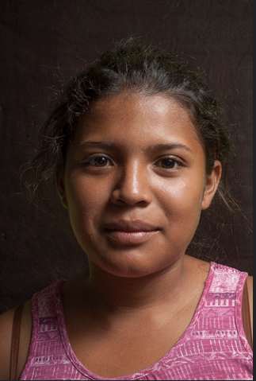
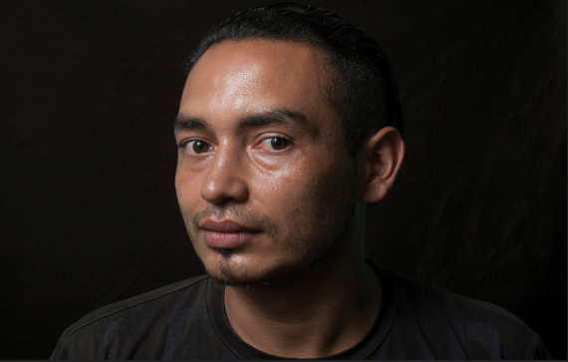
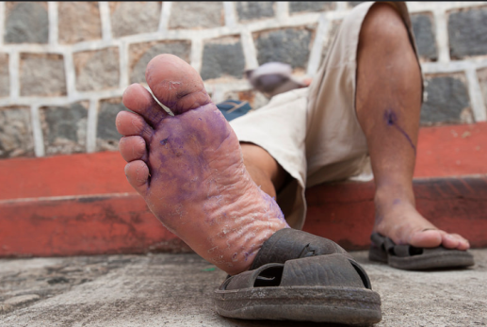
Migration for the benefit of all...

