Slide 1



ADVANCES IN PROTECTION ACTIONS
UNDERSECRETARIAT OF MIGRATION AND CONSULAR AFFAIRS
HONDURAS
JUNE – NOVEMBER 2016

Slide 2

PROJECT FOR THE ESTABLISHMENT OF THE CONSULAR CENTRE FOR PROTECTION TO HONDURAN MIGRANTS (CCPROMH)
CCPROMH will be located in the city of Houston, Texas, United States, attached to the Consulate of Honduras in Houston, and is expected to be opened on December 16, 2016.
The general objective is to provide assistance and protection and to ensure that Honduran migrants are treated with respect and dignity, regardless of their migration status.
The project has been approved by the National Council for the Protection of Honduran Migrants (CONAPROHM), comprised of government institutions, within the framework of shared responsibility.

Slide 3




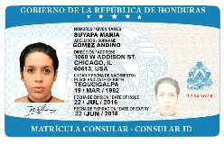
CONSULAR REGISTRATION CARD OF HONDURAS
Honduras has launched the Consular Registration Project with the aim of providing protection to Honduras living in the United States. The project will begin operating in the first quarter of 2017, providing the following benefits:
Delivered on the same day in record time – within 10 minutes;
A validity of 2 years;
A document recognized in the United States;
Designed with high quality and security;
Includes a photograph, personal data, date of issuance and expiration date.

Slide 4

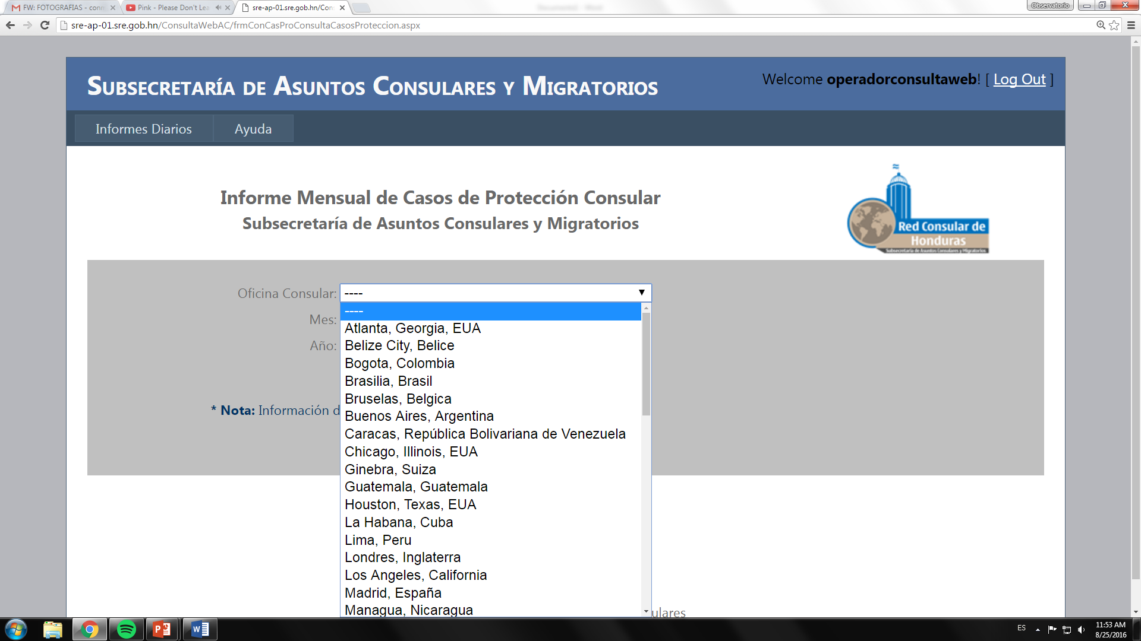
ASUCON INFORMATION SYSTEM
All Honduran consular representations accredited in different countries around the world enter data on consular services and protection provided on a daily basis. These reports can be viewed online at www.sre.gob.hn

Slide 5
CONSULAR AND MIGRATION OBSERVATORY OF HONDURAS (CONMIGHO) http://conmigho.wixsite.com/subscym-conmigho
The CONMIGHO Observatory is a reference point for statistics on migration at a national international level and enables us to obtain information about the migration movements of Hondurans, the services provided and the amounts invested in the services provided.
CONMIGHO monitors operations in the sphere of consular actions and migration, generating timely information for decision-making.

Slide 6
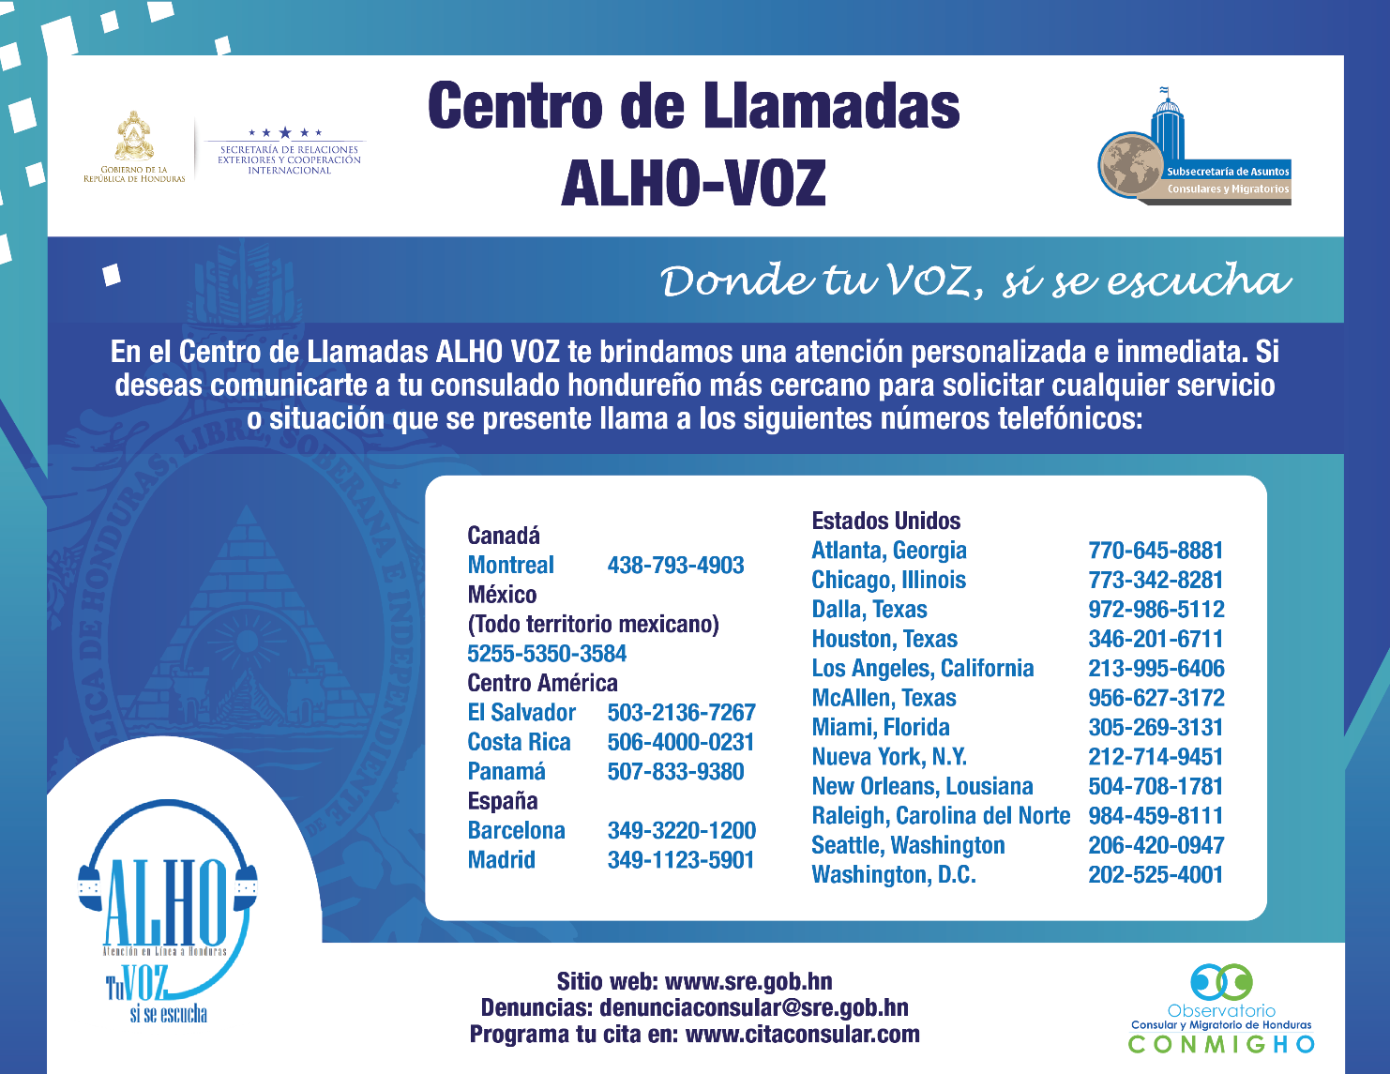
ALHO VOZ
Call Centre
Since its inception on August 23, 2016, consular assistance and protection has been provided to more than
200,696
persons

Slide 7
REINTEGRATION PROJECTS
CONAPROHM approves projects to potentiate government assistance for Honduran migrants
- Within the framework of shared responsibility, counselling, educational support and financial and technical assistance is provided to returned Hondurans through the Honduran Migrant Solidarity Fund (FOSMIH).
- Three reintegration projects are currently being executed.
- A project on the reintegration route, with inter-institutional coordination and led by the Office of the First Lady of the Nation.
PROJECT EXECUTION
- Jobs for returned Hondurans at ALHO VOZ call centre, Secretariat of Foreign Affairs;
- A financial cooperation agreement with the Mennonite Social Action Committee with the aim of providing financial support to returned Hondurans to enable them to establish micro-enterprises;
- Seed capital has been provided to 21 Honduran returned women, who established working groups in their communities of origin with collaboration from SEDIS.

Slide 8
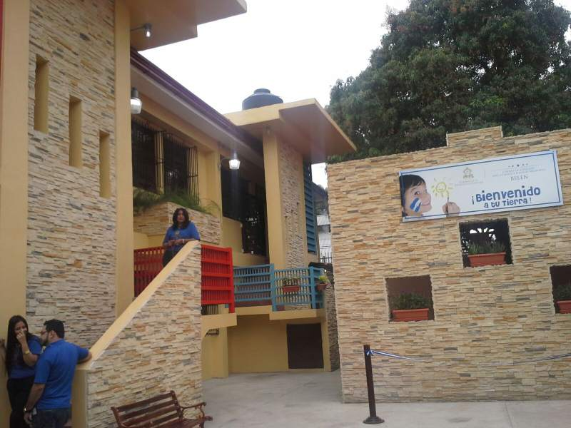
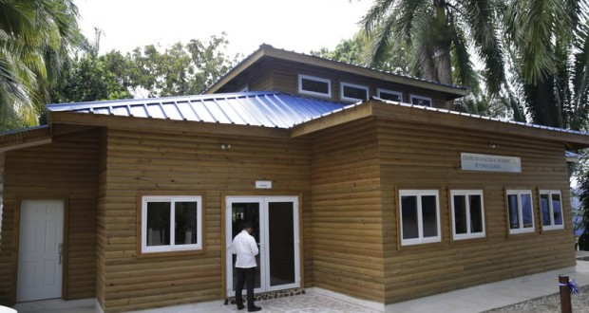
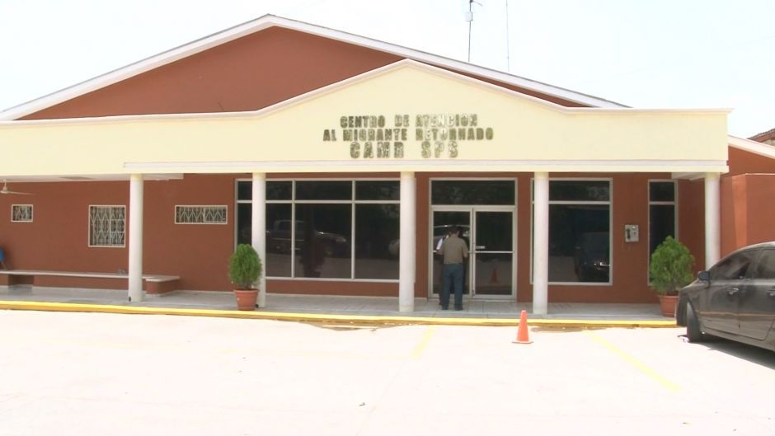
Centre for Assistance to Returned Migrants, Omoa, Cortés (CAMR-OMOA)
- 31,438 Hondurans returned from Mexico by land have been received:
- 89% are male and 11% are female;
- Accommodation capacity: 84 persons.
Centre for Assistance to Returned Migrants, San Pedro Sula (CAMR-SPS)
- 18,718 Hondurans repatriated from the United States by land have been received.
Centre for Assistance to Migrant Children and Adolescents and Families, Bélen (CANFM-Belén)
- 12,951 boys, girls and adolescents and families have been received:
- Accommodation capacity: 40 persons.

Slide 9
ASSISTANCE TO HONDURANS RETURNED FROM THE UNITED STATES

Slide 10
ASSISTANCE TO HONDURANS RETURNED FROM MEXICO
Total number of returned migrants, by gender – boys, girls, adolescents and adults

Slide 11
REPATRIATION OF DECEASED PERSONS, 2016
Cases who received financial support for repatriation (Jan.-Sept. 2016)
Cases who received support in repatriation procedures
Total number of applications received, September
Annual amount of financial support provided in Jan.-Sept. 2016 to Honduran families with limited resources for the repatriation of family members deceased abroad, through the Honduran Migrant Solidarity Fund (FOSHMI)

Slide 12

Thank you for your attention!
Undersecretariat for Consular
and Migration Affairs

