Slide 1



Reintegration of Boys, Girls and Adolescents Victims of Trafficking and other Migrants in Vulnerable Situations
San José, Costa Rica
September 17-18, 2013

Slide 2

Reintegration
Reintegration poses a major challenge
to society and - more directly - to government
authorities.

Slide 3
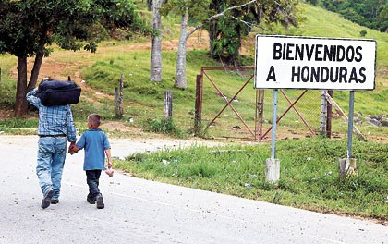
Where does the process begin?
From the moment when the boy, girl or adolescent returns or is repatriated to our national territory and is received by authorities from the Honduran Institute for Children and Family (Instituto Hondureño de la Niñez y la Familia - IHNFA).

Slide 4
Assistance Provided by IHNFA
    Based on the Protocol for Assistance to Migrant Boys, Girls and Adolescents Victims of Trafficking or at Risk of Becoming Victims of Trafficking, as well as current national and international regulations in order to ensure respect and compliance as well as restitution of the fundamental rights of boys, girls and adolescents (Code for Children and Adolescents, Convention on the Rights of the Child, Law Against Trafficking, etc.)

Slide 5
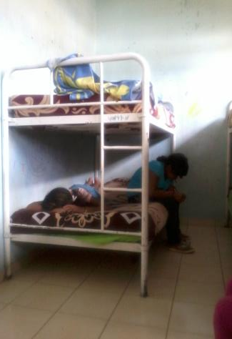
Special Protection Provided to Migrant Boys, Girls and Adolescents in Accordance with the Protocol for Assistance
Safe and appropriate accommodation. Temporary shelter in a protection centre or home, with appropriate conditions to ensure the safety and security or the boys, girls and adolescents and the persons in charge of protecting them.
b) A balanced diet to meet the specific needs of boys, girls and adolescents.
c) Health care and psychological assistance.
d) Inclusion into education and recreation programs, considering the safety and security of the boy, girl or adolescent.

Slide 6
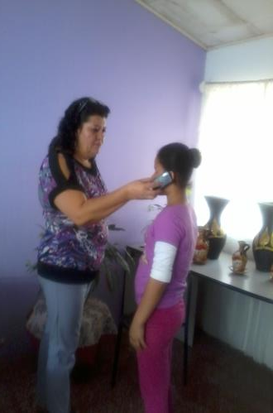
e) Constantly informing the boys, girls and adolescents about their situation or protection status as migrants – considering their age, level of maturity and culture – and also notifying their families of their return to Honduras and establishing immediate contact between the boys, girls and adolescents and their families.

Slide 7
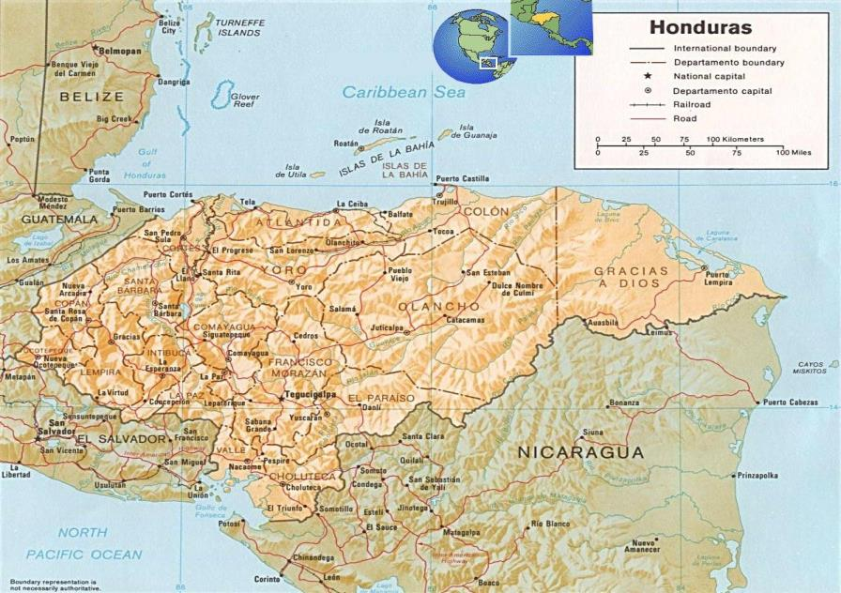
Regions with the Highest Incidence of Trafficking in Persons in Honduras

Slide 8
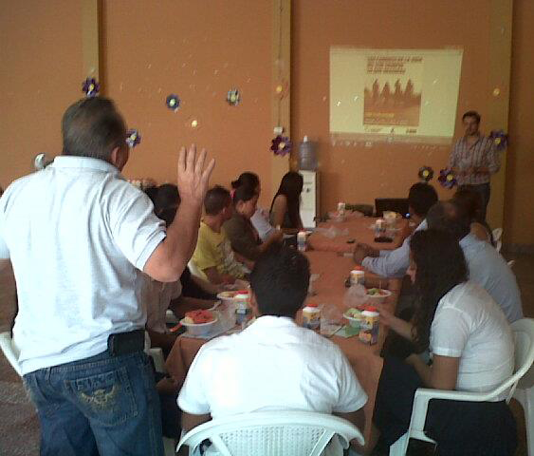
Efforts oriented toward the reintegration of returned migrants, implemented with support from civil society organizations.

Slide 9
Successful Implementation of Innovative Initiatives,
September 2013
Organization | Project Name / Innovative Initiative
Asociación Calidad de Vida; Tegucigalpa | Youth learning to weave nets
Bolsa Samaritana, San Pedro Sula | Provides assistance to adults (the majority are women)
Casa Alianza Honduras | Preparing boys and girls for life
Asociación de Hermanas Misioneras de San Carlos de Borromeo Scalabrinianas, San Pedro Sula and Tegucigalpa | Awareness-raising, identifying and providing immediate assistance to victims of trafficking
Asociación Brigadas de Amor Cristiano/Victoria Project, Tegucigalpa and San Pedro Sula | Comprehensive assistance for victims (most of them are men; ambulatory assistance is provided to women and boys, girls and adolescents)

Slide 10
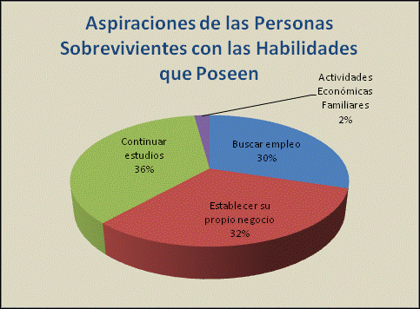
Aspirations of the Surviving Victims
According to
their Abilities
Economic activities as a family
2%
To seek employment
30%
To continue their education
36%
To establish their own business
32%

Slide 11
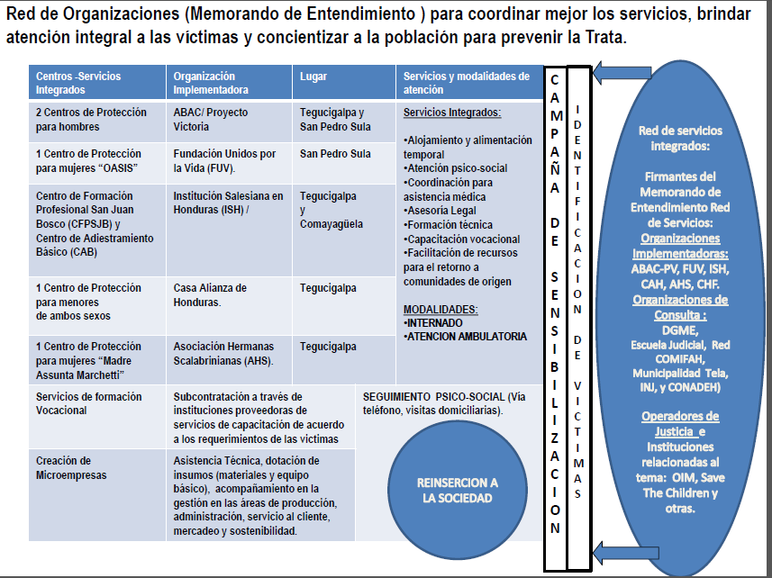
Network of organizations (Memo of Understanding) to improve coordination of services, provide comprehensive assistance to victims and raise awareness among the general population to prevent trafficking.

Slide 12
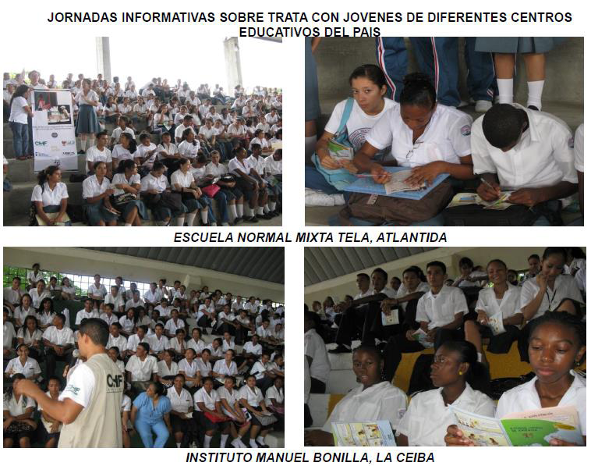
INFORMATION CAMPAIGNS ON TRAFFICKING IN PERSONS FOR BOYS, GIRLS AND ADOLESCENTS IN DIFFERENT SCHOOLS IN THE COUNTRY

Slide 13
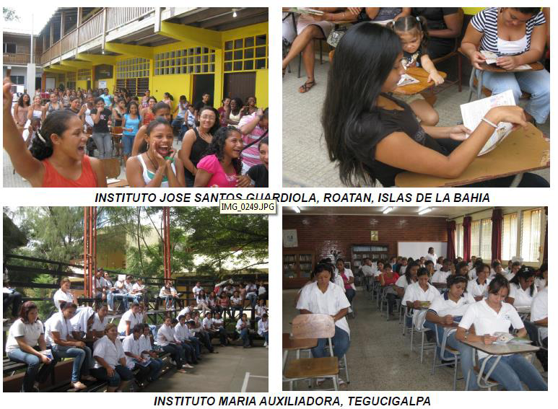

Slide 14
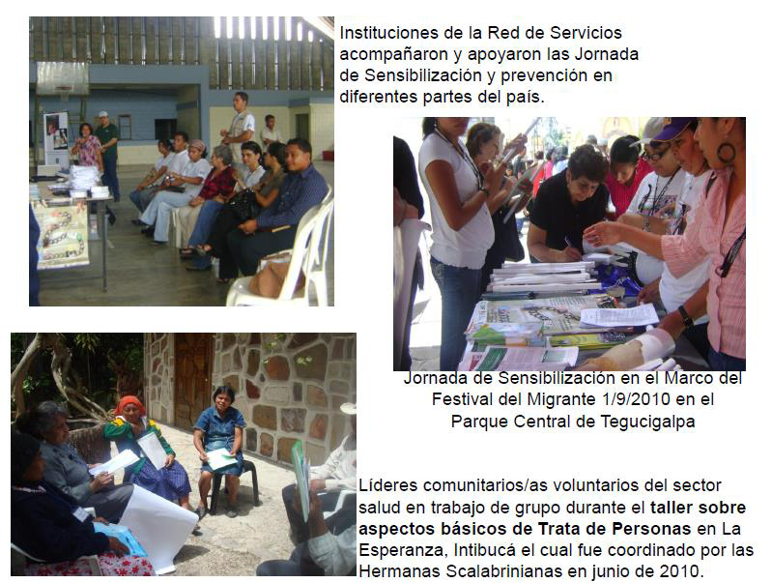
Institutions from the service network accompanied and supported the awareness-raising and prevention efforts throughout the country.
Awareness-raising initiative within the framework of the Migrant’s Festival, Sept. 1, 2010 in the Central Park in Tegucigalpa
Voluntary community leaders from the health sector working together during the Workshop on Basics of Trafficking in Persons in La Esperanza, Intibucá. The workshop was coordinated by the Scalabrinian Sisters and held in June 2010.

Slide 15

THANK YOU

