Slide 1
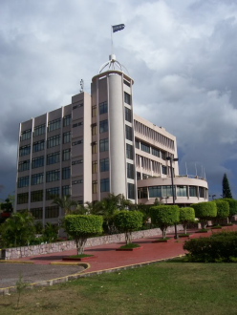
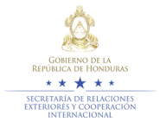
Secretariat of Foreign Affairs and International Cooperation
Achievements in Consular Protection

Slide 2

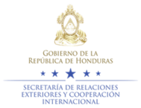
Establishment of the Undersecretariat of Consular and Migration Affairs
Establishing the Undersecretariat of Consular and Migration Affairs of the Secretariat of Foreign Affairs and International Cooperation through Executive Decree No. PCM-038-2015.
Signing the Bylaws to the Law on Protection of Honduran Migrants and their Families in March 2015
  * First disbursement from the Solidarity Fund for Honduran Migrants and their Families ($5 millions annually)
    Establishing the General Office for Protection of Honduran Migrants
                * Office for Assistance to Returned Migrants
                * Office for Protection of Honduran Migrants

Slide 3
Achievements of the General Office of Consular Affairs
Establishing the Consular and Migration Observatory. This enables generating statistics on the following:
        Consular assistance provided;
        Honduran migrants returned;
        Assistance provided through FOSMIH.
Establishing three free telephone helplines at the ALHO VOZ “Donde Tu Voz si se Escucha” Call Centre to serve Hondurans living in Mexico and Spain. To date, more than 80,000 calls have been received.
Reactivating the service of issuance of passports, birth certificates and personal identity documents through mobile consulates, with the presence of the National Registry of Persons. This service, which is being provided in different cities throughout the US, has been expanded to London, Italy and Canada.
Installing surveillance and security cameras in all consular offices and mobile consulates.

Slide 4
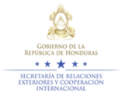
Consular Services
Consular appointments online;
Coordination and dissemination of the online high-school diploma programme for migrants living abroad;
Implementing the biometric assistance system;
Daily reports on consular services provided;
Strengthening the consular network through training on consular protection and services;
Approval by the State Department to open three general consulates in the US (Seattle, Charlotte and Phoenix).

Slide 5

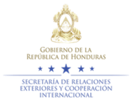
ALHO VOZ
“DONDE TU VOZ SI SE ESCUCHA”
CALL CENTRE
(TELEPHONE ASSISTANCE IN HONDURAS)
80,000+
Hondurans served
Notes:
ALHO VOZ no es un Centro de Llamadas convencional ya que brinda una atención personalizada, cálida y humana a nuestros compatriotas en el exterior. En un lapso de nueve meses hemos logrado incrementar el recurso humano capacitado y así responder de manera efectiva a las inquietudes de casi 63,000 hondureños y sus familiares que antes carecían de este servicio. Para esto contamos con la más alta tecnología para monitorear el sistema, evaluar el desempeño de nuestros funcionarios y la eficiencia de nuestra atención. Asimismo, ha servido como una plataforma para promocionar proyectos sociales para los migrantes, tener un censo y una base de datos más completa de connacionales en Estados Unidos de América y muy importante; un buzón de quejas que ha servido de insumo para mejorar nuestras gestiones consulares e incluso el rescate de compatriotas secuestrados en la ruta.

Slide 6

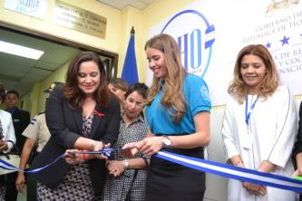
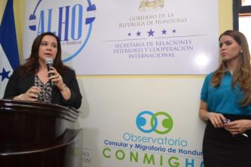
(Consular and Migration Observatory of Honduras)
Monitoring security cameras around the world;
Assessing daily reports on consular services provided;
Statistical data on consular protection provided;
Statistical data on ALHO VOZ call centre;
Statistical data on assistance provided at diplomatic and consular offices around the world.

Slide 7
General Office for Protection of Honduran Migrants
Protection has been provided to a total number of 1,041 persons in 2015 y 2016. The requests have been directly received from Protection Officers of OPROHM, to be duly processed.

Slide 8
Cooperation Agreements
The Consulates of Honduras in the US have signed cooperation agreements with different law firms, with the objective of providing legal aid to Honduran nationals on labour, criminal and migration matters, etc.
In view of the recent migration crisis that led to a dramatic increase in the number of unaccompanied boys, girls and adolescents migrating to the US, a Memo of Understanding was signed with KIND in November 2015 with the aim of providing legal accompaniment to unaccompanied migrant boys, girls land adolescents during their migration process. One of the benefits of the agreement signed with KIND is the strengthening of the consular network of Honduras in the US through quarterly training on matters relating to migration.

Slide 9
Protection Relating to Missing Persons
In 2012 the Secretariat of Foreign Affairs and International Cooperation signed a cooperation agreement on the establishment of mechanisms to exchange information about missing migrants and unidentified bodies of deceased persons. The agreement was signed by the Secretariat of State at the Ministries of Human Rights, Justice, Interior and Decentralization, the National Forum for Migration of Honduras (FONAMIH), the Centre for Research and Human Rights Promotion (CIPRODEH) and the Argentine Forensic Anthropology Team (EAAF), with the aim of locating missing migrants among unidentified remains.
Efforts are under way, with the accompaniment of the International Committee of the Red Cross (ICRC), to develop a single and standardized form to collect data on missing migrants.

Slide 10
Achievements in the Sphere of Protection
Strengthening the consular network of Honduras in Mexico. This has been achieved by appointing more staff to provide assistance to Honduran nationals along their migration route.
Strengthening the consular network of Honduras in Mexico and the US through training on protection matters.
Appointing a supervisor in the area of protection for the Northern Triangle countries.
Allocating vehicles to strengthen the consular network of Honduras in Mexico, with the objective of increasing the promptness of consular protection for Honduran nationals.

Slide 11

Repatriation of Deceased Honduran Nationals 2015 – May 2016
363 Honduran nationals who died outside national territory were repatriated in 2015 – May 2016.
363
Families

Slide 12
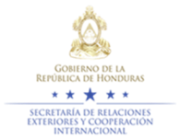
Thank you for your attention!

