Slide 1

Reintegration of Boys, Girls and Adolescents Victims of Trafficking and other Migrants in Vulnerable Situations
Guatemala, September 2013

Slide 2
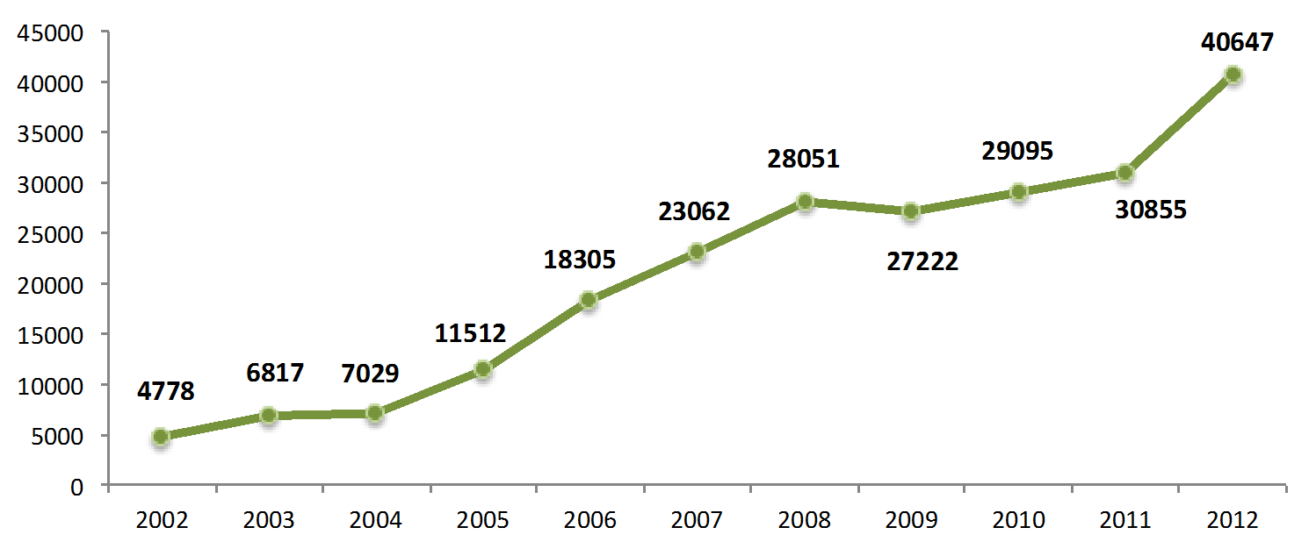
GENERAL CONTEXT
Guatemalan Nationals Repatriated from the United States

Slide 3
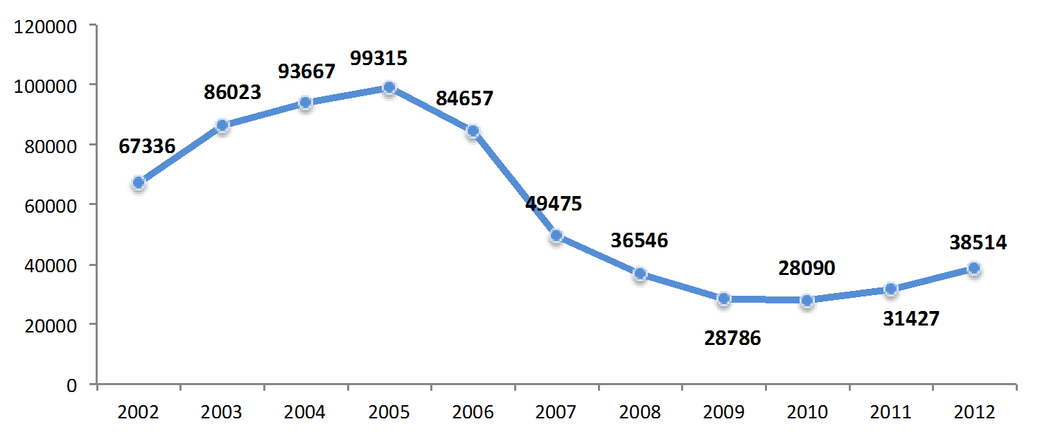
Guatemalan Nationals Repatriated from Mexico

Slide 4
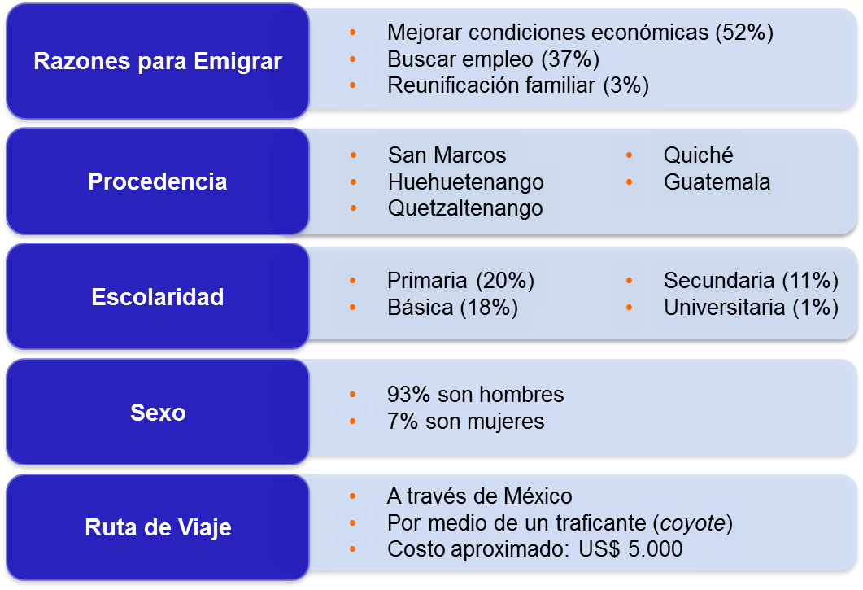
Characteristics of Migrants
To improve the financial situation (52%)
To seek employment (37%)
Family reunification (3%)
Reasons for Migrating
Place of Origin
Primary (20%)
Middle school (18%)
Secondary (11%)
College (1%)
Education Level
93% are men
7% are women
Gender
Through Mexico
Through a migrant smuggler (coyote)
Estimated cost: US$5,000
Travel Route

Slide 5
Characteristics of Migrants
Their families in Guatemala depended on the remittances they sent
Limited labour market
Outstanding debts
Psychological issues
Family separation

Slide 6
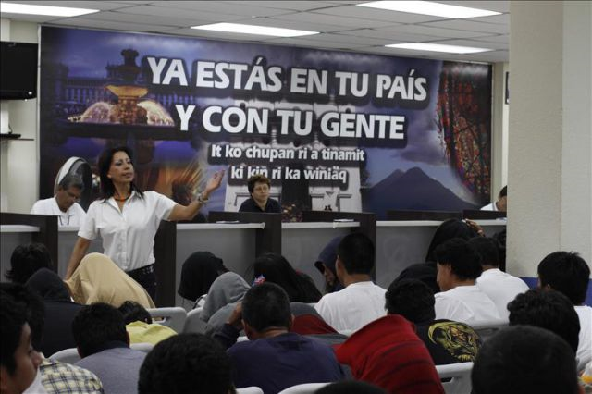
Guatemala, as a country of origin, transit, destination and return of migrants, has developed public policy on aid, protection and comprehensive assistance to migrant populations.
In this regard, the following should be highlighted as an important and innovative achievement: the implementation, since 2006, of the Centre for Assistance to Deported Persons, located within the Guatemalan Air Force. The centre was designed to provide timely, dignified and effective aid and essential assistance to deported Guatemalans, facilitating access to the services they need to enable a more dignified return to the country.
In addition, IOM provides valuable support through a programme named “Proyecto de Apoyo a Repatriados Guatemaltecos (GRP)”.

Slide 7
In regard to reintegration and integration, Guatemala is still in the process of implementing State programmes and projects. However, the following progress has been made:
Developing legislation on trafficking in persons, in accordance with guiding principles such as the “Life Project”.
Strengthening a strategy to address the issue of unaccompanied boys, girls and adolescents which allows the institutions to provide them with immediate assistance and detection of unreported cases of repatriation of minors. It also facilitates the provision and monitoring of basic services needed to provide comprehensive and personalized care based on the reintegration and prevention of irregular migration of this vulnerable sector of the migrant population.

Slide 8
Developing a strategy to address the migration of unaccompanied boys, girls and adolescents which, besides including the work on reintegration/integration, is based on the key principle of prioritizing reintegration into schools and also, facilitating an appropriate labour integration.
Ensuring the right to education for all children and young migrants and refugees, through administrative directives from the Ministry of Education.
Inter-institutional coordination with civil society organizations to implement programmes aimed at promoting social reintegration and controlling irregular migration.
Actions implemented in accordance with the national basic education programme to promote the reintegration of boys, girls and adolescents children of temporary migrant workers into school.

Slide 9
SOCIAL REINTEGRATION PROGRAMME FOR VICTIMS OF TRAFFICKING
The Programme for Social Reintegration of Girls and Adolescents Victims of Trafficking and other Crimes was established in 2010 to provide assistance to girls and adolescents affected by such crimes that could be eligible for family reintegration or living independently.
The primary objective of the programme is to implement actions that promote the comprehensive development of girls and adolescents, considering their requests and needs as well as specific contexts and promoting actions oriented toward the restitution of their rights and rescuing their life plan.

Slide 10
The Social Reintegration Programme assists girls and adolescents in 4 areas. Efforts are coordinated and information is exchanged between all 4 areas in order to provide comprehensive assistance to the girls and adolescents:
1. Psychological care
2. Justice administration
3. Legal aid
4. Social work and home coordination
The foundation of the efforts oriented toward social reintegration is the development of a “Life Plan or Project”, developed by each victim with support from an educator. The aspects considered in developing the Life Plan are: Research, Assessment, Plan of Action, and Follow-up.

Slide 11
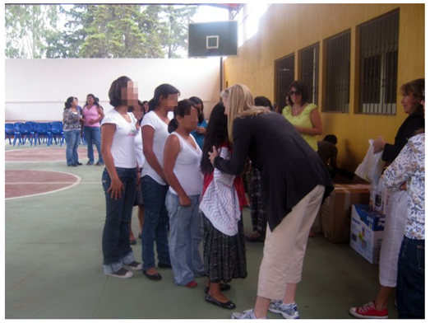
Sustainability
Under the components of counselling and social work, the social reintegration programme first implements methods with the girls and adolescents to establish their concerns and needs in regard to their families and social environment. Secondly, the programme interacts with the families with the aim of learning about, validating and assessing the situation of each family.
If reintegration is deemed appropriate, guidance and support is provided to the child within the family and in addition, guidance and support is provided to the other family members.
Local authorities and community leaders have been involved in these actions – particularly in the rural areas of the republic.

Slide 12
Lessons Learned
It is important to highlight that in order to obtain the best possible results in a reintegration programme, follow-up should be considered – through guidance and support of the girl or adolescent and her family – for a maximum period of two years.
Required Conditions
The social reintegration porgramme developed by La Alianza Association is sometimes limited in terms of actions to monitor the reintegration processes of girls and adolescents living in rural areas of the republic. Monitoring actions are seldom implemented or are sometimes carried out through telephone calls.

Slide 13
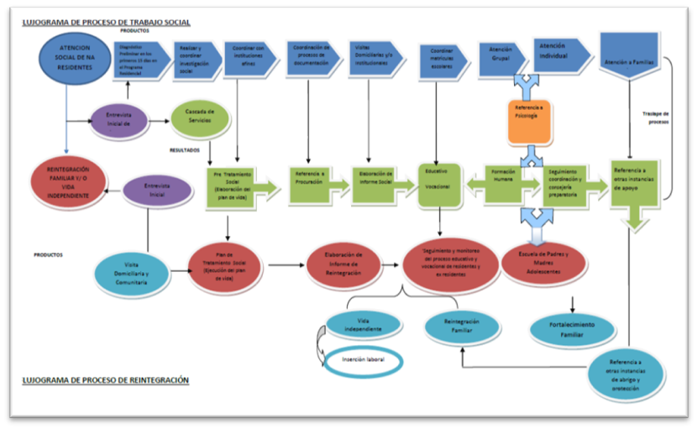

Slide 14
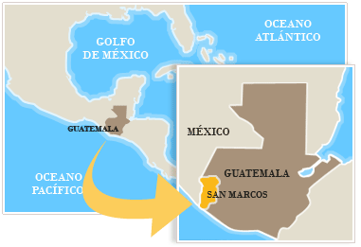
REINTEGRATION OF MIGRANT BOYS, GIRLS AND ADOLESCENTS AND PREVENTING MIGRATION IN CONCEPCIÓN TUTUAPA, SAN MARCOS
The programme initiated in 2010 in one of the municipalities with the highest irregular migration levels, located in the border region between Guatemala and Mexico.
The primary objective of the programme is to ensure protection of migrants in vulnerable situations, especially boys, girls and adolescents, through comprehensive reintegration and preventing irregular migration.

Slide 15
The programme for reintegration of migrants and preventing migration is developed around three central themes:
• Psychosocial workshops
• Educational reinforcement and awareness-raising workshops
• Technical/agricultural accompaniment

Slide 16
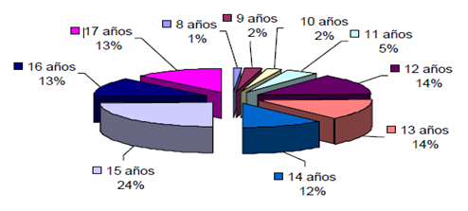
Achievements
100% of the boys, girls and adolescents with scholarships are continuing their education, and 100% of them have passed the 2 school years.
85% of the productive family projects have become sustainable.
85% of the 239 boys, girls and adolescents have not migrated again.
100% of the boys, girls and adolescents and their parents participating in the projects have been made aware of the risks and dangers of migration, and this process has been strengthened through psychosocial accompaniment.

Slide 17
Sustainability
The project has achieved positive results since it addresses not only boys, girls and adolescents; certain levels of participation of municipal governments and communities have been achieved (“Municipal/Community Participation Strategy”) and parents, leaders and community and municipal authorities have been included into the monitoring and evaluation process.

Slide 18
Lessons Learned
The starting point was the dissemination of information about the risks of migration. However, awareness-raising and psychosocial support were essential.
Scholarships have been accompanied by additional educational reinforcement classes.
The involvement and empowerment of municipal institutions, community authorities/leaders and parents has been a very important achievement which enables a long-term positive impact at a national level.

Slide 19
Thank you

