Slide 1

Government of Guatemala
Ministry of Foreign Affairs

Slide 2
advances by GUATEMALA relating to trafficking in persons
Ministry of Foreign Affairs
Guatemala, December 4, 2012

Slide 3
Advances Relating to Trafficking in Persons
at a National Level

Slide 4
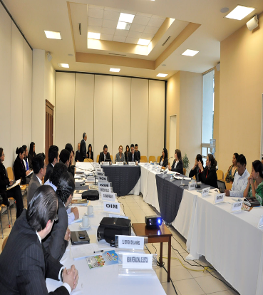
Inter-institutional Committee Against Trafficking in Persons (CIT)
Currently being coordinated with the Secretariat Against Sexual Violence, Exploitation, and Trafficking in Persons (SVET). Three ordinary meetings were held this year.

Slide 5
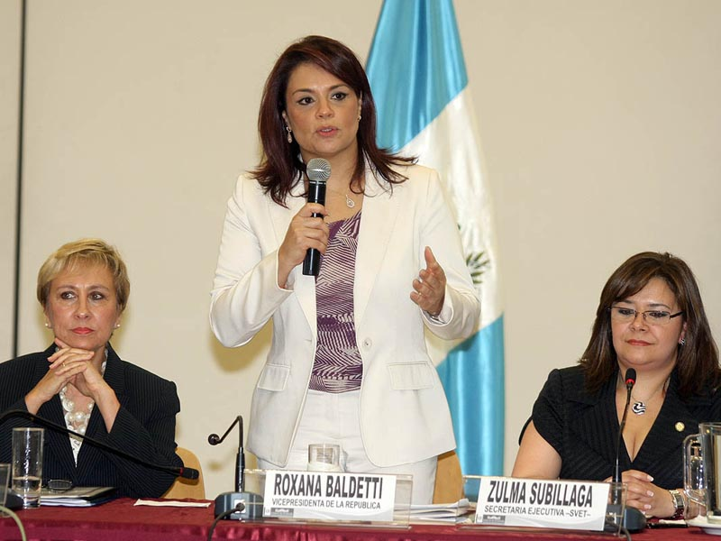

Slide 6
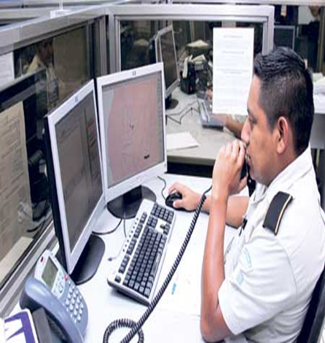
Prevention Actions
Training of consular officers
Dissemination workshops
A Protocol to identify cases of forced labour
Call Centre 1561
Radio broadcasts

Slide 7
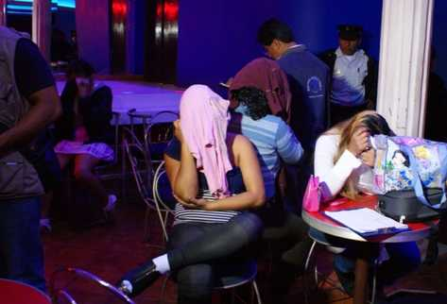
Assistance Actions
Regular accompaniment of the Multisectoral to identify and assist potential victims of trafficking in persons.

Slide 8
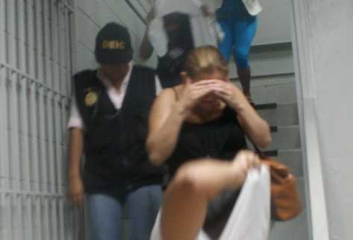
Investigation, Prosecution, and Punishment Actions
Investigation: Establishing a Unit Against Trafficking in Persons
Prosecution: Establishing the Public Prosecutor’s Office Against Trafficking in Persons
Punishment: Establishing specific courts for cases of trafficking in persons

Slide 9
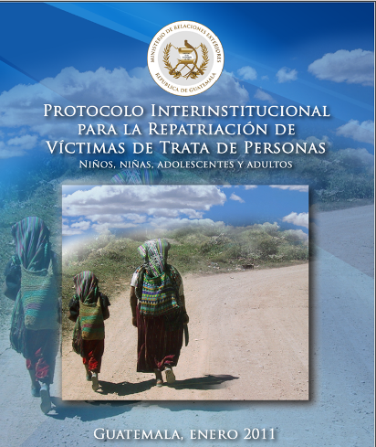
Repatriation Actions
Disseminating and implementing the Repatriation Protocol
12 repatriation processes have been completed this year, including 8 Guatemalan nationals and 4 foreign nationals

Slide 10
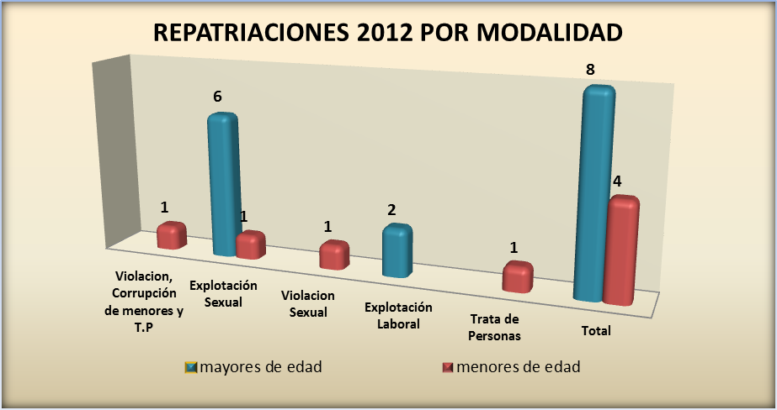
REPATRIATIONS IN 2012, BY MODE
Violations, corruption of under-age persons, and trafficking in persons
Sexual exploitation
Sexual assault
Labour exploitation
Trafficking in persons
Adults
Boys, Girls, and Adolescents

Slide 11
Advances Relating to Trafficking in Persons at a Regional Level

Slide 12

Regional Framework to Combat and Prevent Trafficking in Persons and Provide Assistance to Victims of Trafficking in Central America
National and Regional Guidelines to Strengthen Institutional Coordination to Combat Trafficking in Persons in Central America
A Regional Strategy for Comprehensive Assistance to and Accompaniment of Victims of Trafficking

Slide 13
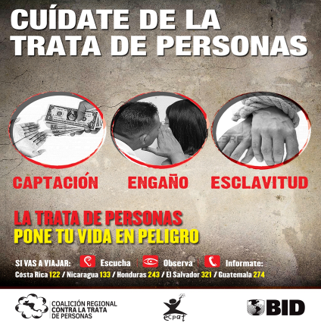
Regional Framework to Combat and Prevent Trafficking in Persons and Provide Assistance to Victims of Trafficking in Central America
A Regional Campaign to Prevent Trafficking in Persons developed, validated, and approved by National Committees.

Slide 14

Regional Coalition Against Trafficking in Persons
The objective of the Coalition is to establish and consolidate a regional space for discussion and coordination among representatives and coordinators of Coalitions, Committees, and Commissions established in each Central American country.

Slide 15
Advances Relating to Trafficking in Persons at an International Level

Slide 16
Report on Trafficking in Persons
Guatemala has shown, as a State, its commitment to combat trafficking in persons and has been classified under Level 2 of the TIP Report developed by the United States Department of State in the past two years.

Slide 17
III Meeting of National Authorities for Matters of Trafficking in Persons
To extend the “Work Plan to Combat Trafficking in Persons in the Western Hemisphere 2010-2012” for two more years.
To consider the victim at the centre of all processes in order to guide comprehensive assistance programmes enabling the social, labour, and economic reintegration of victims.
In addition, to promote non-tolerance of the crime of trafficking in persons and to promote information dissemination in order to make this crime visible and prevent impunity.

Slide 18
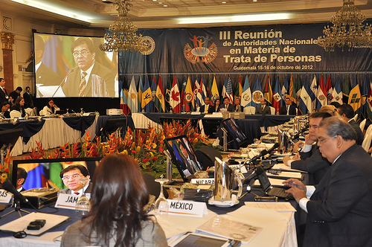

Slide 19
THANK YOU

