Slide 1

REPORT ON TRAFFICKING IN PERSONS 2013
Ministry of Foreign Affairs
Guatemala, November 18, 2013

Slide 2
Background
Guatemala as a country of origin, transit, destination and return of migrants, records boys, girls, adolescents and adults who become victims of trafficking in persons during their journey. This is a national and transnational crime that is increasingly affecting the general population.
To the Government of the Republic of Guatemala, discussing and addressing trafficking in persons is a priority and a cross-cutting theme on the national agenda of every State institution. This leads to the obligation to adopt and implement actions to prevent and combat the various modes of the crime of trafficking in persons.

Slide 3
Advances in Combating
Trafficking in Persons at a
National Level

Slide 4
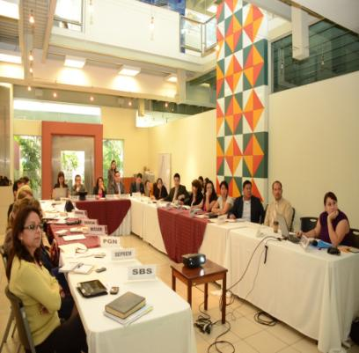
Inter-institutional Committee Against Trafficking in Persons (CIT)
The following has been achieved in 2013:
4 ordinary meetings;
2 extraordinary meetings;
6 work sessions of Sub-committees for
Prevention, Assistance, Strengthening
and Prosecution.

Slide 5
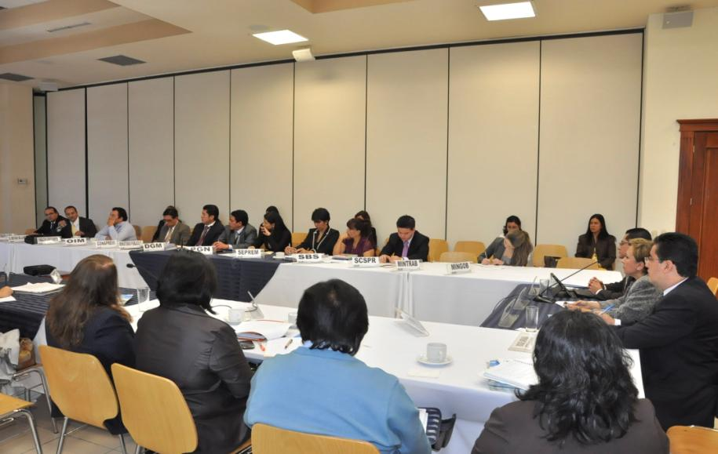

Slide 6
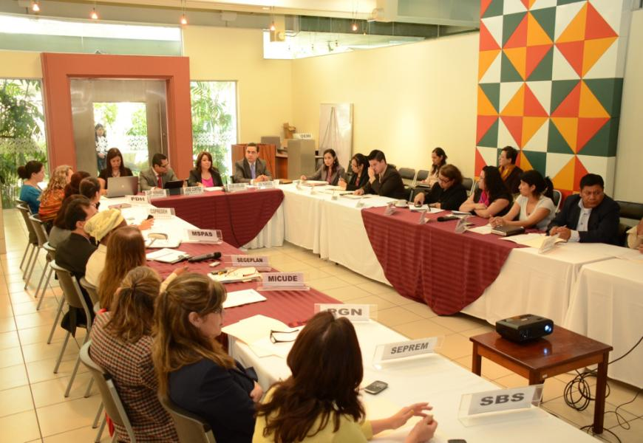

Slide 7
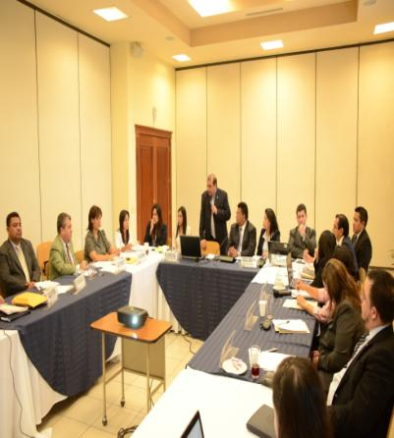
Prevention Actions
Training for consular officers;
Establishing a Monitoring Unit;
Dissemination workshops;
Information and awareness-raising
workshops;
Information and legal aid actions;
Training for labour inspectors from
national delegations.

Slide 8
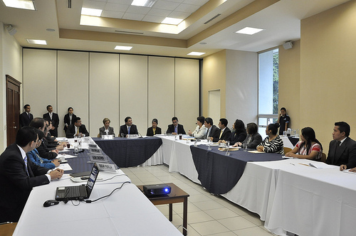
Prevention Actions
Training for students from schools and
high schools of the Republic of Guatemala;
Training for staff from health facilities;
Launching the campaign “No me dejo
engañar por agresores, tratantes y
explotadores de personas” [I will not be
deceived by aggressors, traffickers and
exploiters of persons”].

Slide 9
Detection and Assistance Actions
Implementing the Protocol of the General Labour Inspections Institution for the detection and referral of cases of trafficking in persons and the worst forms of child labour.
Implementing specialized temporary shelters for assistance to victims of trafficking.
Allocating vehicles to the Unit for Sexual Crimes and Trafficking in Persons of the Specialized Division of Criminal Investigation (DEIC) of the National Civil Police Force.

Slide 10
Repatriation of Victims of Trafficking
Guatemalan boys, girls
and adolescents
Foreign adults
Foreign boys, girls
and adolescents
Repatriations Trafficking 2013
Repatriations Migrant Smuggling 2013
Total Number of Repatriations

Slide 11
Repatriations by Mode, 2013
Sexual Exploitation
Labour Exploitation
Migrant Smuggling
Boys, girls and adolescents
Adults

Slide 12
Advances in Combating
Trafficking in Persons at a
Regional Level

Slide 13
Regional Memo of Understanding on
Trafficking in Persons
Guatemala has finalized the negotiations relating to the “Memo of Understanding between the Governments of the Republics of Costa Rica, El Salvador, Guatemala, Honduras and Nicaragua, Establishing the Implementation of the Regional Framework for Action to Address the Crime of Trafficking in Persons in Central America in a Comprehensive Manner”. The Memo is expected to be signed shortly by Member States.

Slide 14
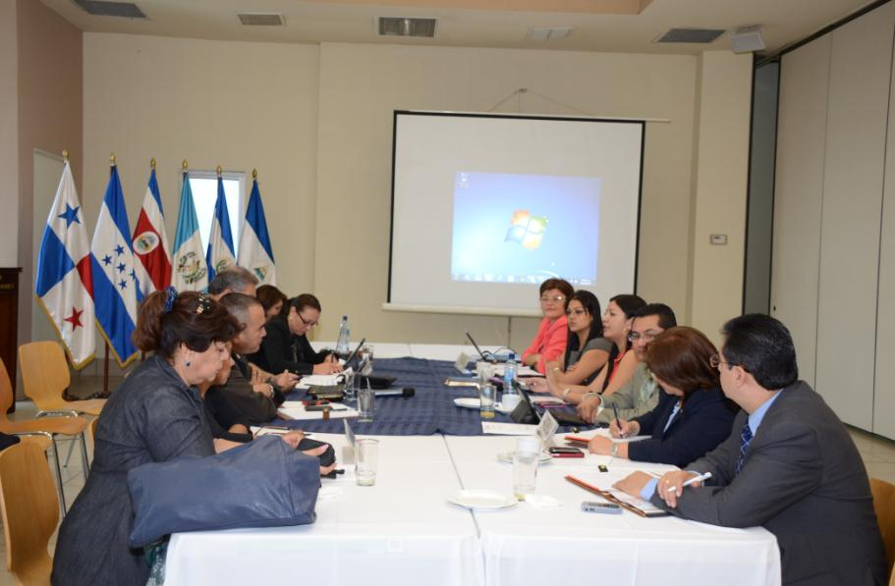

Slide 15
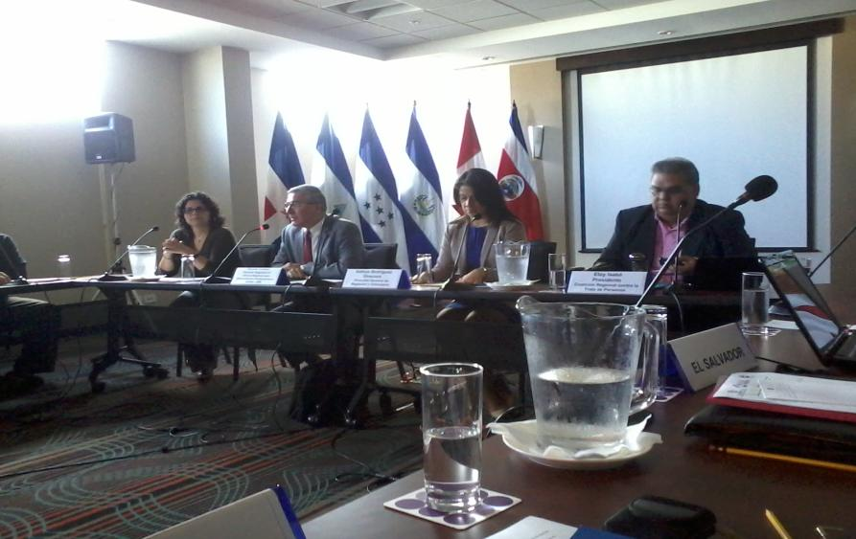

Slide 16
THANK YOU

