Slide 1

Consular Protection
Programmes and Actions
GUATEMALA
December 2012

Slide 2
The Government of Guatemala and Migration
The Government of Guatemala, being aware of the current problems relating to migration, has adjusted its Foreign Policy 2012-2016 with the aim of addressing the topic of migration in a comprehensive manner, considering that Guatemala is a country of origin, transit, destination, and return of migrants.
In this spirit, the Ministry of Foreign Affairs is committed – within the framework of its responsibilities and in compliance with international agreements and conventions and national legislation – to the establishment of a comprehensive policy, with full respect for human rights irrespective of the migration status of the person.

Slide 3
Consular Assistance and Protection for Guatemalan Nationals
The Government of Guatemala, through the Ministry of Foreign Affairs, has prioritized assistance and protection for Guatemalan nationals living abroad, Guatemalan nationals in transit toward countries of destination, and the assisted return of Guatemalan nationals to their communities of origin in Guatemala.
  Consular Assistance Sphere
    Guidance relating to migration;
    To deceased Guatemalans and Guatemalans in vulnerable situations;
    To victims of trafficking;
    Relating to education, culture, and tourism;
    Relating to document issuance and other procedures.

Slide 4
  Consular Protection Sphere
    Consular visits to ensure compliance with due process;
    Consular visits to hospitals to verify the care provided to sick persons;
    Visiting migration centres;
    Searching for missing Guatemalan nationals abroad;
    Comprehensive protection and assistance to unaccompanied boys, girls, and adolescents.

Slide 5
Strengthening the Consular Network
The Government of the Republic believes that the Consular Service of Guatemala should be strengthened and expanded. Therefore, 4 new offices will be established: Seattle, Washington, USA; Omaha, Nebraska, USA; Toronto, Ontario, Canada; and Chihuahua, Mexico.
  Current Consulates: 25 Missions
  12 consulates in the US
  10 consulates in the United Mexican States
  1 consulate in Canada
  1 consulate in San Pedro Sula, Honduras
  1 consulate in Belize
  Honorary Consulates:
  120 honorary consulates of Guatemala currently exist worldwide.

Slide 6
Supporting Migration Regularization
The Government of the Republic of Guatemala has established the objective of continuing to support Guatemalan migrants to enable them to regularize their migration status in countries of destination, with the purpose of ensuring full respect for their rights. In addition, coordinated efforts (government, civil society, and migrant communities) are being implemented to lobby for migration policy favouring Guatemalan migrants with irregular migration status in primary countries of destination – for example, the comprehensive migration policy of the United States.

Slide 7
Actions have been implemented to follow up on these efforts, and a new request has been made for Guatemalan nationals that could benefit from a Temporary Protected Status (TPS). In addition, consular actions are being carried out to support young Guatemalan nationals that comply with the requirements of the executive order of President Obama known as “Deferred Action”. To date, more than 5,000 have benefited from this order, according to the US Department of Homeland Security.

Slide 8
Programmes and Services for Guatemalan Nationals Abroad
Strengthening efforts shall continue to be implemented through executing and expanding assistance programmes and services that are considered to be beneficial to the community of Guatemalan migrants:
An assistance programme for deceased Guatemalan nationals and Guatemalans in vulnerable situations abroad
    A migration assistance and guidance programme
    A programme to search for missing Guatemalan nationals abroad
    Mobile consulates
    Consular services on Saturdays
    A programme for humanitarian aid for Guatemalan nationals returned from the United States by air
    A video-conference programme

Slide 9
Repatriation Fund for Deceased Persons: 185 beneficiaries.
Deported Guatemalan nationals assisted abroad: 42,979.
Programme to assist Guatemalan nationals deported from the United States by air: 36,754 persons served.
Men: 33,687 Women: 2,521

Slide 10
Assistance to Guatemalan nationals deported from Mexico: 33,780 persons (31/10/2012)
Men: 28,617 Women: 3,142
Boys: 1,553 Girls: 468
Fund for transferring deported migrants to their communities of origin: 5,920 persons benefited.
Assistance to persons in vulnerable situations: 15 persons benefited.

Slide 11
Assistance for the repatriation of unaccompanied boys, girls, and adolescents: 2,060 boys, girls, and adolescents:
446 –from the United States by air
1,614 –from Mexico by land
Assistance provided to Guatemalan nationals in prison or arrested: 5,402 persons.
Mobile Consulates implemented: 121.
Assistance to repatriated victims of trafficking: 12 victims (8 Guatemalan nationals and 4 foreign nationals).

Slide 12
Legal Aid and Guidance Programme
The legal aid programme has been redesigned. This service was provided through a contract with only one law firm that provided services to all 12 Consulates of Guatemala in the United States. The need was identified to decentralize, supervise, and implement efficient practices in regard to this service.
The Ministry of Foreign affairs has hired migration assistants and persons providing guidance relating to migration for each one of the 12 consulates accredited in the United States. The hired persons are qualified to serve, assist, and guide Guatemalan nationals abroad, mainly in regard to migration matters and related topics.

Slide 13
More than 2,129 persons have benefited from the redesigned services provided by each consulate. Alliances have been established with not-for-profit organizations that are authorized to provide legal aid, law firms providing legal services, and other types of associations working to benefit migrants.
Relevant studies have been initiated to implement this programme in Mexico.

Slide 14
Migrant Boys, Girls, and Adolescents
The Ministry of Foreign Affairs, led by Mrs Rosa Leal de Pérez, First Lady of the Republic, together with the Secretariat for Social Welfare of the President’s Office, the General Directorate of Migration, the Attorney General’s Office, and other Guatemalan State institutions, civil society organizations and international organizations involved in the topic of migrant boys, girls, and adolescents has promoted and implemented a series of actions to benefit migrant boys, girls, and adolescents.

Slide 15
The following actions should be highlighted:
  The upcoming approval of an executive order to establish the “Inter-institutional Committee for Comprehensive Assistance and Protection to Migrant Boys, Girls, and Adolescents” and the institutionalization and implementation of “Child Protection Officers”.
  Reviewing the project of the Protocol for the Assistance and Protection of Unaccompanied Boys, Girls, and Adolescents Repatriated from Mexico.
  Developing a project for a Protocol for the Assistance and Protection of Unaccompanied Boys, Girls, and Adolescents Repatriated from the United States of America.

Slide 16
Trafficking in Persons
For the Government of the Republic of Guatemala, the topic of trafficking in persons is a priority on the national agenda and an overarching theme to be discussed and addressed by each State institution. Therefore, actions should be adopted and implemented to provide comprehensive assistance to victims.

Slide 17
Assistance Centre for Migrants
As a result of the experience of the Ministry of Foreign Affairs in managing programmes to support migrant populations in order to provide a more comprehensive assistance to migrants and their families, the need has become apparent to restructure the Assistance Centre for Migrants.

Slide 18
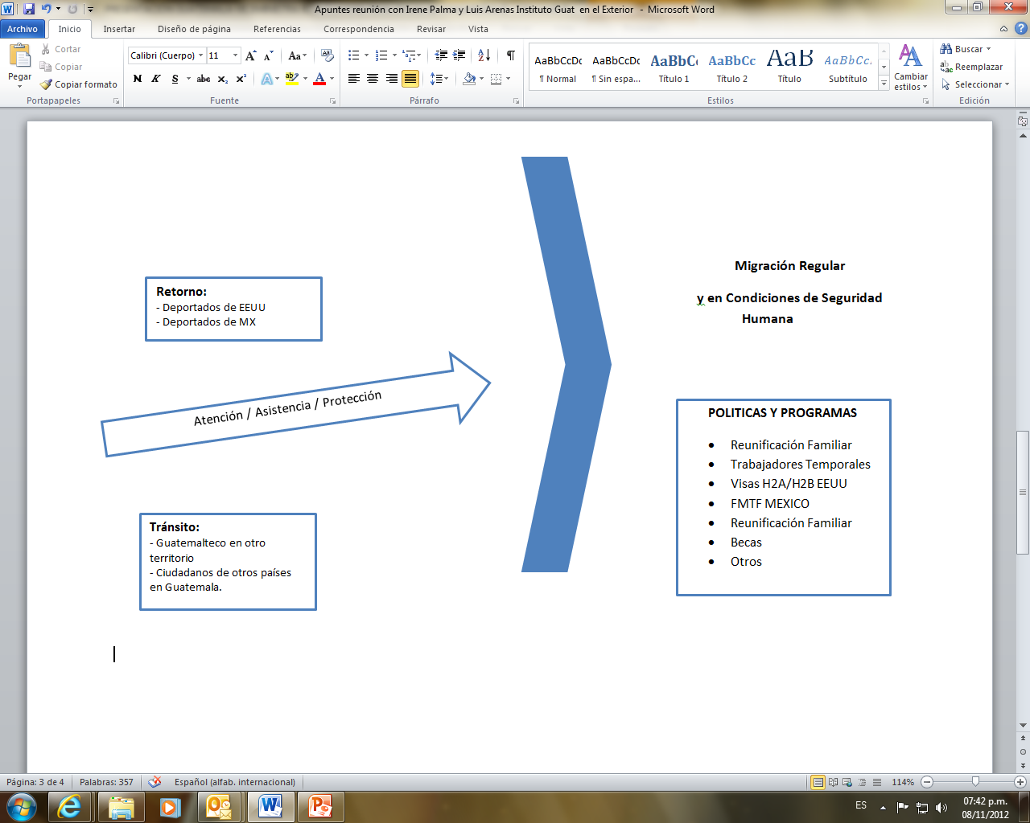
Designing Comprehensive Assistance Programmes
Regular Migration
Under Conditions of Human Security
Return:
- Deported from the US
- Deported from Mexico
Assistance / Protection
POLICIES AND PROGRAMMES
Family reunification
Temporary workers
H2A/H2B US visas
FMTF Mexico
Family reunification
Scholarships
Other
Transit:
- Guatemalan nationals in another territory
- Foreign nationals in Guatemala

Slide 19
THANK YOU

