Slide 1

Government of Guatemala
Ministry of Foreign Affairs

Slide 2
“ADVANCES OF GUATEMALA IN MATTERS RELATING TO
TRAFFICKING IN PERSONS”
Ministry of Foreign Affairs
Guatemala, June 24, 2014

Slide 3
Advances in
Trafficking in Persons at a National Level

Slide 4
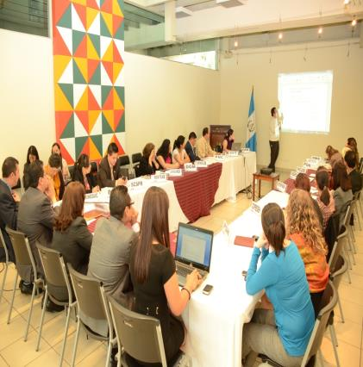
Inter-Institutional Commission Against Trafficking in Persons – CIT
The following meetings were held in 2013:
4 ordinary sessions
2 extraordinary sessions
6 meetings of subcommittees

Slide 5
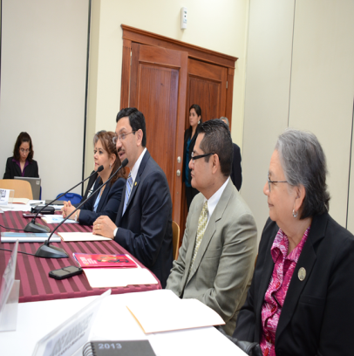
Inter-Institutional Commission Against Trafficking in Persons – CIT
The following meetings have been held thus far in 2014:
3 ordinary sessions
1 extraordinary session
2 meetings of subcommittees
13 departmental networks against sexual violence, exploitation and trafficking in persons established

Slide 6
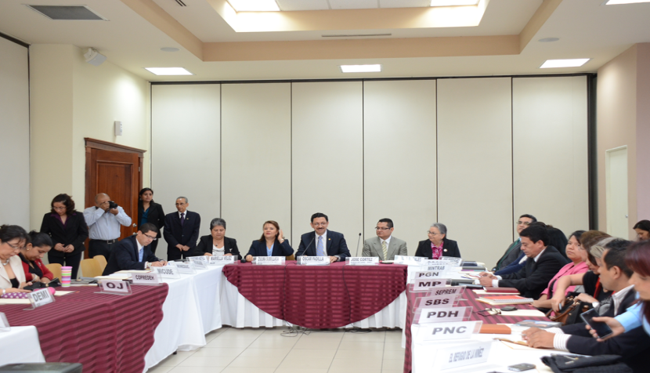
Inter-Institutional Commission Against Trafficking in Persons – CIT

Slide 7
Meetings of the Inter-Institutional Commission Against Trafficking in Persons – CIT

Slide 8
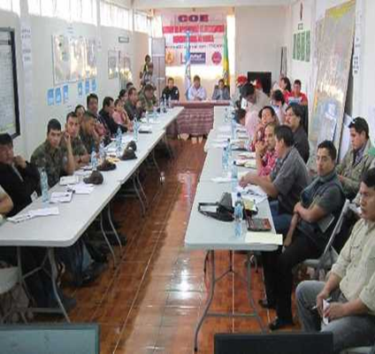
Departmental Networks
Sololá Departmental Network
13 departmental networks against sexual violence, exploitation and trafficking in persons established in 11 departments in the country

Slide 9
Prevention Actions
Training on prevention in various member institutions of CIT, for internal staff and the general public – approximately 89,474 persons were trained;
Campaigns, workshops and other activities on prevention of trafficking in persons, covering all 22 departments of the country and benefiting the general population;
Inter-institutional coordination for comprehensive assistance to victims of trafficking;
Including the topic of child labour in textbooks in primary schools at a national level;
Information and awareness-raising workshops;
Information and Legal Aid Days.

Slide 10
Identification, Assistance and Protection Actions
Entry into force of the Protocol of the Inspector General for Labour for the Identification and Referral of Cases of Trafficking in Persons disseminated at a national level to officials from the Ministry of Labour and Social Welfare;
As a result of research and inter-institutional coordination actions, advances have been made in regard to the identification of alleged victims of trafficking in persons. This has enabled rescuing the victims – the majority of them were boys, girls and adolescents, mainly victims of labour exploitation.
Specialized assistance to women and girls and female adolescents identified as alleged victims of trafficking in persons.

Slide 11
Protection and Assistance Actions

Slide 12
Repatriation Actions
Updating and disseminating the new Protocol on Inter-institutional Coordination for the Repatriation of Victims of Trafficking.
Orderly and safe repatriation of alleged victims of trafficking – Guatemalan nationals abroad as well as foreign nationals in Guatemala.

Slide 13
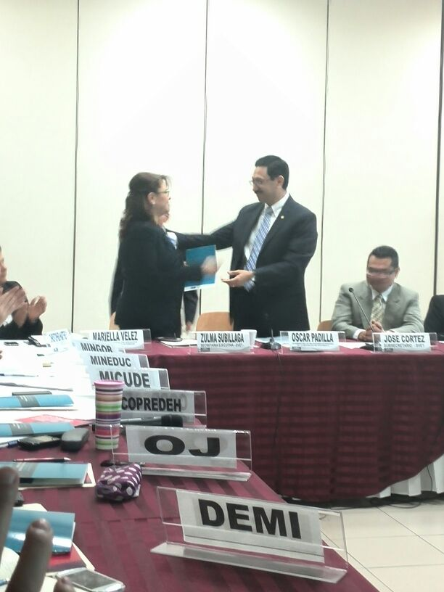
Repatriation Actions

Slide 14
Repatriations by Mode, 2013

Slide 15
Repatriations, 2013 – May 2014

Slide 16
Prosecution and Punishment Actions
The Prosecutor’s Office Against Trafficking in Persons of the Public Prosecutor’s Office has been strengthened, increasing the number of staff from 12 officials (in 2012) to 22 officials.
The number of indictments of cases of trafficking in persons increased to 62 in 2013.
In 2013, 67 persons were charged with the crime of trafficking in persons.
12 guilty judgments were issued in 2013 and 8 guilty judgments have been issued thus far in 2014.

Slide 17
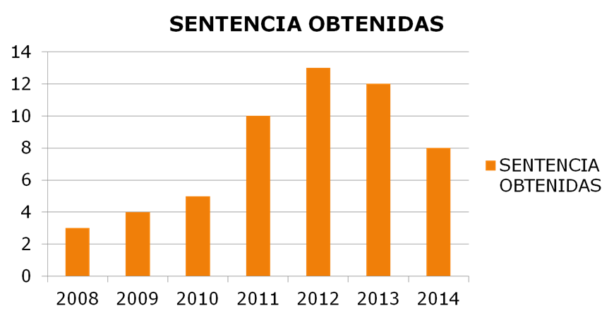
CONVICTIONS
CONVICTIONS

Slide 18
Prosecution and Punishment

Slide 19
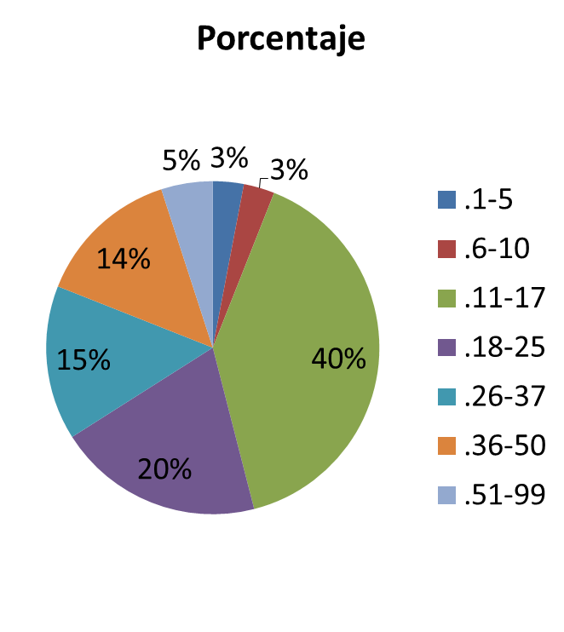
Ages of Victims Identified by the Public Prosecutor’s Office
Percentage

Slide 20
THANK YOU

