Slide 1

Republic of El Salvador
Reintegration of Boys, Girls and Adolescents
Victims of Trafficking and
Other Migrants in Vulnerable Situations
San José, Costa Rica, September 2013

Slide 2
Contents
1. The Context in El Salvador
2. Special Law for the Protection and Development of Salvadoran Migrants and their Families
3. National Council for the Protection and Development of Salvadoran Migrants and their Families (CONMIGRANTES)
4. Project for the Return and Reintegration of Unaccompanied Migrant Boys, Girls and Adolescents, executed by IOM with funds from the United States
5. Project for the Reintegration of Returned Migrants and Victims of Trafficking in El Salvador, executed by IOM with funds from Canada

Slide 3
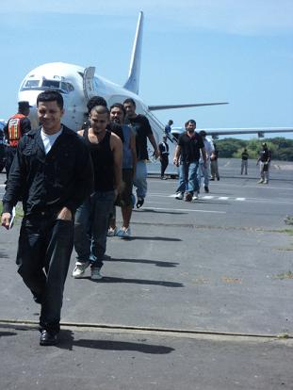
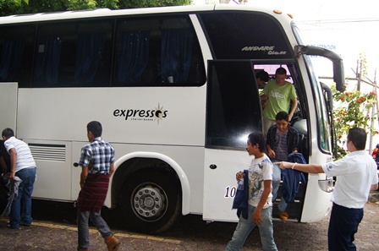
The Context in El Salvador
El Salvador currently faces the challenge of addressing one of the realities of the context of migration in El Salvador: providing assistance to migrant populations returning by air and land, and providing assistance and protection to victims of the crime of trafficking in persons and refugee status applicants, with a special focus on boys, girls and adolescents. Within this context, favourable conditions need to be gradually and progressively established for the social, labour and economic integration of the returned migrants.

Slide 4
STATISTICAL DATA
MIGRANTS RETURNED BY AIR AND LAND IN 2012 AND
JANUARY-JUNE 2013
Source: GENERAL DIRECTORATE OF MIGRATION AND IMMIGRATION

Slide 5
SPECIAL LAW FOR THE PROTECTION OF SALVADORAN MIGRANTS AND THEIR FAMILIES (CONMIGRANTES)
. Legislative Decree No. 655 (March 17, 2011)
Programme for the Assistance and Protection of Migrants
Migration and Development Programme
. To develop guiding principles aimed at ensuring the rights of Salvadoran migrants and their families through the design, development, evaluation, and monitoring of comprehensive public policies on protection and development, with inter-institutional and inter-sectoral coordination between the State and civil society in the national development processes.

Slide 6
Principles of the Law
Full respect for human rights
Non-discrimination
Extraterritorial protection
Special protection for groups in vulnerable situations
The Child’s Best Interest
Co-development

Slide 7
Members of CONMIGRANTES
Government Representatives:
  Ministry of Foreign Affairs, through the Vice-Ministry for Salvadorans Abroad
  Min. of Labour and Social Welfare
  Min. of Health
  Min. of Education
  Min. of Economy
  Min. of Agriculture and Livestock
  Min. of Tourism
  Min. of Justice and Public Security, through the General Directorate of Migration and Immigration
  Corporation of Municipal Governments of the Republic of El Salvador
  PGR and RNPN
Non-governmental Representatives
  3 representatives of Associations of Salvadorans Abroad
  1 representative of NGOs registered in El Salvador, interested and involved in the matter
  1 representative of private universities
  1 representative of the University of El Salvador
  1 representative of associations of micro, small, and medium enterprises (MIPYMES)

Slide 8
REINTEGRATION PROGRAMME FOR RETURNED MIGRANTS
The Vice-Ministry for Salvadorans Abroad has established the integration of returned Salvadoran migrants as one of its strategic lines of action.
Conceptual Framework: A human rights approach and promoting resettlement in the country.
A Programme for the Reintegration of Returned Migrants has been established within the General Human Rights Directorate.

Slide 9
REINTEGRATION PROGRAMME FOR RETURNED MIGRANTS
A State programme that promotes and facilitates the social and productive reintegration of returned migrants and fosters education and awareness-raising of the Salvadoran society about the phenomenon of migration, through coordinated efforts between civil society, the government and international cooperation. In addition, the programme promotes dignified reception of the returning migrants.

Slide 10
THE PROCESS OF REINTEGRATION OF RETURNED MIGRANTS
COUNSELLING
Group and individual therapy
LEGAL AID
Assistance for migrants with legal issues and victims of human rights violations
LABOUR ASSISTANCE
FAMILY AND COMMUNITY SUPPORT
Recognition of skills and diplomas / training opportunities, vocational courses
Coordination with private enterprises, local authorities, financing plans, etc.
Assistance for returned migrants and their families to facilitate their reintegration
EDUCATIONAL ASSISTANCE

Slide 11
Integration Processes
Seed capital, clothes selling business is generating income to survive.
Seed capital for raising chickens, self-sustainable, follow-up on the wife of the deceased person.
Coordinated efforts with the Ministry of Health, has received physical therapy to recover forearm and wrist mobility.
Treatment and follow-up at the Ministry of Health to address her situation. Basic food basket negotiated and support provided through equipment or raw materials to establish a pupusa (stuffed tortilla) business.
Assistance through the Ministry of Health (antenatal care), counselling. Basic food basket negotiated and support provided through equipment or raw materials to establish a pupusa (stuffed tortilla) business.

Slide 12
Integration and Follow-up Processes
6 months rent paid and a washing machine provided to enable her to generate income, since she will offer laundry services.
Support from Don Bosco University for a prosthetic leg, and support for raw materials and seed capital for a pupusa business.
Efforts are being coordinated with the Ministry of Education, she expressed the wish to continue her education to improve her quality of life and find dignified employment.
Is receiving counselling through the Ministry of Health and treatment for removal of body tattoos.
Support from Don Bosco University for a prosthesis, as well as support from EDUCAME to continue education and counselling through the Ministry of Health.
Seed capital for buying and selling clothes.

Slide 13
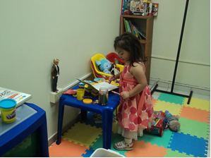
4. PROJECT FOR THE RETURN AND REINTEGRATION OF UNACCOMPANIED BOYS, GIRLS AND ADOLESCENTS
IOM/El Salvador developed this project with support from the U.S. Department of State, financed by the Bureau of Population, Refugees and Migration of the U.S. Department of State.
The project has provided the following assistance for reintegration:
a) Institutional and community support to ensure the well-being and comprehensive development of boys, girls and adolescents in a safe environment.
b) Assistance in a wide range of aspects, especially education, health and integration.
c) Supporting the family of the boy, girl or adolescent in the country of origin through vocational training and negotiating micro-credits, with the objective of promoting the improvement of living conditions.

Slide 14
5. Project for the Reintegration of Returned Migrants and Victims of Trafficking in El Salvador
The programme, which is executed by the International Organization for Migration (IOM) is an important element in accompanying the efforts of the Government of El Salvador to improve the services provided to returned Salvadoran nationals, strengthening the foundations for sustainable assistance and referral.
Components:
1. Component 1: To improve infrastructure and equipment to meet the immediate needs of returned Salvadoran nationals.
2. Component 2: Technical and operative capacity-building to enable the Department of Assistance to Migrants to provide psychosocial support to returned Salvadorans with special needs.
3. Component 3: Promoting economic reintegration through productive initiatives.

Slide 15

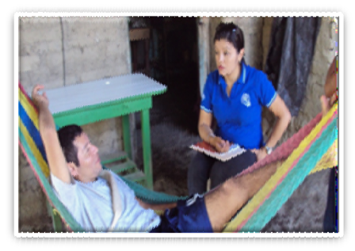


Achievements of the Project for the Reintegration of Returned Migrants and Victims of Trafficking in El Salvador
Benefits for Migrants:
1000 pairs of shoes;
1000 shirts;
1000 personal hygiene kits;
1000 basic food baskets;
1000 toy kits;
17 scholarships for vocational courses;
20 Salvadorans, selected due to their particular situation and accompanied in a psychosocial reintegration process, reintegrated into productive life and received support to start their own business;
Counselling;
Improving infrastructure for immediate assistance;
Prescription drugs.

Slide 16
THANK YOU

