Slide 1





National Plan for the Regularization of Foreign Nationals
January 2014

Slide 2

GENERAL OBJECTIVE
To enable foreign nationals living in the country with irregular migration status to regularize their migration status.

Slide 3
SPECIFIC OBJECTIVES
To enable foreign nationals with irregular migration status to approach public authorities.
To identify the length of their stay in Dominican territory.
To grant legal status to these migrants.

Slide 4
ACTORS
Associated Actors
Ministry of the President’s Office
Administrative Ministry of the President’s Office
Ministry of Labour
Ministry of Public Health and Social Welfare
Central Electoral Board
Law Enforcement Institutions of the State
Diplomatic Missions
International Cooperation
Civil Society
Key Actors
National Migration Council
Ministry of the Interior and Police
General Directorate of Migration
Ministry of Foreign Affairs
Notes:
Ejecutor DGM preguntar a Samir

Slide 5
SCOPE
  Persons subject to regularization:
  Persons that have entered national territory in an irregular manner;
  Persons that have entered national territory in an irregular manner and whose irregular status is a result of:
    Having overstayed the authorized period of time in national territory;
    Having infringed the conditions of their regular migration status;
    Children of foreign nationals with irregular migration status that have not been registered in the Civil Registry of the Dominican Republic (Art. 7, Act 169-14).

Slide 6
SCOPE
Specific Cases:
  Procedures based on the immediate family;
  Foreign nationals in vulnerable situations:
    Senior citizens;
    Foreign boys, girls and adolescents;
    Persons applying for a medical treatment.

Slide 7
TARGET POPULATION
Total Number of Immigrants:
5.4% (524,623) of the country’s total population.
Primary Countries of Origin:
Haiti, United States and Puerto Rico, Spain, Italy, China, France, Venezuela, Cuba, Colombia and Germany.

Slide 8
DISTRIBUTION OF THE TARGET POPULATION

Slide 9
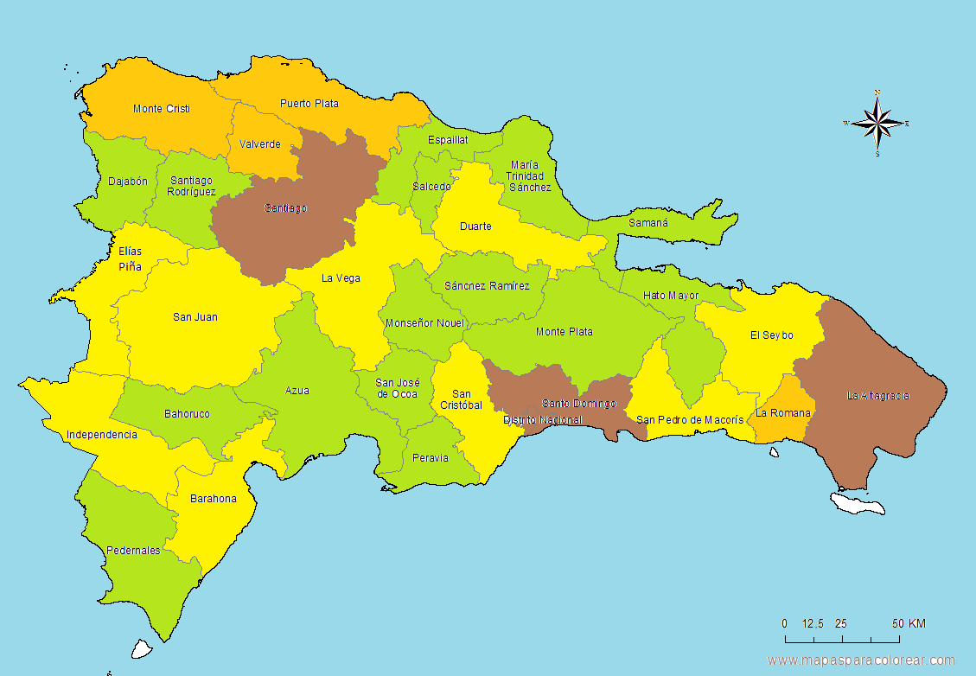

DISTRIBUTION OF THE TARGET POPULATION
Very High
High
Medium
Low

Slide 10
PHASES
PHASE I
December 1, 2013 - May 31, 2014
To plan, budget, institutionalize and organize resources, conditions and institutions required for the technical, labour and administrative implementation of the Plan.
Purpose
PHASE II
June 1, 2014 – May 31, 2015
To accredit immigration documents based on an assessment, review and supervision process.
Purpose

Slide 11






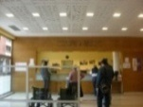
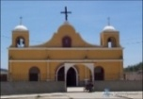
GENERAL OUTLINE OF THE PROJECT
One-Stop Single Operation Regularization
Information and/or Promotion Centres
Immigrant
Customer Service
Reception and Registration Centres
Personalized telephone assistance
Mobile units
Permanent offices
Electronic means and social networks
Registration of Applications
Promoters/monitoring officers
Assessment
Approval
Delivery
Issuance
Governments
Churches
Renewal
Civil Society Accompaniment
Management and Quality Control

Slide 12
CHALLENGES
High sensitivity of migration matters;
A 45-day processing period;
Interacting with persons with various educational levels and cultural background.

Slide 13
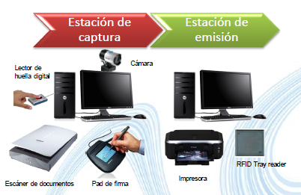
APPROACH
An Automated Solution:
Receive applications;
Record biometric data;
Issue a proof of application for the applicant;
Process, make a decision and communicate the decision;
Issue highly secure documents.

Slide 14
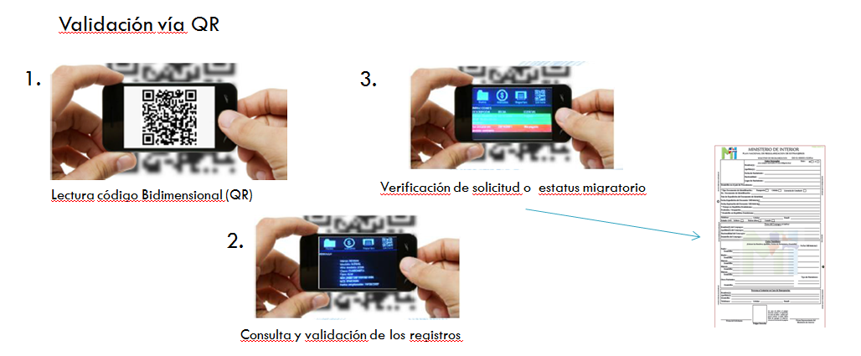
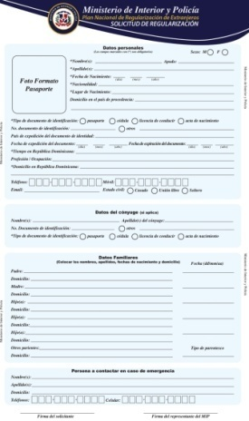
COMPONENTS
Physical:
A centralized highly available technology platform;
Recording applications, biographic and biometric data of applicants and verification by authorized institutions.

Slide 15

COMPONENTS
II. Logical:
A centralized data base system;
AFIS, which enables storing and managing biometric and socio-demographic data.

Slide 16
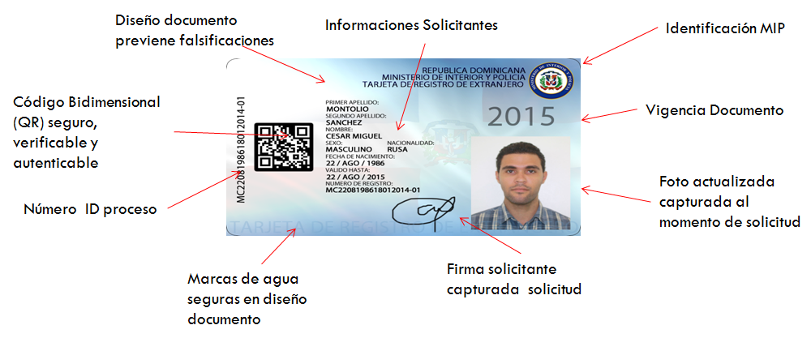
COMPONENTS
III. PRINTING:
A system (ID Trust) that enables the issuance of an identity card which allows authenticating the holder:
  Verifying the migration status;
  Verifying the authenticity of the document.

Slide 17
CENTRES FOR ASSISTANCE AND REGISTRATION OF
FOREIGN NATIONALS
National Structure:
35 facilities;
Headquarters located in the National District;
1 facility in each provincial government;
3 mobile units;
A free call centre, dial *788.

Slide 18

INFORMATION/INSTRUCTIONS BROCHURE
Instructions
(Spanish – Creole – English)
A list of requirements to access the National Plan for the Regularization of Foreign Nationals.

Slide 19
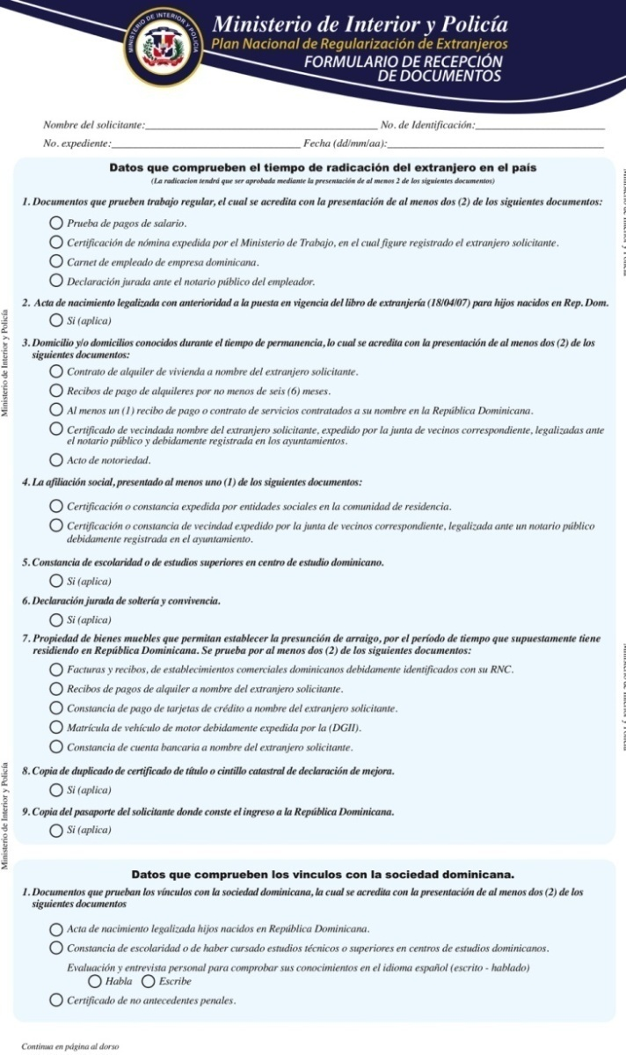
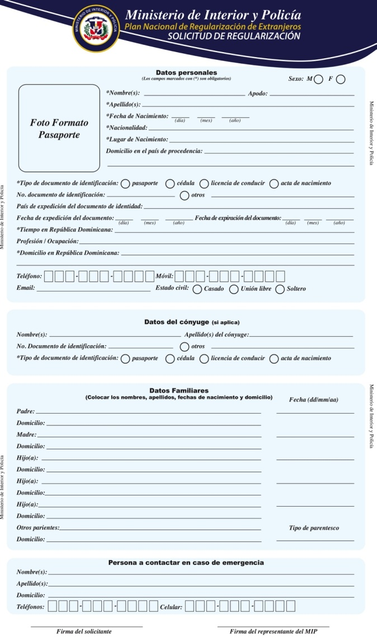
FORMS
Designing forms:
Regularization application form;
Document reception form;
Proof of process.

Slide 20
PROCESSES
A manual for the regularization process and a path of the records throughout the process have been designed.
Transfer
Reception and Registration
Supervision
Coordination, Control and Distribution
Approval
Identity Card Issuance
Coordination, Control and Distribution of Identity Cards
Delivering the Identity Card or Refusal Certificate
Data Cleaning
Coordination, Control and Distribution
Coordination, Control and Distribution
Data Entry

Slide 21
HUMAN CAPITAL
Human Capital
Position
Director
Coordinator
Area Supervisor
IT Support
Secretary
Receptionist
Customer Service
Interpreter
Operator
Data Entry
Driver
Security Guard
Janitor
Manuals on profiles;
Wage scale;
Minimum staffing requirements of the centres;
Staff that speak Creole and English.

Slide 22
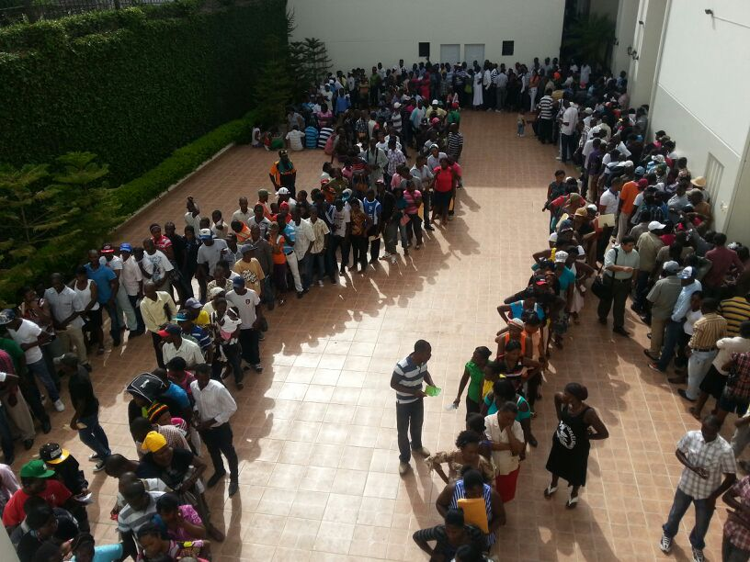
Santiago de los Caballeros

Slide 23
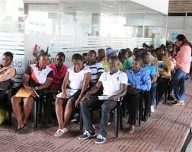
NATIONAL DISTRICT

Slide 24
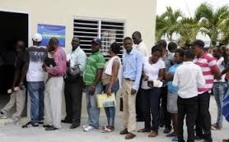
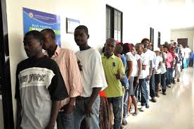
OTHER PROVINCES

Slide 25
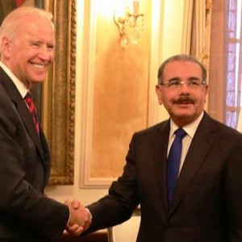
Biden congratulates President Medina on the Plan for the Regularization of Foreign Nationals.

Slide 26
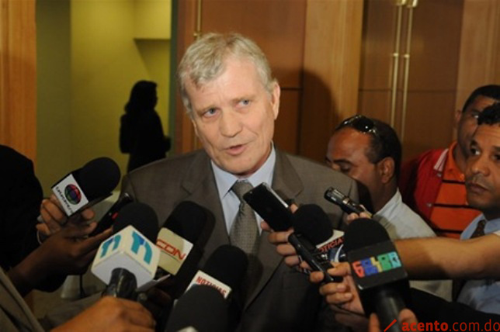
The Ambassador of Canada considered the Plan for the Regularization of Foreign Nationals as positive.
George Boissé

Slide 27

Thank you

