Slide 1

DOMINICAN REPUBLIC
ADVANCES RELATING TO THE MIGRATION REGULARIZATION PROGRAMME FOR TEMPORARY WORKERS IN THE DOMINICAN REPUBLIC
XVII REGIONAL CONFERENCE ON MIGRATION (RCM)
PANAMA CITY, PANAMA
JUNE 19-22, 2012

Slide 2
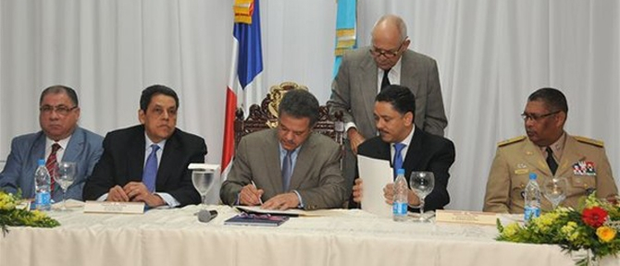
THE PRESIDENT OF THE DOMINICAN REPUBLIC, DR LEONEL FERNANDEZ, SIGNS BYLAWS 631-11 TO IMMIGRATION LAW 285-04

Slide 3
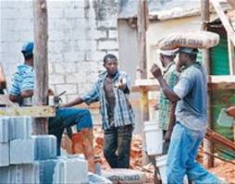
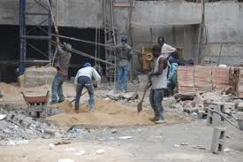
53% OF THE CONSTRUCTION WORKERS IN THE DOMINICAN REPUBLIC ARE HAITIAN NATIONALS.

Slide 4
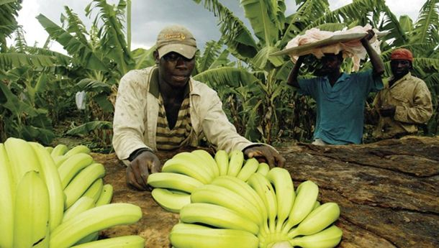
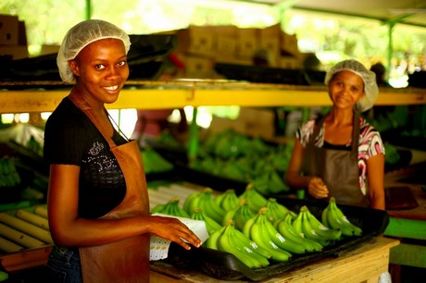
51,000 PERSONS WORK IN THE NORTHWESTERN AND SOUTHEASTERN REGION OF THE COUNTRY PREPARING SOIL, GROWING CROPS, HARVESTING, AND PACKAGING BANANAS. 63% OF THEM ARE HAITIAN NATIONALS – THAT IS, 32,130.

Slide 5
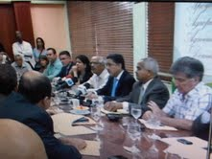
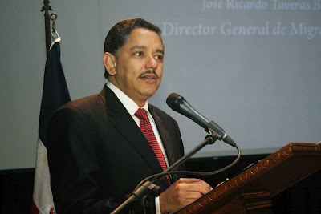
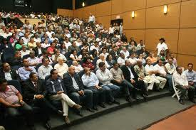
Immigration and agricultural entrepreneurs meet to discuss the status of Haitian workers in the Dominican Republic
CONFERENCE FOR AGRICULTURAL MOCHA PRODUCERS ON IMMIGRATION REGULATIONS, MIGRATION POLICY, AND THE LABOUR MARKET.

Slide 6
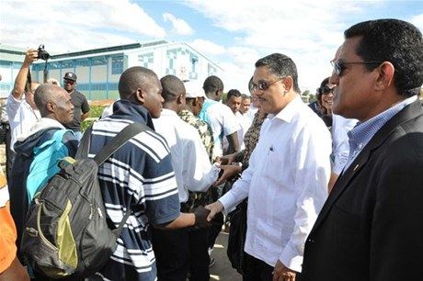
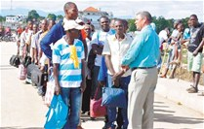
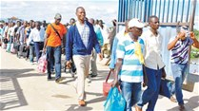
January 9, 2012
Immigration receives the first contingent of Haitian workers entering the country in a regular manner.

Slide 7

TOTAL NUMBER OF WORKERS: 800
TO BE DOCUMENTED: 600 WORKERS
CURRENTLY DOCUMENTED: 380
TO BE DOCUMENTED: 220

Slide 8

THANK YOU

