Slide 1
TEMPORARY AGRICULTURAL WORKER PROGRAMMES
Mexico – Canada
Daniel Aguado Ornelas
Sub-director of Protection Policy
General Directorate for the Protection of Mexicans Abroad
Secretariat of Foreign Affairs

Slide 2
TEMPORARY AGRICULTURAL WORKER PROGRAMME
The Temporary Agricultural Worker Programme (PTAT) was established in 1974 with the signing of the Memo of Understanding between the Government of the United Mexican States and the Government of Canada. PTAT incorporates mechanisms from the Bracero Agreements with the United States that were in effect from 1941-1964.
The Programme is a bilateral cooperation model which promotes temporary orderly and safe migration flows of Mexican agricultural workers, ensuring respect for their labour, social, and human rights.

Slide 3
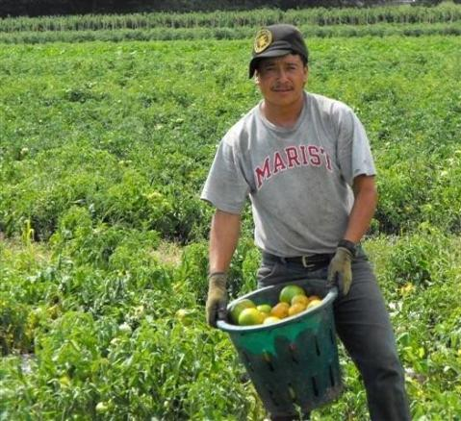
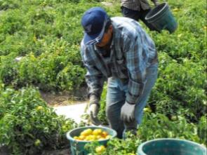
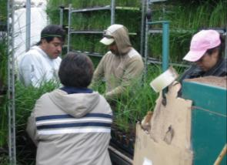
TEMPORARY AGRICULTURAL WORKER PROGRAMMES
Agricultural workers in Toronto

Slide 4
To date, 225,181 Mexican agricultural workers have participated in the programme.

Slide 5
PARTICIPATING WORKERS
BY CANADIAN PROVINCE, 2007-2011

Slide 6


PTAT – MEMO OF UNDERSTANDING
Canada The Canadian government regulates admittance of workers, indicates the numbers of workers required, notifies cancellations, and grants employment notifications. | Mexico The Mexican government recruits and selects agricultural workers, integrates and processes documents, and submits data on workers and their dates of arrival in Canada to relevant authorities.

Slide 7
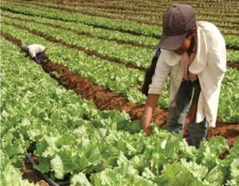
REQUIREMENTS TO JOIN PTAT
To be a Mexican citizen
To be 22-45 years old
To be a peasant or agricultural worker or perform tasks related to agricultural work and to live in a rural area
Education: 3rd grade minimum, 9th grade maximum
Men and women that are married or in a legally binding relationship, and – as an exception – single persons with financial dependants

Slide 8
PTAT GUIDELINES
Obligations of the Employer:
  No more than 40 hours or six days of work each week;
  Providing accommodation, food, and transport for workers;
  Covering health costs for workers and providing all security measures required by the law;
  Paying at least the established minimum wage;
  Depositing a part of the salary to an account to be used by the family of the agricultural worker.
Obligations of the Worker:
  Working for the same employer during the established period;
  Working during a 14-day trial period;
  Returning to his/her country of origin;
  Reimbursing the employer for the cost of migration procedures and other services provided. These amounts are reviewed.

Slide 9
PTAT REVIEW AND MONITORING MECHANISMS
A regular review of the operational rules
Annual inter-governmental evaluation meetings of:
  Government institutions of Mexico and Canada – federal and provincial;
  Representatives from associations of close to 1000 employers from Ontario, Quebec, and British Columbia.
Inter-secretarial meetings in Mexico to review competencies:
  Secretariat of Labour and Social Welfare (STPS)
  Secretariat of Foreign Affairs (SRE)
  Secretariat of Health (Salud)
  Secretariat of the Interior (Segob)
  Treasury and Public Credit Department (SHCP)

Slide 10
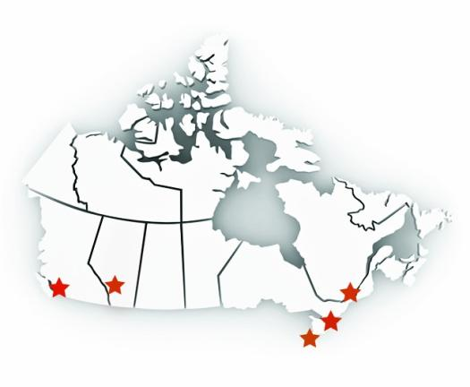
CONSULAR NETWORK OF MEXICO IN CANADA
Consulates keep records of all agricultural workers and employers from different provinces of Canada that participate in the programme:
General Consulate of Mexico in Montreal, Quebec
General Consulate of Mexico in Toronto, Ontario
General Consulate of Mexico in Vancouver, British Columbia
Consulate of Mexico in Leamington, Ontario
Consulate of Mexico in Calgary, Alberta
Yukon Territory
Nunavut Territory
Terranova
North-Western Territories
British Columbia
Quebec
Alberta
Manitoba
Prince Edward Island
Ontario
Nova Scotia
New Brunswick
Saskatchewan

Slide 11
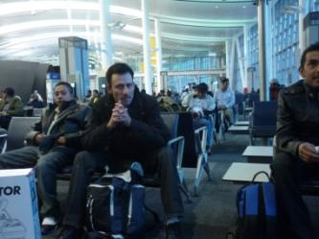
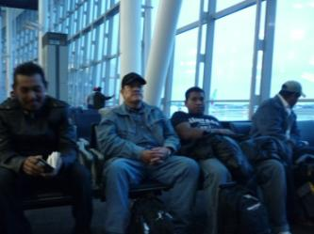
CONSULAR ASSISTANCE ACTIONS
Arrival of Workers in Canada
Verifying that the workers have arrived in Canada in order to respond to requests from employers or request substitute workers.
Workers at the Toronto airport, before returning to Mexico.

Slide 12
CONSULAR ASSISTANCE ACTIONS
Visits to Farms
Providing information to workers about their rights, obligations, and benefits;
Reminding them that they should have a bank account to facilitate sending financial resources or receiving payments from the employer;
Reminding them that they should submit their tax declaration before returning to Mexico, with the aim of requesting – if applicable – reimbursement of any retained taxes.

Slide 13


CONSULAR ASSISTANCE ACTIONS
Visits to Farms, cont.
Ensuring compliance with the terms and conditions of contracts and providing good offices in cases of conflicts between workers and employers.
A “farm” and crops covered with plastic in Saskatoon.

Slide 14
CONSULAR ASSISTANCE ACTIONS
  Procedures before Authorities
Consulates provide assistance to workers for procedures before province authorities, such as payments for medical disability, parental rights, etc.
4) Assistance in Case of Accident or Disease
Consular officers visit hospitals when a worker is transferred due to health reasons, to verify the condition of the worker and establish what type of assistance can be provided and to collect information to be provided to the worker’s family and STPS.
5) Legal Aid
Consular officers ensure compliance with the labour conditions established in PTAT and provide assistance in cases of denouncement of violations under the programme.

Slide 15
PTAT IN FIGURES
Approximately 7 out of every 10 workers (70%) return as nominal workers the following season.
Close to one third (30%) of new workers join the programme each year (selected workers).
STPS keeps a list of 300 substitute workers to replace workers that cannot join PTAT.
In 2011, consulates of Mexico in Canada only received 27 complaints against PTAT employers, out of a total number of 16,494 hired workers.

Slide 16
CONSIDERATIONS
Various mechanisms are in place in PTAT to reduce potential conflicts between workers and employers:
  Existence of a mutual agreement (Memo of Understanding between Canada and Mexico) which provides a specific legal framework regulating programme operations.
  Clearly defined roles of authorities from both countries to ensure compliance of the programme in relevant areas.
  An on-going review of the programme and regular meetings of authorities at a domestic and international level.
  Timely intervention of consular officers to provide information and preventative protection.

Slide 17
TEMPORARY AGRICULTURAL WORKER PROGRAMME
MEXICO – CANADA
Daniel Aguado Ornelas
Secretariat of Foreign Affairs
Sub-director of Protection Policy
Plaza Juárez #20, Colonia Centro
Ciudad de México, Distrito Federal
CP 06010, Mexico
Tel. 52 (55) 36 86 51 00, Ext. 7539
daguado@sre.gob.mx

