Slide 1
LEGAL TOOLS FOR THE PROTECTION OF THE LABOUR RIGHTS OF MIGRANTS IN THE UNITED STATES
The Experience of Mexico
Daniel Aguado Ornelas
Sub-director of Protection Policy
General Directorate for the Protection of Mexicans Abroad
Secretariat of Foreign Affairs

Slide 2
LABOUR MIGRATION
MEXICO – UNITED STATES
Mexico has the second highest documented flows after Canada of temporary labour migration to the United States – 516,000 workers in 2010.
  In that year, 1 out of every 5 temporary workers in the US came from Mexico (18.3%).
  In regard to Mexican temporary agricultural workers, the percentage was 91% - 9 out of every 10 workers.
In addition, undocumented migration occurs primarily for economic reasons. At least 70% of the migrants in the US stated that they had migrated to “work or find employment” in the US.

Slide 3
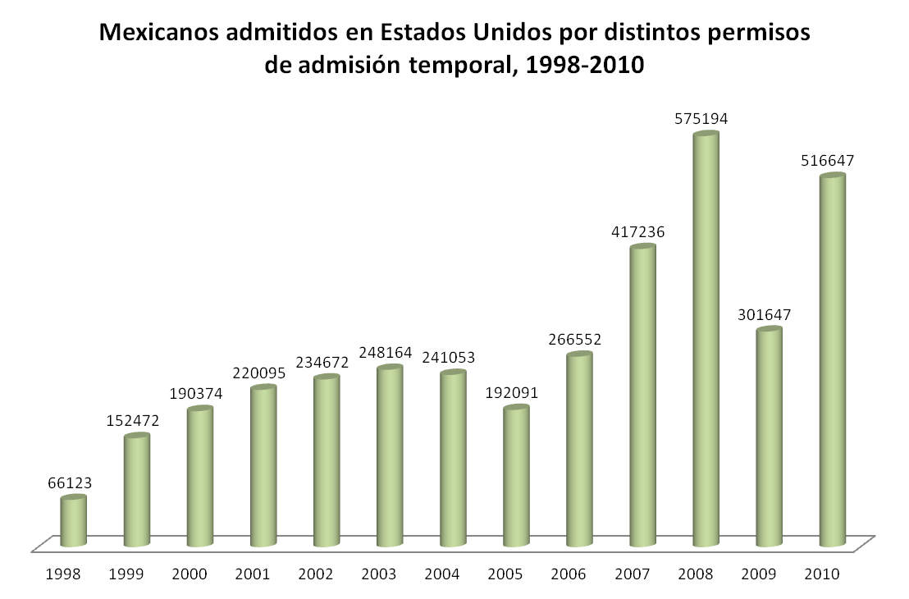
Mexicans Admitted into the US with Different
Temporary Stay Permits, 1998-2010
Source: Office of Immigration Statistics, 2010, US Yearbook of Immigration Statistics, DHS, 2011.

Slide 4
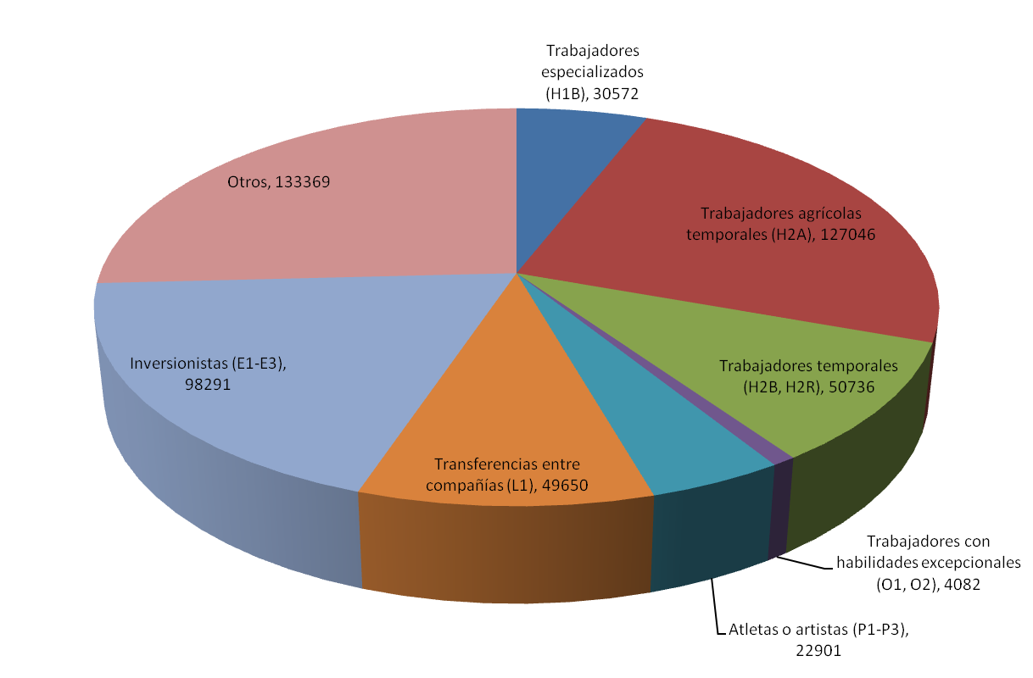
Mexican Temporary Workers Accepted by the US, by Type of Visa, 2010

Slide 5
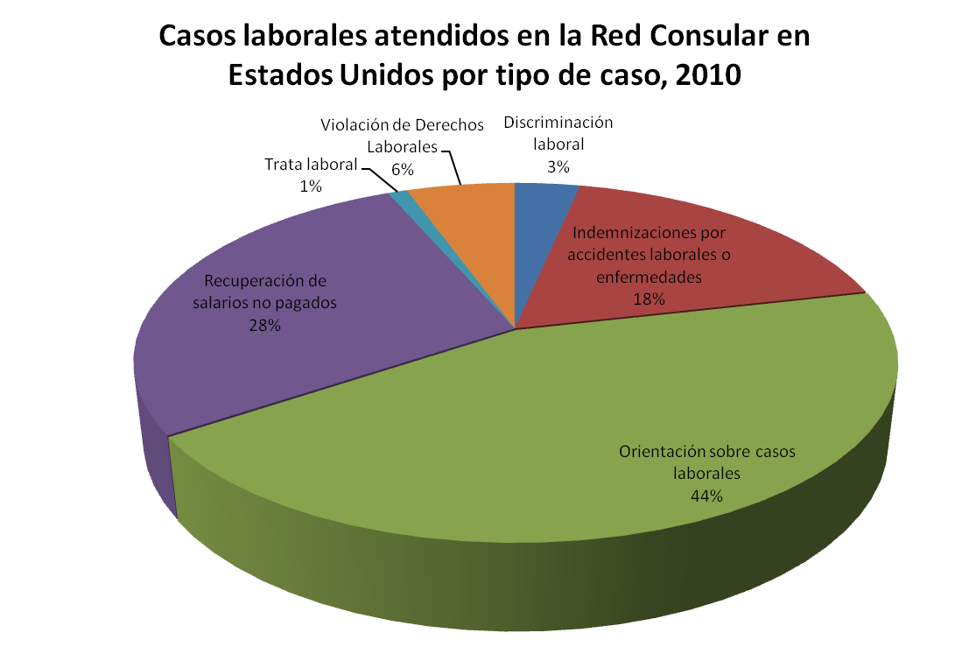
In 2010, the consular network of Mexico in the US assisted 128,819 cases of protection; 2,809 of them were labour-related.
ASSISTANCE ON LABOUR-RELATED MATTERS
Labour Cases Assisted by the Consular Network in the US, by Type of Case, 2010

Slide 6
LABOUR PROTECTION MECHANISMS IN
THE UNITED STATES
Preventative Protection
Guidance and dissemination of the labour rights of workers
Agreements with agencies of the Labour Department to educate, communicate, and disseminate the rights of workers
Legal Aid
External Legal Aid Programme (PALE)
Legal Actions
Specialized Technical Legal Programme (PROTEJE), high- impact lawsuits
Assistance and guidance by consulting attorneys

Slide 7
PREVENTATIVE PROTECTION ACTIONS
General assistance and guidance on labour-related matters
  Low wages
  Security in the workplace
  Occupational hazards and accident prevention
Agreement with US labour agencies to disseminate information on their work and channel applications
  Preventing occupational hazards, Occupational Safety and Health Administration (OSHA)
  Protecting wages, Wage and Hour Division (WHD)
  Promoting equal employment opportunities, Equal Employment Opportunity Commission (EEOC)
Promoting and disseminating labour rights supported by US legislation
  Labour Rights Week
    Occupational Safety and Health Administration (OSHA) Act of 1970
    Fair Labour Standards Act of 1938
    Migrant & Seasonal Agricultural Worker Protection Act

Slide 8
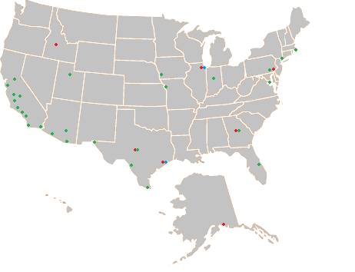
Agreements with Agencies of the
Department of Labour
Agreements between 26 consulates and agencies of the US Department of Labour, OSHA, WHD, and EEOC
● Occupational Safety And Health Administration (OSHA)
● Wage and Hour Division (WHD)
● Equal Employment Opportunity Commission (EEOC)

Slide 9
LEGAL AID
Consulting Attorney Programme
Attorneys appointed by the Government of Mexico to provide initial specialized assistance on various matters, upon request of the Consul.
External Legal Aid Programme (PALE)
The programme is oriented toward strengthening protection actions for Mexicans through hiring attorneys specializing in different aspects of US law.
Assistance was provided to 6,456 cases in 2010 and 2011; 495 (8%) of them were on labour-related issues.

Slide 10
LEGAL ACTIONS
Specialized Technical Legal Programme (PROTEJE)
The programme is a legal tool developed to create jurisprudence and thus, establish precedent in US legislation to enable improving the conditions of migrants in the US through high-impact lawsuits.
Cases assisted by PROTEJE can be addressed simultaneously with other protection programmes.

Slide 11
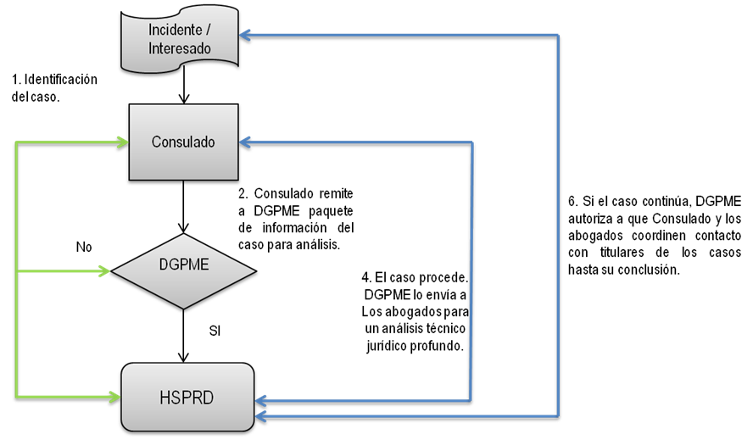
LEGAL ACTIONS
Process of PROTEJE
Incident/
interested person
Identifying
a case
Consulate
6. If the case continues, DGPME authorizes the Consulate and attorneys to coordinate contact with the main person involved in the case until conclusion of the process.
2. The Consulate submits the information package on the case to DGPME for analysis.
4. The case is processed. DGPME submits it to attorneys for an in-depth technical legal analysis.
YES

Slide 12
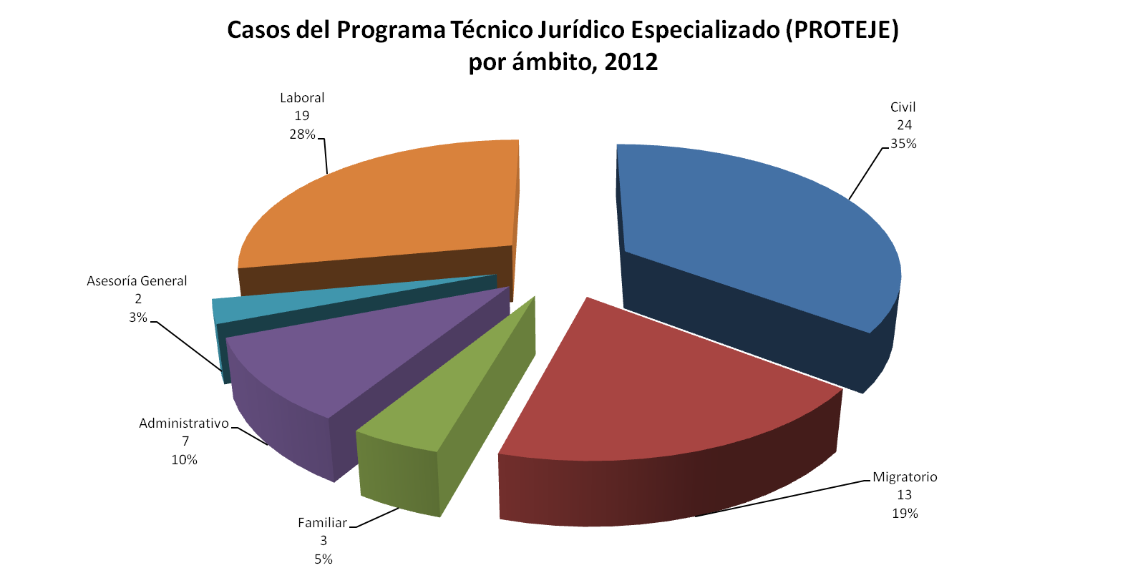
LEGAL ACTIONS
Cases Addressed by the Specialized Technical Legal Programme (PROTEJE)
by Sphere, 2012

Slide 13
LEGAL ACTIONS
Relevant cases – PROTEJE:
Abuse of the labour rights of workers hired under the H2B y H2A visa scheme; non-compensated labour accidents; labour discrimination; abuse and trafficking in persons.
  Peri & Sons, NV, violation of H2A visas
  Fish Farms, GA, violation of H2A visas
  LT Wets Inc, LA, violation of H2B visas and harassment
  Great Lakes Kraut, WI, violation of H2B visas
Designing legal strategies to develop compensatory legislation in key labour sectors.
PROTEJE is supported by a network of organizations protecting labour and civil rights to identify potential related violations.

Slide 14
LEGAL TOOLS FOR THE PROTECTION OF THE LABOUR RIGHTS OF MIGRANTS
IN THE UNITED STATES
THE MEXICO EXPERIENCE
Daniel Aguado Ornelas
Secretariat of Foreign Affairs
Sub-director of Protection Policy
Plaza Juárez #20, Colonia Centro
Ciudad de México, Distrito Federal
CP 06010, Mexico
Tel. 52 (55) 36 86 51 00 Ext. 7539
daguado@sre.gob.mx

