Slide 1
THE SOCIAL MIGRATION FUND
AND THE
NATIONAL INTEGRATION PLAN

Slide 2
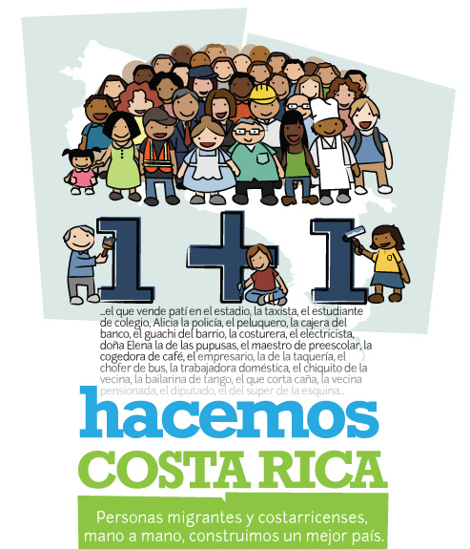
[1 + 1 we build Costa Rica
Migrants and Costa Ricans, hand in hand, build a better country.]

Slide 3
Contents
The National Integration Plan
The Social Migration Fund
Participating institutions
Vision, objectives and principles of the National Integration Plan
Central themes of action of the National Integration Plan

Slide 4
What is the Social Migration Fund?
The Social Migration Fund (FSM, Spanish acronym) is a fund with resources – in accordance with Article 33, Paragraphs 4 & 5 of Act 8764 – obtained through the payment of a fee of $25 by foreign nationals upon regularizing their migration status and also, each time they renew their stay in the country. In addition, non-residents and persons under special categories pay an annual fee of $5.

Slide 5
WHAT IS THE NATIONAL INTEGRATION PLAN?
The National Integration Plan (PNI, Spanish acronym) is the instrument that organizes the physical and financial investment programming of projects submitted to the trust of the Social Migration Fund.

Slide 6
What is the relationship between FSM and PNI?
FSM is managed through a trust. Art. 233, General Migration and Immigration Act No.8764.
Guidelines “Technical rules about the government budget N-1-2012-DC-DFOE2”. Budget managed through a trust, requires an execution plan.
The General Directorate of Migration and Immigration (DGME), the Directorate of Integration and Human Development (DIDH), and participating institutions developed the National Integration Plan.

Slide 7
How will the FSM be invested?
The Social Migration Fund has been established to support the social integration process of migrants into national services of migration, health, education, security and justice.
The Fund shall be used to provide humanitarian assistance for the repatriation of Costa Rican nationals abroad.
Art. 242, General Migration and Immigration Act No. 8764.

Slide 9
How was the National Integration Plan developed?
Basis of the National Integration Plan, Phase 1: The General Directorate of Migration and Immigration, through the Directorate of Integration and Human Development, established the structure, principles and central themes of action of the National Integration Plan.
Presentation of the Social Migration Fund, Phase 2: The Social Migration Fund and the requirements for obtaining funds were presented at a series of meetings with heads of institutions participating in the Fund. Designated representatives developed the projects and initiatives that can be financed through the Social Migration Fund.

Slide 10
How was the National Integration Plan Developed?
Participative Development, Phase 3: From this moment, meetings were held to develop various matrixes with different actors involved in the process, divided into the following sectors: migration, education, security, justice, community participation and health.
Participative Development, Phase 3: From this moment on, meetings were held to develop various matrixes with different actors involved in the process, divided into the following sectors: migration, education, security, justice, community participation and health.
Presentation to Civil Society, Phase 4: Workshops were held for presentation before the Permanent Forum of Migrant Populations and the National Integration Observatory.
Validation, Phase 5: Final validation of the National Integration Plan and ratification by the General Directorate of Migration and Immigration, the Administrative Board of the General Directorate of Migration and Immigration.

Slide 11
Participating Institutions
General Migration and Immigration Act No. 8764
.
EXECUTIVE DECREE Nº 36646-MP-PLAN
.
Political Constitution

Slide 12
Participating Institutions
Education sector:
Ministry of Public Education
University of Costa Rica
National University
Technological University of Costa Rica
Long-Distance State University
National Technical University
National Learning Institute
University College of Limón
San Luis Gonzaga School
University College of Cartago
FAETSUP

Slide 13
Participating Institutions
Health sector:
Ministry of Health
Social Security Institution
Water and Sewerage Institution
Costa Rican Sports Institute
Security:
Ministry of Public Security
Justice:
General Directorate of Social Adaptation
Participation:
National Directorate for Community Development

Slide 14
Vision of the National Integration Plan
“To use the projects financed by the Social Migration Fund as instruments to improve public services and as bridges, based on cultural respect and equitable and equal treatment of foreign nationals, Costa Rican nationals and civil servants, with the aim of promoting the integration of immigrants and refugees into the social dynamics in Costa Rica.”

Slide 15
Objectives of the National Integration Plan
General Objective:
To establish a framework for priority public actions relating to the social integration of immigrants, refugees and national citizens in Costa Rica, guiding the first four-year management period of the Social Migration Fund.
Specific Objectives
To promote the full exercise of rights and duties of immigrants and refugees in Costa Rica in the civl, social, economic, and cultural spheres.
To promote a culture of respect for differences and thus, prevent xenophobia.
To establish a programme for the return of Costa Rican nationals abroad in situations of social vulnerability.
To establish a programme for the return of Costa Rican nationals deprived of their liberty abroad, enabling them to serve their sentence in their country of origin.
To adjust and improve the public services of education, health, migration, justice, community participation and public security through promoting social integration processes among immigrants, refugees and Costa Rican nationals.

Slide 16
Bidirectionality:
Integration is a process that equally involves Costa Rican and foreign nationals. Therefore, it can be stated that integration is a bidirectional process.
Principles of PNI
NATIONAL INTEGRATION PLAN
Shared Responsibility:
Integration is a shared responsibility among each and every individual living in Costa Rica.
Inter-culturality:
This is a dynamic concept that refers to the evolving relations between cultural groups. It has been defined as “the presence and equitable interaction between various cultures and the possibility of generating shared cultural expressions through dialogue and an attitude of mutual respect.”

Slide 17
Central Themes of Action of the National Integration Plan

Slide 18

Migration and Integration:
1. Immigration services and integration;
2. Communication and integration;
3. Knowledge and integration;
4. Integrating boys, girls and adolescents.
Actions:
Digitalization of records;
Campaigns to combat xenophobia;
Preparing the Annual Migration and Integration Report;
An education and awareness-raising programme to integrate immigrant and refugee boys, girls and adolescents into educational institutions.

Slide 19
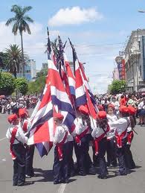
Education and Integration:
1 Training and college education services;
2 Equipment;
3 Infrastructure.
Actions:
1 Strengthening the College Education Programme in matters relating to migration (UCR-CUNLIMON-TEC);
2Providing equipment and remodelling training centres in the communities of Sarapiquí, Talamanca and Alajuelita;
3 Building a library in San Luis Gonzaga School.

Slide 20
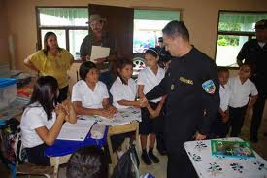
Public Security and Integration:
Preventing violence and crime in areas with significant numbers of immigrants.
Actions
Prevention actions jointly implemented by local police forces in border and vulnerable regions.

Slide 21

Justice and Integration:
Reducing the vulnerable situations of immigrant populations in the programmes of the National Penitentiary System;
Repatriation of imprisoned Costa Rican nationals serving sentences in other countries.
Actions
Designing and executing a training programme to improve assistance by officers from the General Directorate of Social Adaptation to foreign nationals deprived of their liberty;
Purchasing air tickets for persons deprived of their liberty and relevant officers and providing per diem to officers that participate in the repatriation of national citizens that have been sentenced abroad and that have complied with the requirements.

Slide 22
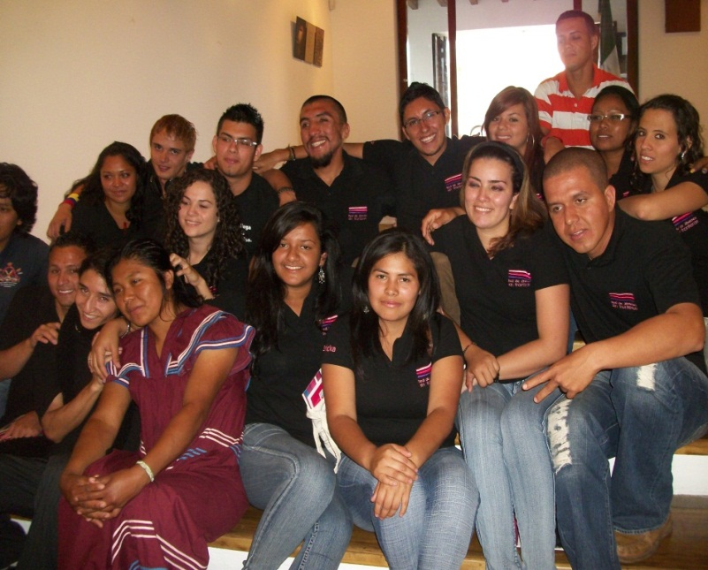
Participation and Integration:
Establishing procedures for registration and participation in community development associations;
Developing a communication plan to disseminate the registration and participation procedures;
Awareness-raising and training.
Actions
Conducting an assessment of the registration and participation process of immigrant and refugee populations in associations;
A mass media campaign on the registration and participation procedures.

Slide 23

Public Health and Integration:
Building infrastructure and improving the equipment of health offices in Peñas Blancas, Sabalito, Los Chiles, Upala, Paso Canoas, Sixaola, Puerto Alemán (Caribe), Puerto Caldera, Juan Santamaría International Airport and Daniel Oduber International Airport, within the framework of international health regulations.

Slide 24
Thank you

