Slide 1
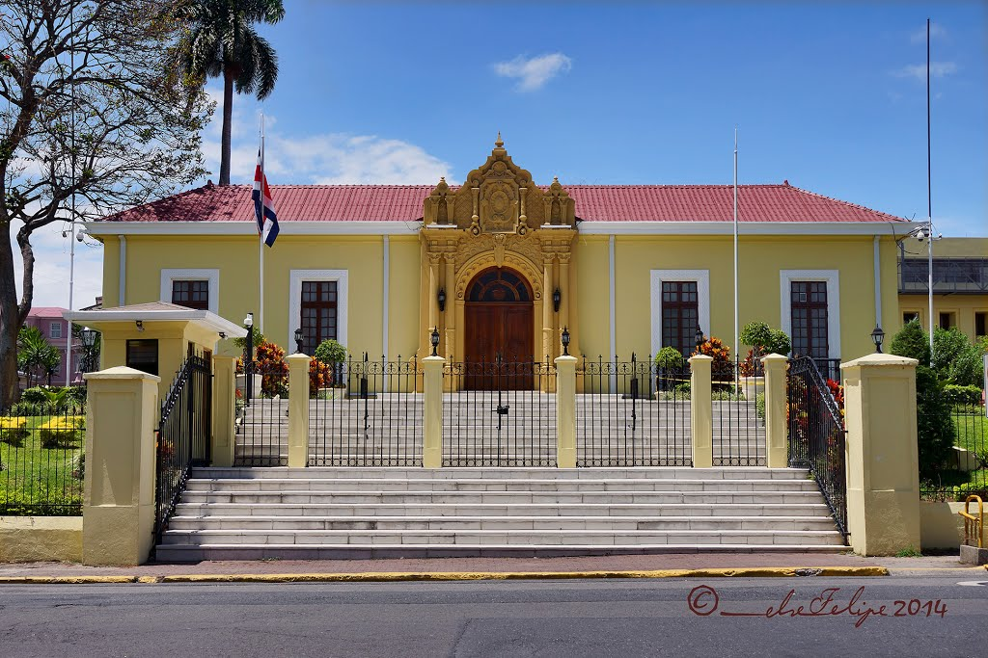
MINISTRY OF FOREIGN AFFAIRS AND CULT OF COSTA RICA

Slide 2
Efforts of the Consular Department
Action Protocol for Consuls on Repatriation of Costa Ricans Abroad
Management System of the Foreign Service Office

Slide 3
Management System of the Foreign Service Office –
Conceptual Level
What is it?
A software application developed with the aim of supporting the management of consular procedures, registration of persons and follow-up and administration of the information generated by consulates of Costa Rica abroad.

Slide 4
Management System of the Foreign Service Office –
Administrative Perspective
Consulates, Foreign Service Office:
1. Reviewing applications daily;
2. Processing, follow-up (change of status), monitoring;
3. Registration;
4. Appointments;
5. Reports.

Slide 5
Management System of the Foreign Service Office –
User’s Perspective
Users (on the Internet):
1. Registration and self-creation of personal records;
2. Registration of persons;
3. Consular applications;
4. Requesting appointments.

Slide 6
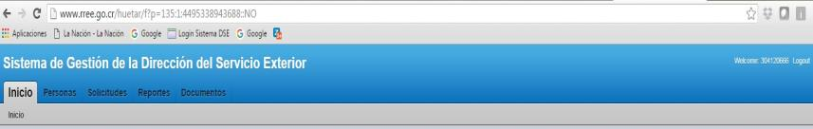
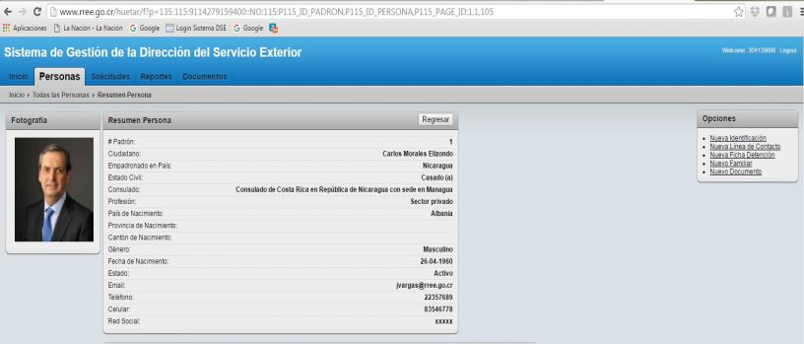

Slide 7
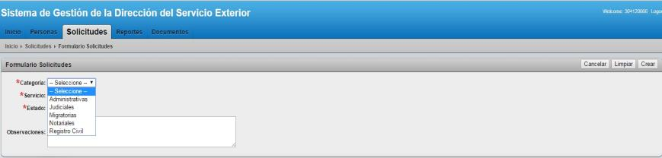
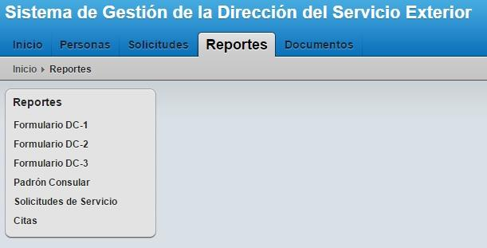

Slide 8
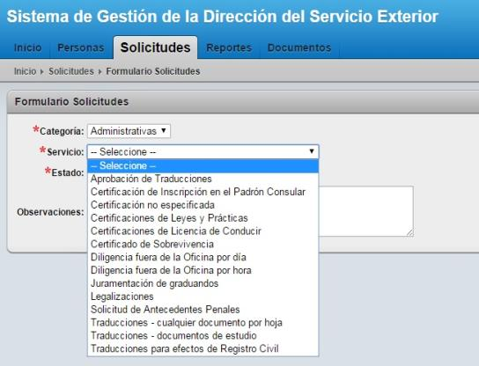
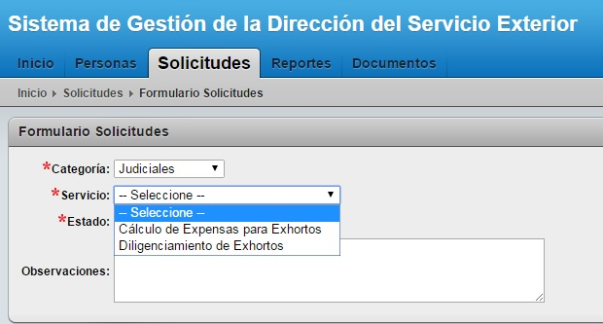

Slide 9
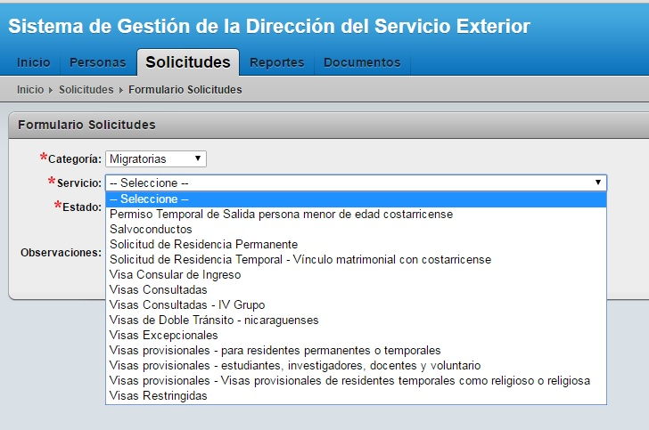

Slide 10
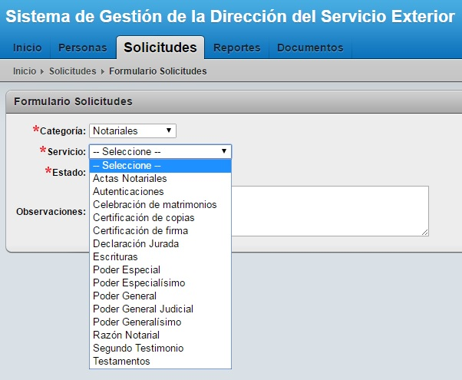

Slide 11
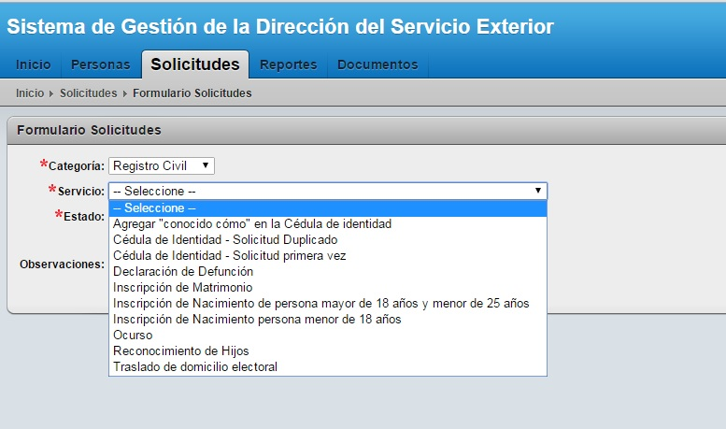

Slide 12
Action Protocol for Consuls on Repatriation of Costa Ricans Abroad
General Migration and Immigration Law, Article 13, Paragraph 34): To repatriate Costa Ricans who are abroad when it is required for humanitarian reasons. In addition, to repatriate Costa Ricans declared dead abroad, provided that the families are unable to cover the costs of transport of the mortal remains due to extreme circumstances of need. In both cases, this should be based on a founded resolution.

Slide 13
Characteristics
A Trust Fund with the Bank of Costa Rica;
Financed through the Social Fund for Migration ($30 renewal or first time for residence);
The Comprehensive Migration Policy of Costa Rica establishes among its objectives “to expedite the processing of requests by Costa Ricans at the consular offices, simplifying procedures and improving inter-institutional coordination”;
And, consequently, “to develop manuals and protocols in accessible formats to facilitate the voluntary return of Costa Ricans to the country; [the manuals and protocols] should include information on: moving, recognition of studies, employment, health insurance, payment of taxes, repatriation, and repatriation of deceased persons.”
General Office of Migration and Immigration and Ministry of Foreign Affairs and Cult (DGME-MREC), with collaboration from IOM;
Based on profiles.

Slide 14
